Slide 1
APCTP workshop on
“Exotics and Exotic phenomena in Heavy Ion Collision ExHIC III”
Period: 2022-10-03 ~ 2022-10-8 (flexible)
Location: Pohang APCTP Headquarter or Online
Organizer: 이수형(연세대),
Akira Ohnishi (YITP, Kyoto)
Xu-Guang Huang (Fudan Univ.)
조성태 (강원대)
1

Slide 2
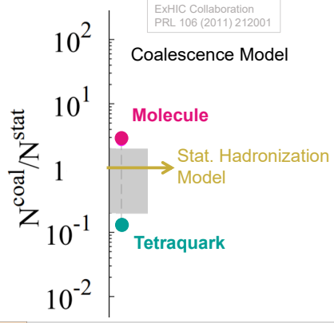
Origin of Exotics from Heavy Ion Collision (ExHIC): Theory Collaboration
2007.12-3 -12-14: APCTP Focus program on Hadron Physics at RHIC
2010.5.17-30: Yukawa Institute (YITP) workshop on ExHIC
2019.3-25 -4.5: YITP workshop on “Hadron Interactions and Polarization from High energy Collisions”
Outcome:
Charmed exotics in heavy ion collision: EPJC (2008)
ExHIC: PRL(2011), PRC(2011), PPNP(2017)
all >100 citations
ExHIC-p: PRD (2020)
Measure Exotics in Heavy Ion Collision
ex: can discriminate structure of X(3872), Tcc
ExHIC PRL (2011)

Slide 3
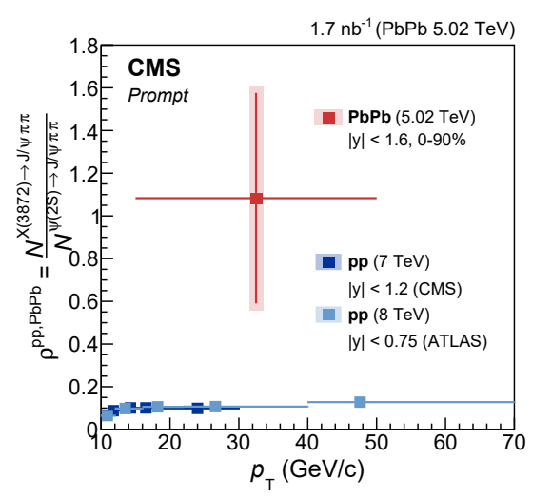
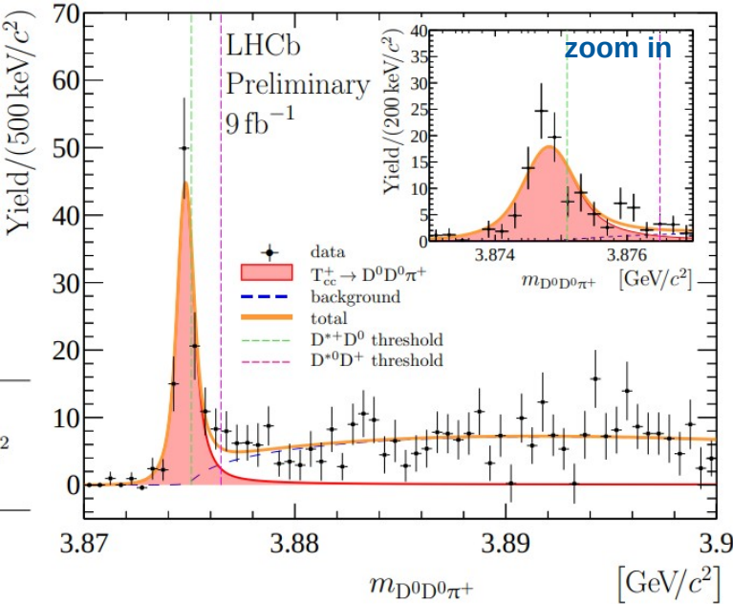
ExHIC to Experiment
Method used
2102.13048
First Exotics is measured in Heavy ion collision
→ shows anomalous production rate
Tcc was indeed measured in 2021

Slide 4
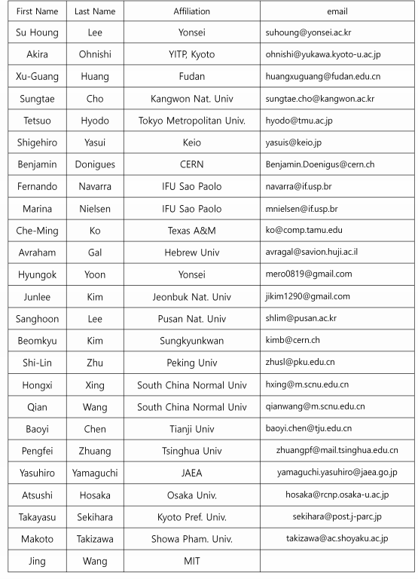
Purpose of this ExHIC workshop
Bring original members + new input from experiment and theory
- Discuss recent experiment and point to new directions

