Slide 1



The Shape of Complexity: Geometry, Topology, and Statistics in Complex Systems
Lecture 2: Stretching fractal polymer near a disc reveals Kardar-Parisi-Zhang-like statistics
Sergei Nechaev
LPTMS, CNRS & Universite Paris Saclay, France
APCTP Lecture Series – Pohang, 2026

Slide 2
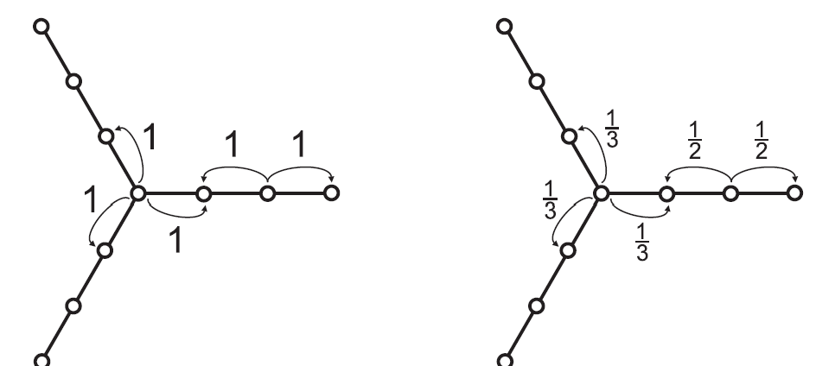
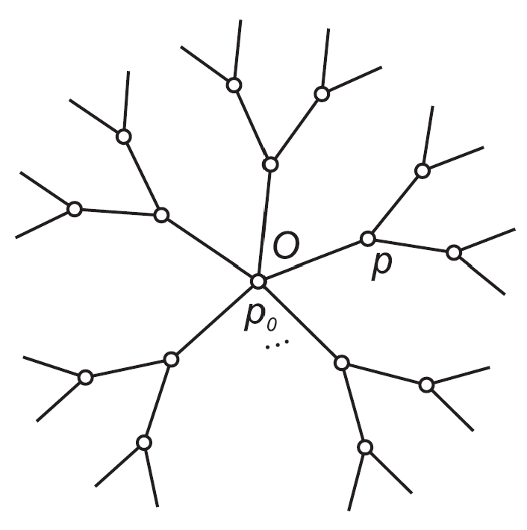
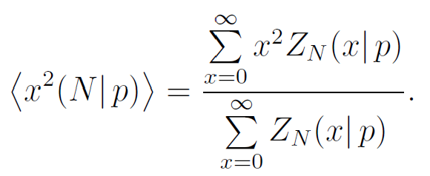
Back to Lecture 1:
Comment concerning the difference between random walks and paths counting in non-homogeneous spaces
entropic trap
no entropic trap
localization
no localization
The behavior of paths depends on what Z_{N} (x | p) is:
counting partition function (non-normalized)
probability distribution (normalized)

Slide 3
Fluctuations of elongated 2D polymer above an impermeable disc
Biased tracer diffusion in channel through a curved bottleneck

Slide 4
1. Fluctuations of elongated 2D polymer above an impermeable disc

Slide 5
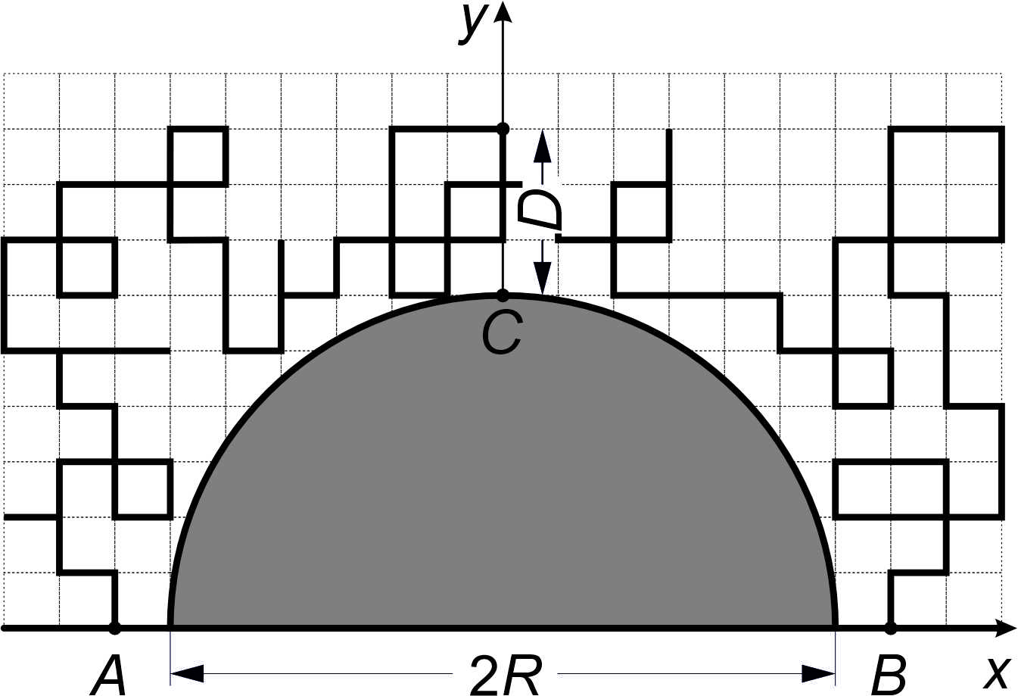
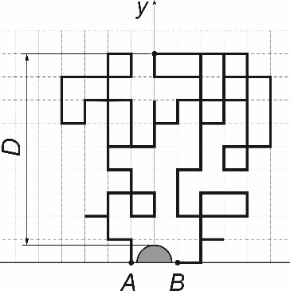
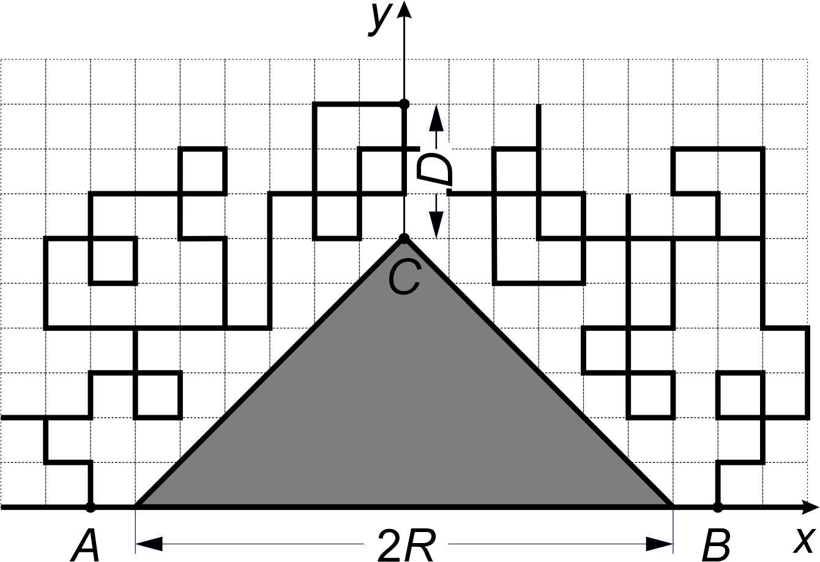
2D Random paths above voids of various shapes
typical RW scaling
under stretching conditions
under stretching conditions

Slide 6
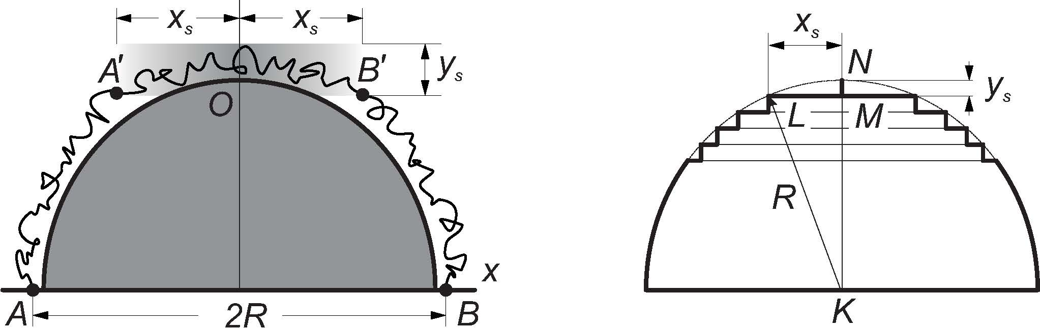
Stretched (N = c/a R) paths above the semicircle:
scaling approach “a la de Gennes”
Linearizing curved shape, we get:
Above the flat line one has a random walk
thus , and finally,
Stretching above algebraic curve provides scaling
with
SN, K.Polovnikov, S. Shlosman, A.Valov, A. Vladimirov (2019); N. Smith, B. Meerson (2019)

Slide 7
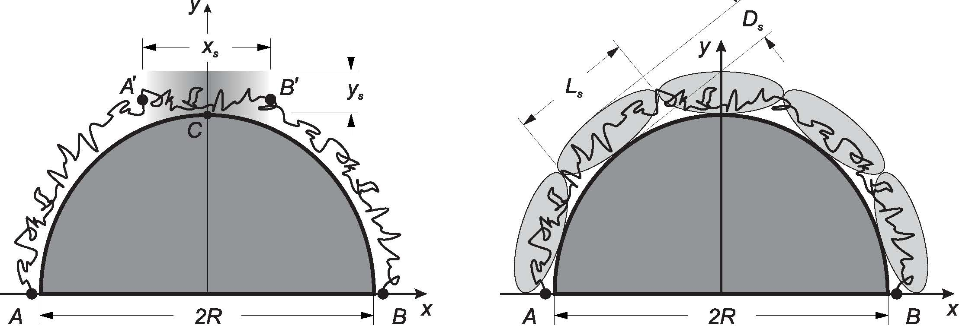
Free energy of a paths stretched above the disc (N = c/a R)
Blob’s width , blob’s length
Free energy of a chain stretched above a [semi]circle
Gibbs measure

Slide 8
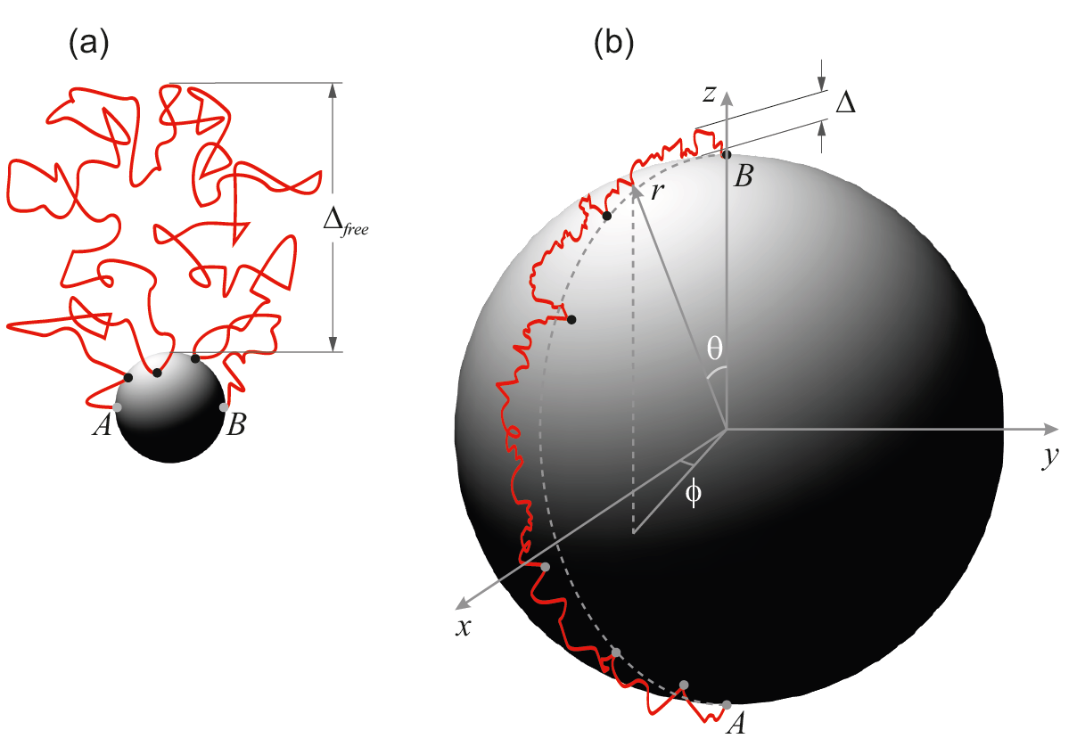
Path’s stretching above an impermeable sphere/disc

Slide 9
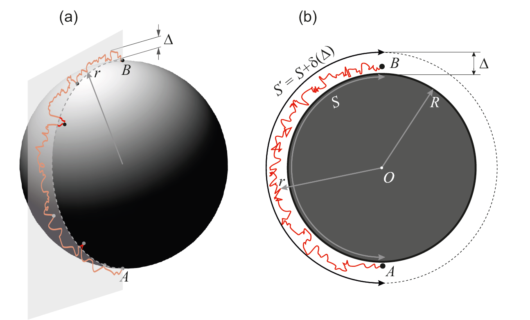
Path’s stretching above an impermeable sphere/disc

Slide 10
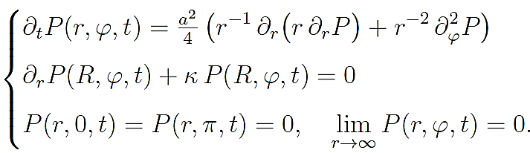
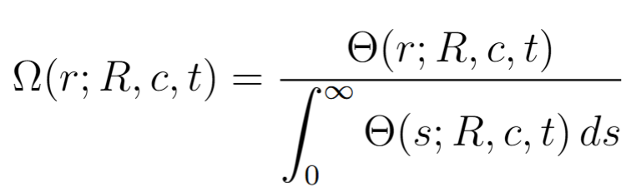

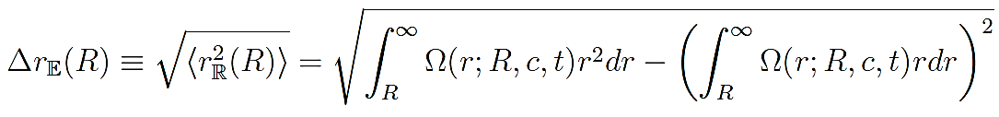
Stretched diffusion evading the disc
Cauchy problem for diffusion in polar coordinates, subject to a mixed boundary condition at r = R:
The initial condition fixes the starting point of the diffusion (r₀, φ₀):
The probability of finding a path at the point (r, π/2) is:
The average span of the random walk above the disc of radius R

Slide 11
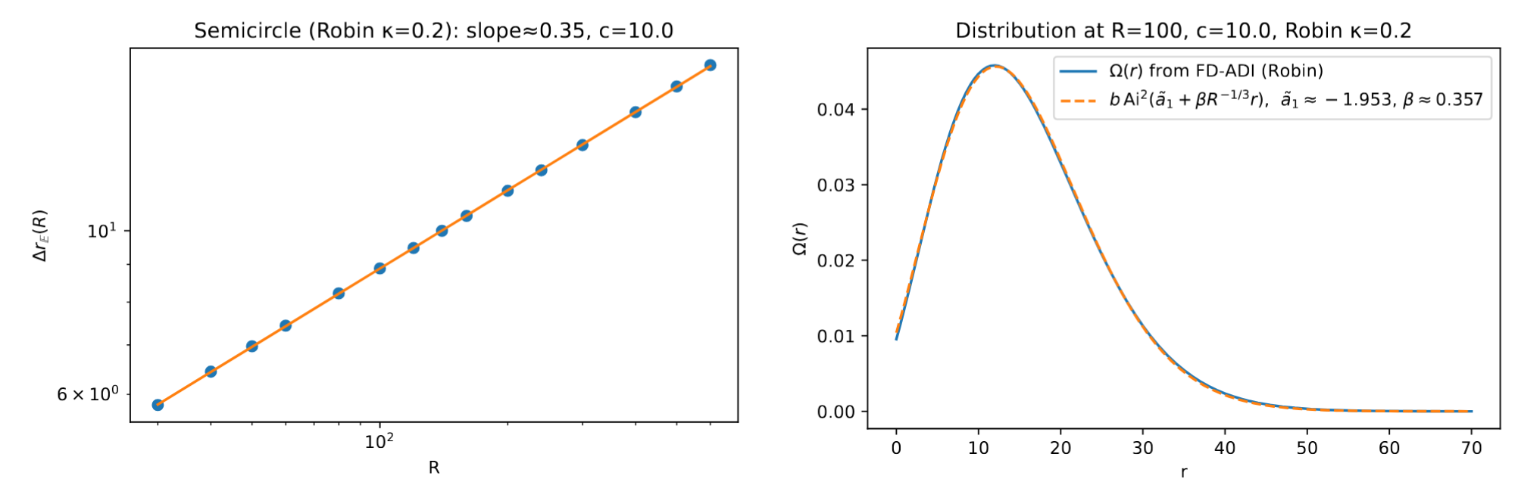
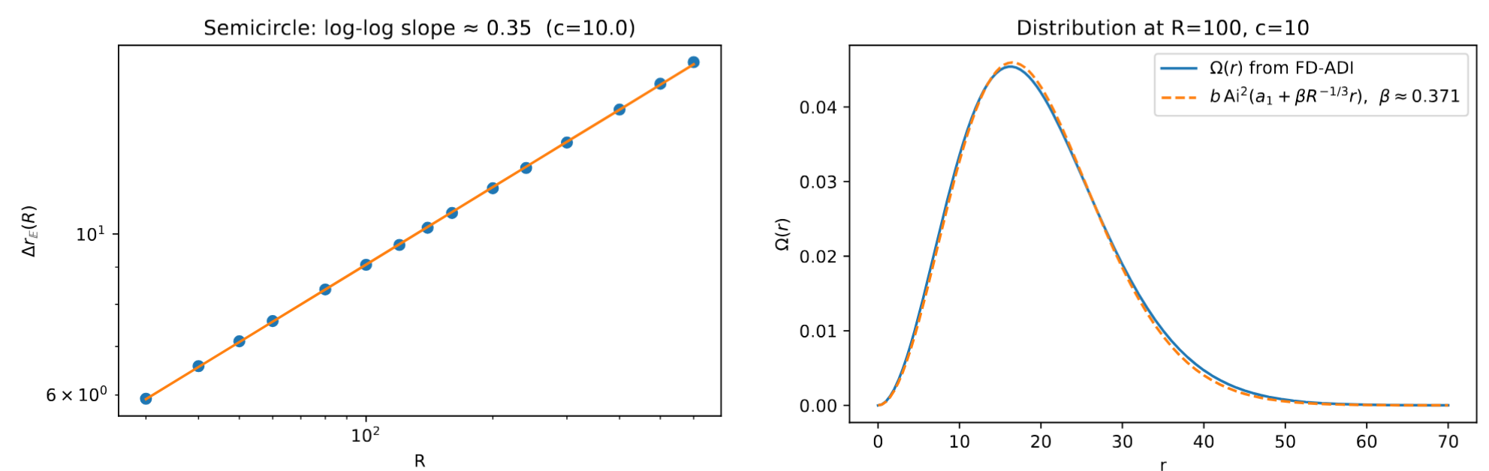
Fluctuations of stretched random walk above the impenetrable disc: Results
Mixed boundary conditions
Dirichlet boundary conditions

Slide 12
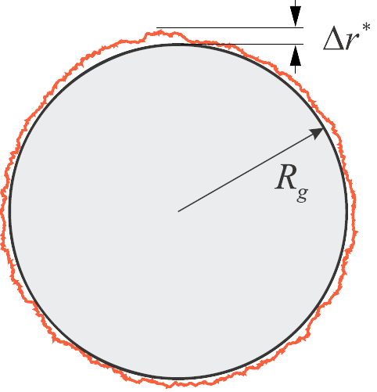
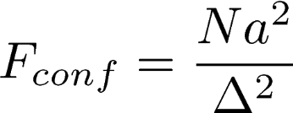
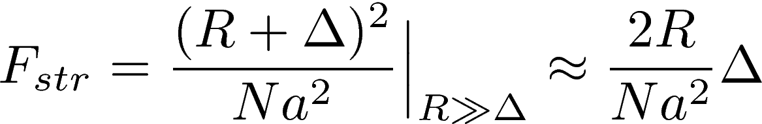
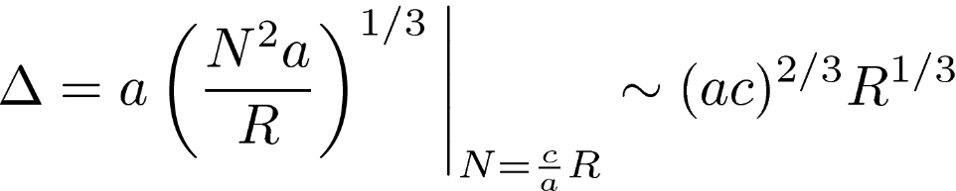
Path’s stretching above an impermeable disc (mean field approach)
“Optimal fluctuation” approach
Free energy of confinement in a tube of width Δ
Free energy of stretching in a tube of width Δ
Minimizing F = F_{conf} + F_{str} for stretched paths, N = c/a R, we get:

Slide 13
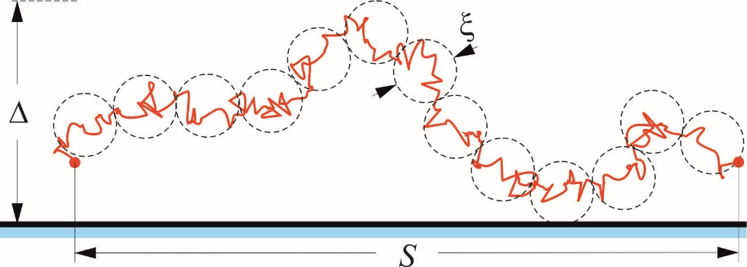
Reminder:
Stretching of a fractal polymer above a flat surface
“Pincus blob” of g monomers
stretching
M – number of monomers in a chain, b – monomer size; g – number of monomers in a blob; ξ = bg^{ν} – size of a blob; ν – scaling exponent
Since , for free energy of a stretched chain one has
For ideal chain ν = ½ and the free energy reads

Slide 14
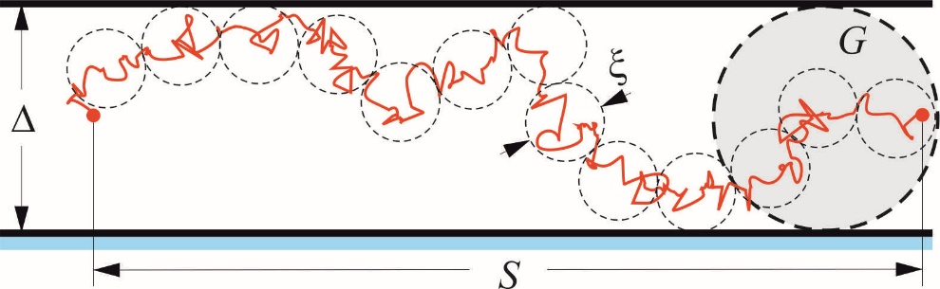
Reminder:
Stretching of a fractal polymer in a flat tube
confinement
M – number of monomers in a chain, b – monomer size; g – number of monomers in a blob; ξ = bg^{ν} – size of a small blob; ν – scaling exponent
G – number of composite ξ-monomers in a big gray blob
Scaling relations:
Free energy of a chain in a tube:
For ν = ½ one has:

Slide 15
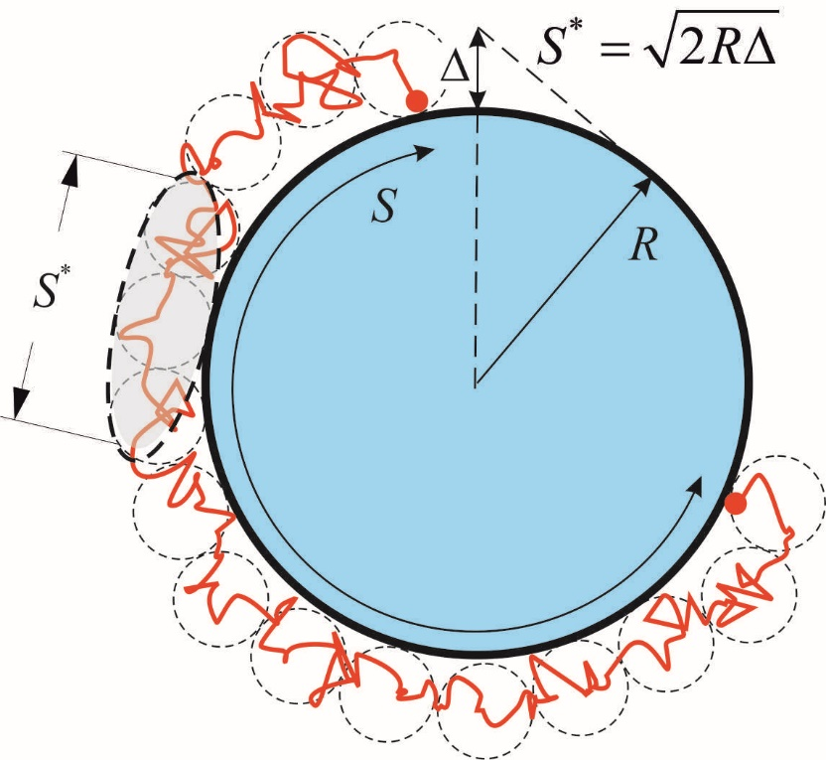
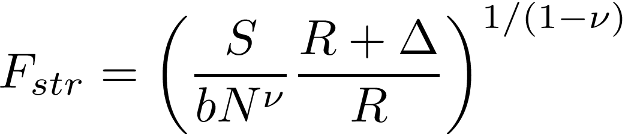
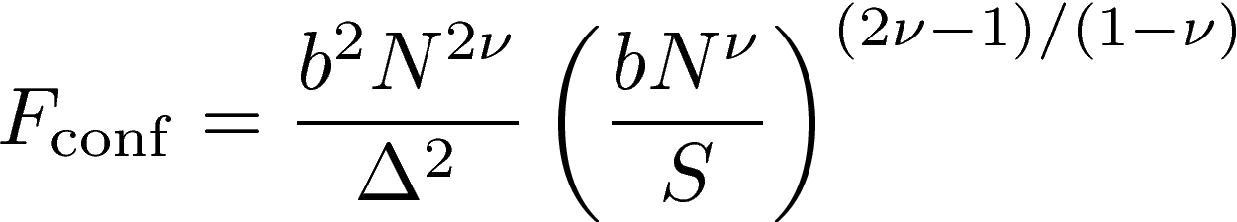
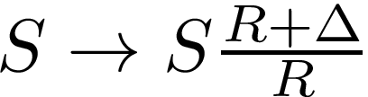
Stretching of a fractal polymer above an impermeable disc
(optimal fluctuation)
Free energy above a disc consists of two parts: stretching:
and confinement:
We are using former equations subject to
replacements:
Minimizing the free energy with respect to Δ
we find the equilibrium span Δ at Δ << R:

Slide 16

Dependence of normalized fluctuations above the disc, , on
normalized chain stretching, ( )
negative Poisson ratio
On scale S* the boundary is effectively flat. For ultimate chain stretching
. we get the “KPZ-like” scaling for any ν:
(span of fluctuations) and (length of elliptic blob)

Slide 17
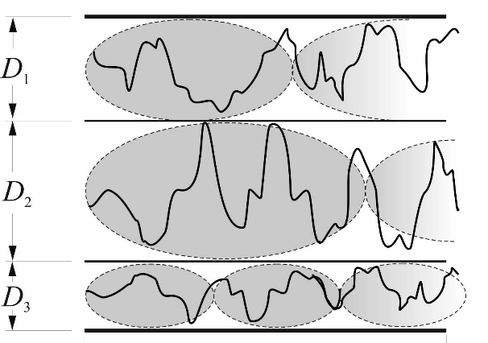
Optimal fluctuation for ultimately stretched paths above a disc
For ultimate chain stretching we get the “KPZ-like” scaling:
Forget about a disc and consider “optimal fluctuation” for Balagurov-Vaks (Donsker-Varadhan) random walk trapping in 1D array of Poissonian traps
Estimate survival probability in an ensemble of random intervals D with the distribution Q(D) ~ p^{D}
Free energy to be minimized over D:
where and
Minimization gives and survival probability (Balagurov, Vaks, 1974) is
Lifshitz tail of 1D Anderson localization

Slide 18
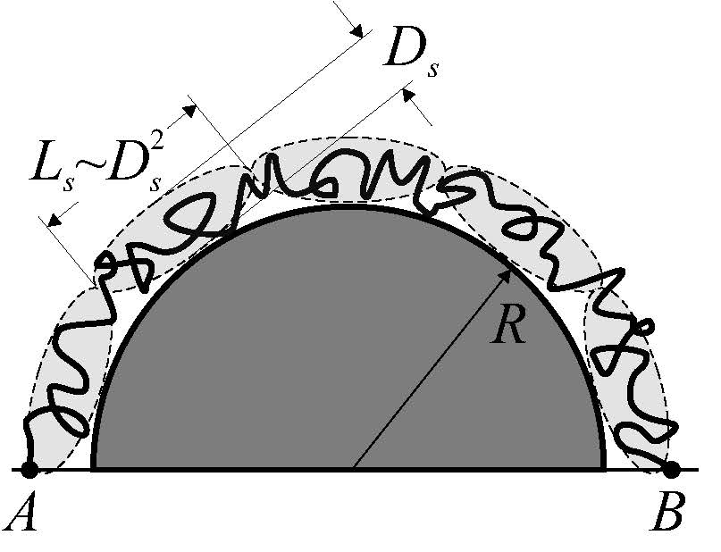
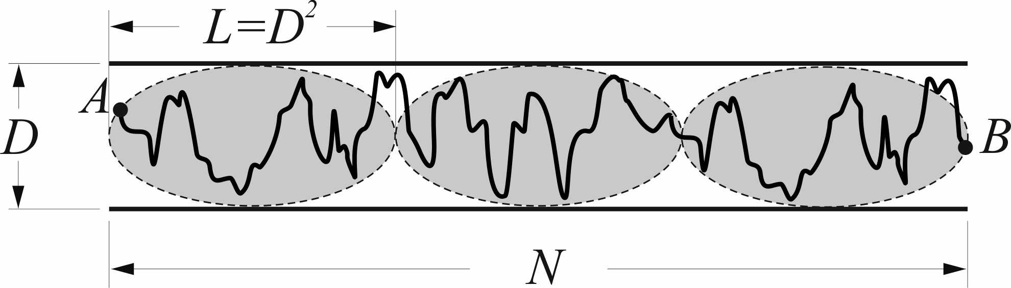
Comparison of disorder-free stretched KPZ exponent above convex boundary and Lifshitz tail in a Poissonian field
Gibbs measure of stretched
path in curved channel
Survival probability in 1D
trapping in a Poissonian field
Free energy has to be minimized over D
In Poissonian disorder one gets
The survival probability is
Tube width at R~cN is
We “mimic” disorder by a path
stretching above a semicircle

Slide 19


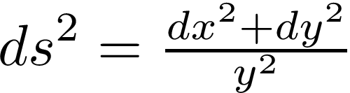
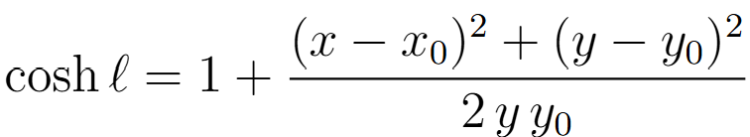
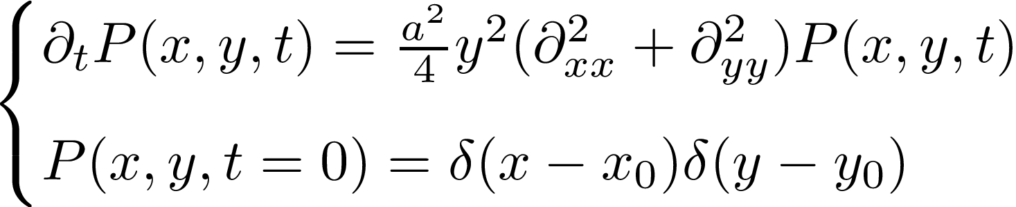
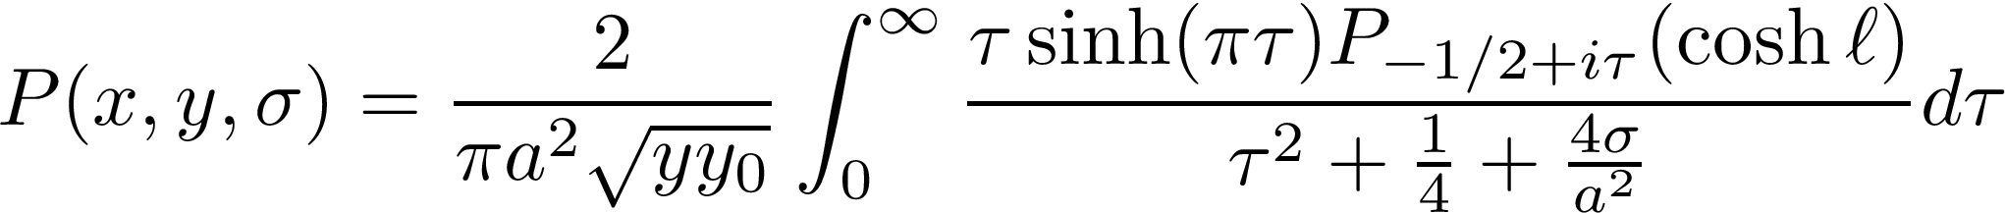
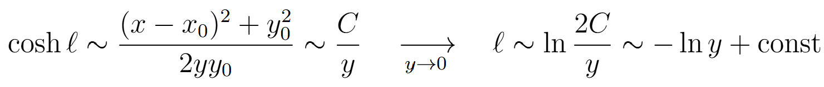
Reminder about diffusion in 2D Poincare halfplane
The surface has the constant negative curvature and the metric element . The hyperbolic distance (the geodesic length), ℓ, in between points (x, y) and (x₀, y₀) is defined as
The solution to the Cauchy problem for the diffusion equation in
after Laplace transform t ↔ σ can be expressed in terms of Legendre polynomials of the first kind

Slide 20
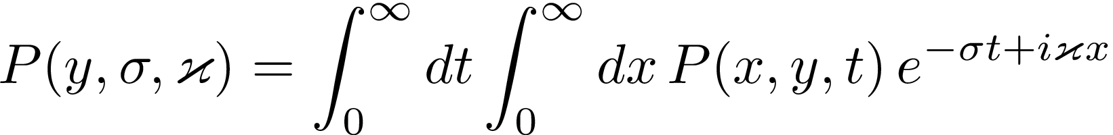

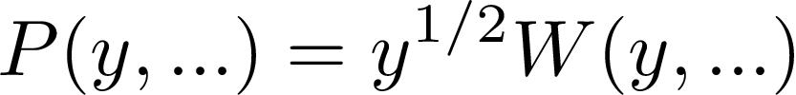
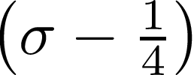



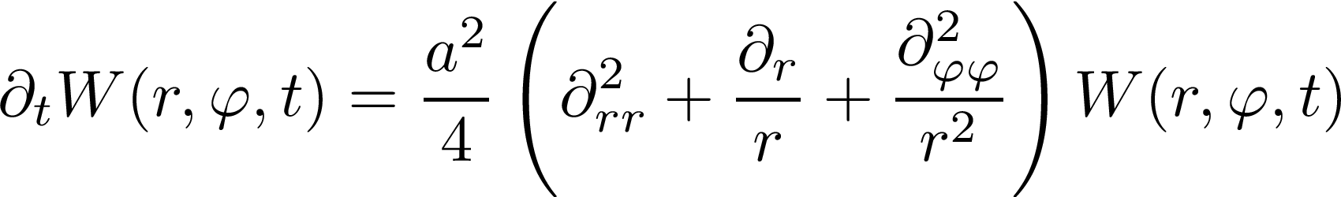
Connection with spectral problem in polar coordinates
Applying Laplace-Fourier transform
to the diffusion equation in ,
we get spectral problem in the Poincare upper halfplane
Now, making use of the substitution , we arrive at the Laplace equation in polar coordinates with the “radius” y
where now the chemical potentials are exchanged: controls the angle variable , and controls the “time” t. Compare to the equation in polar coordinates, where :

Slide 21

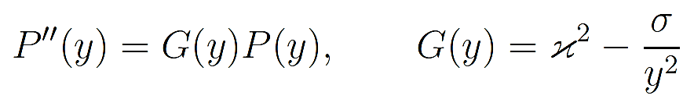



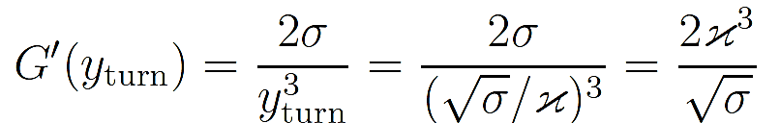

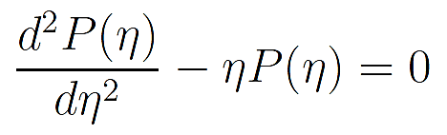

WKB-type approach in the Poincare upper halfplane
Laplace-Fourier-transformed diffusion equation (where ) in Poincare halfplane reads:
It can be rewritten as:
The turning point is defined by giving . In the vicinity of the turning point, one has the expansion:
where
For rescaled coordinate we arrive at the Airy equation

Slide 22

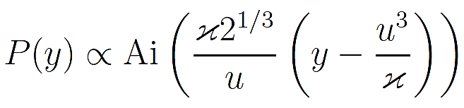





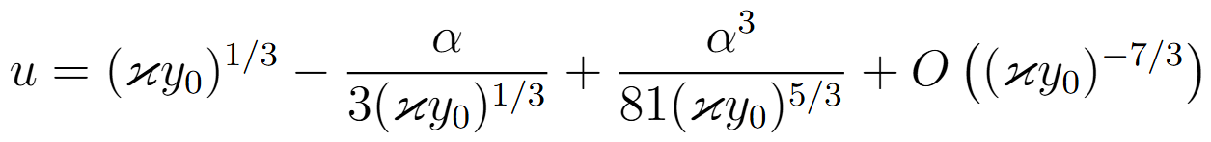
For the Dirichlet condition the solution near the turning point is
where .
The value of u is defined by the cubic equation ,
where and is the first zero of Airy Ai function.
In the asymptotic regime one has

Slide 23
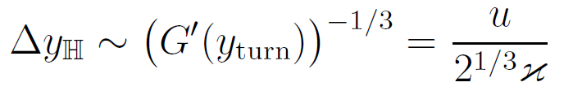





The fluctuations within the WKB-type approach share the KPZ-type scaling:
Compare the WKB-type solution of diffusion in with the former numerical solution of stretched diffusion above the impenetrable disc given by the Airy distribution in
Solutions are equivalent up to a redefinition implying that stretching of diffusive paths above convex void in is equivalent to WKB approximation for diffusion in near a solid boundary, where plays the role of the inverse elongation parameter.
Dirichlet boundary conditions

Slide 24
2. Biased tracer diffusion in channel through a curved bottleneck

Slide 25
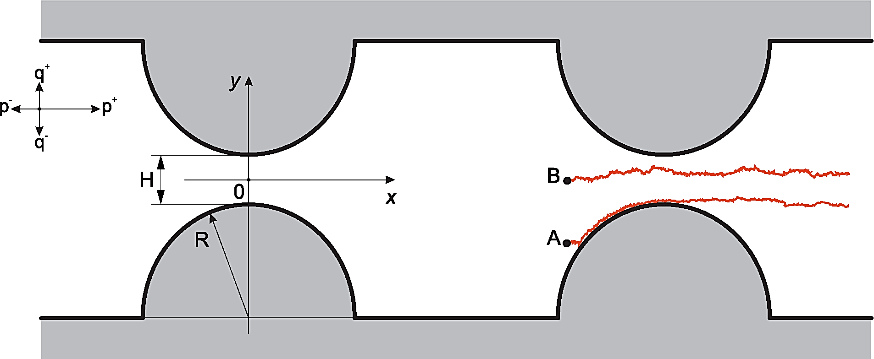
Diffusion with a drift in non-uniform channels

Slide 26
Diffusion with a drift in non-uniform channels

Slide 27
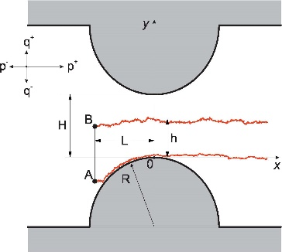
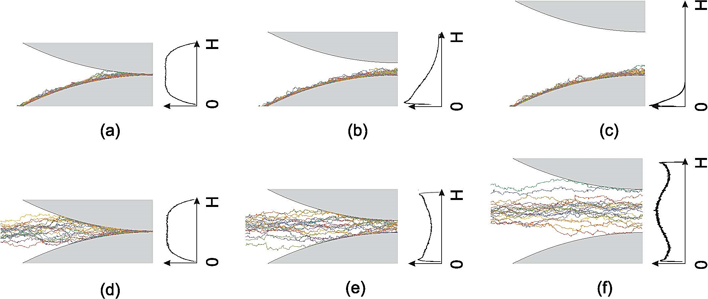
Typical trajectories of a tracer particle starting away from a funnel and passing through it.

Slide 28
Probability density of paths in a section of a channel

Slide 29
“KPZ-like” fluctuations:
Gaussian fluctuations:

Slide 30
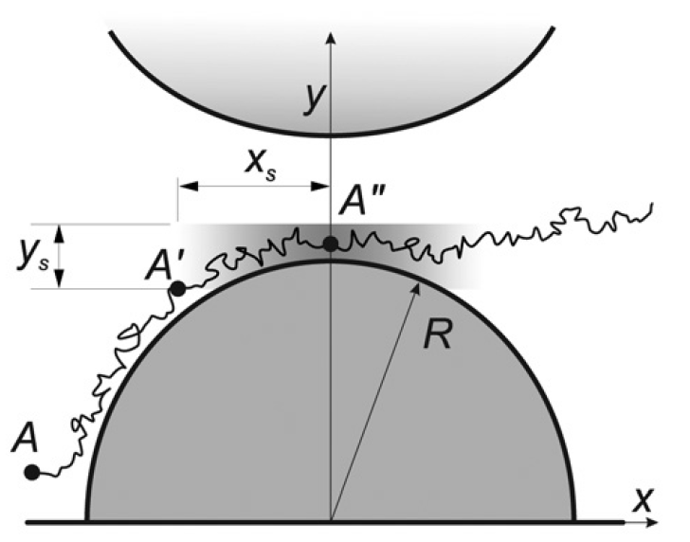
Geometry-induced attraction of tracers
Correlation coefficient of two different trajectories
geometry-induced focusing

Slide 31
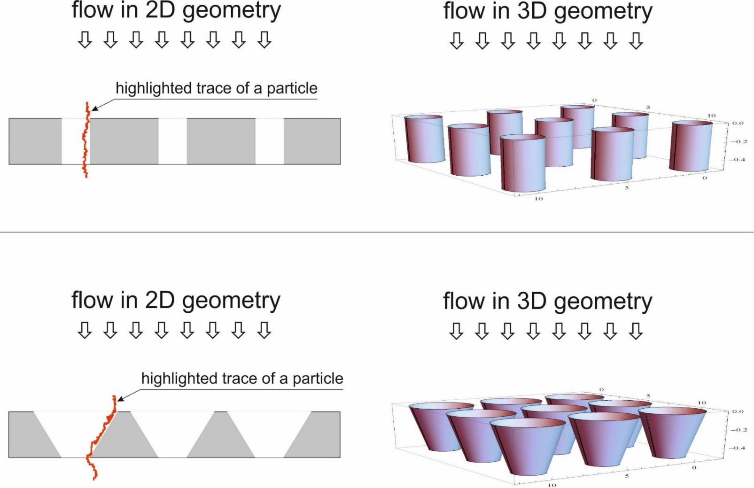
Possible applications in physics of fluid flows
almost uniform spot
spot with a nonuniform density

Slide 32
Literature
On fluctuations of stretched random walk above convex voids:
S. Nechaev, K. Polovnikov, S. Shlosman, A. Valov, and A. Vladimirov, Anomalous 1D fluctuations of a simple 2D random walk in a large deviation regime, Phys. Rev. E, 99 (2019), 012110
K. Polovnikov, S. Nechaev, A. Grosberg, Stretching of a Fractal Polymer around a Disc Reveals Kardar-Parisi-Zhang Scaling, Phys. Rev. Lett. 129, 097801 (2022)
Fedotov, S. Nechaev, Three faces of random walks in hyperbolic domain: BKT, Lifshitz tails, and KPZ, https://arxiv.org/abs/2511.18510
On fluctuations of tracers in a laminar flow in corrugated channels:
A. Valov, V. Avetisov, S. Nechaev, G. Oshanin, Field-driven tracer diffusion through curved bottlenecks: Fine structure of first passage events, Phys. Chem. Chem. Phys., 22 (2020), 18414

