Slide 1


Odd-Even Staggering and Kinks of Hg and Pb Isotopes
Myeong-Hwan Mun, Seonghyun Kim, Eunja Ha
Myung-Ki Cheoun
(Soongsil University, OMEG Institute & Dept. of Physics, Seoul, Korea)
https://omeg.ssu.ac.kr/
14th APCTP-BLTP JINR Joint Workshop - Memorial Workshop in Honor of Prof. Yongseok Oh
(Modern problems in nuclear and elementary particle physics)
From July 9 to July 14, 2023, POSCO International Center, APCTP, Pohang, Korea

Slide 2
Contents
1. Experimental evidences of OES and Kink structures
1-1. Odd-Even Staggering (OES)
1-2. Kink
2. Deformed Relativistic Hartree Bogoliubov in Continuum
(DRHBc) mass model
3. OES and Kink of Hg by DRHBc mass model
3-1. OME of Hg
3-2. Kink of Hg and Pb
4. Summary

Slide 3
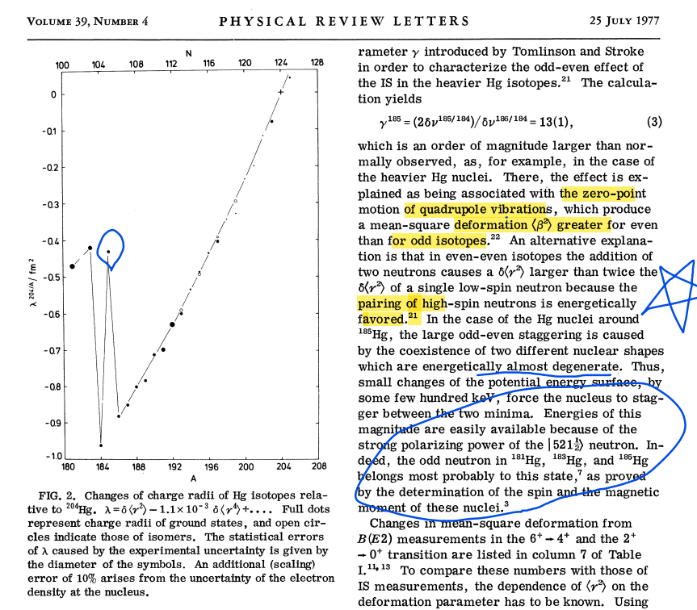

Slide 4
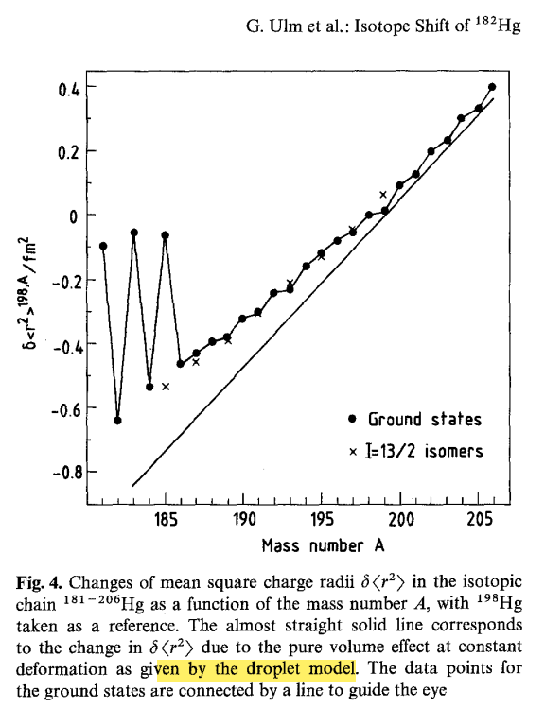
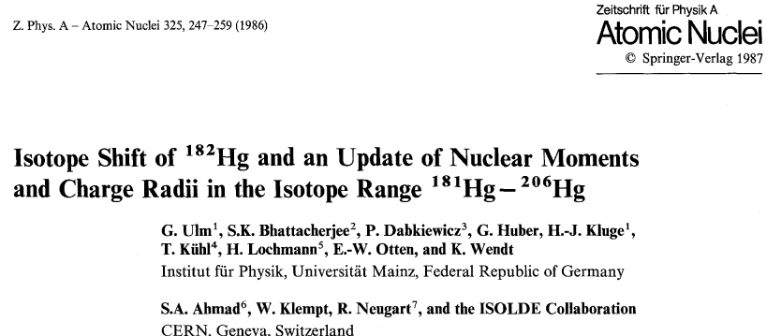


Slide 5
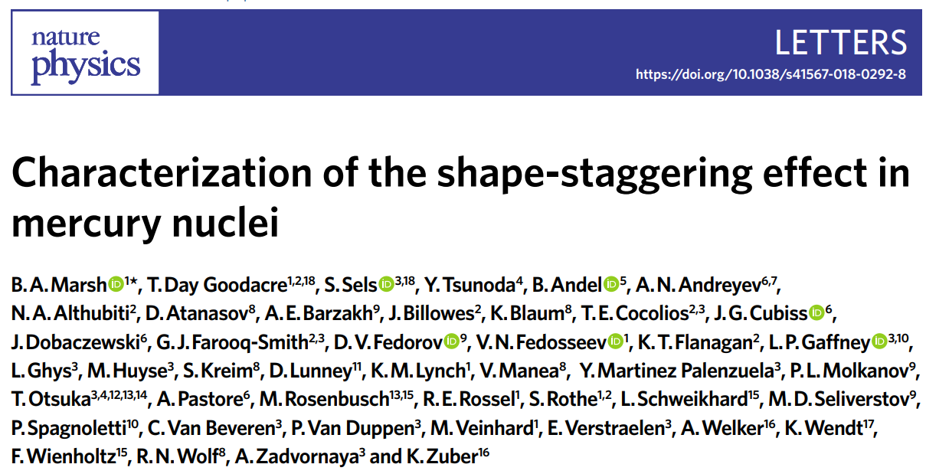

Slide 6
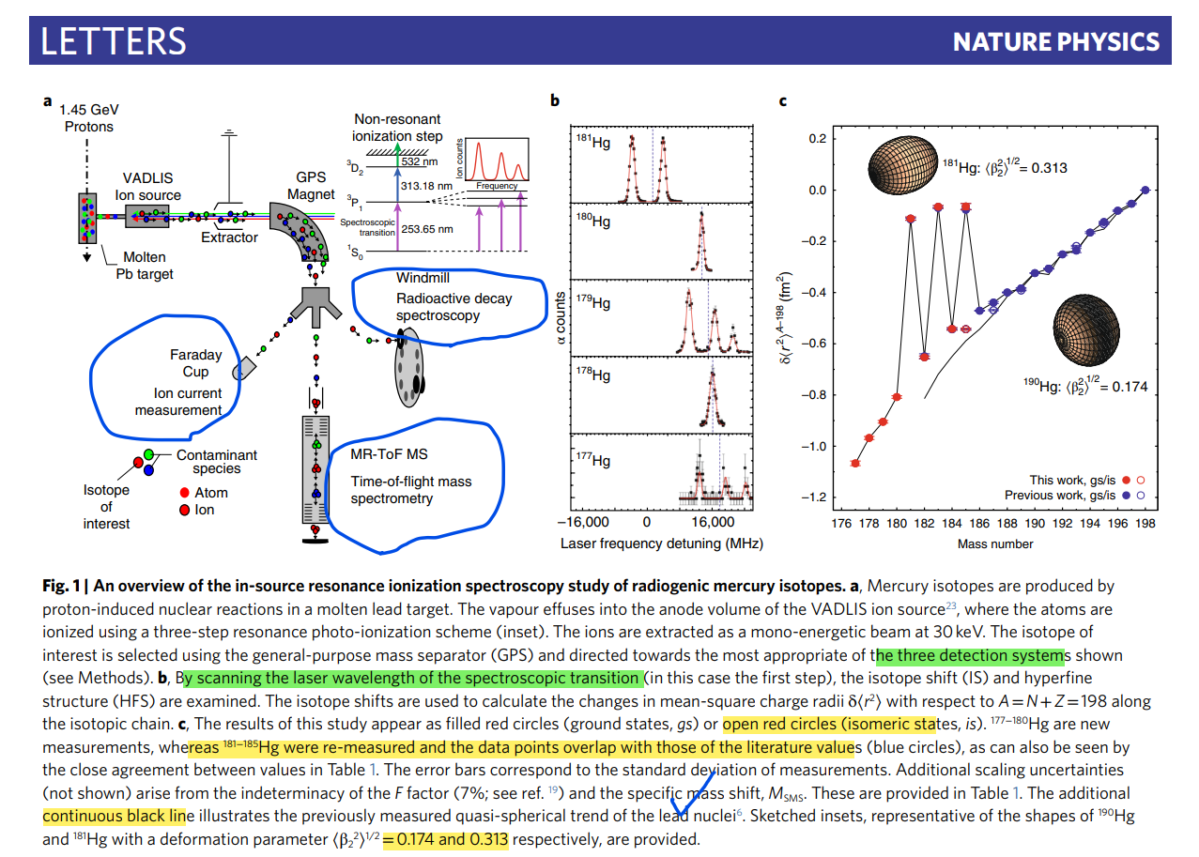




Slide 7
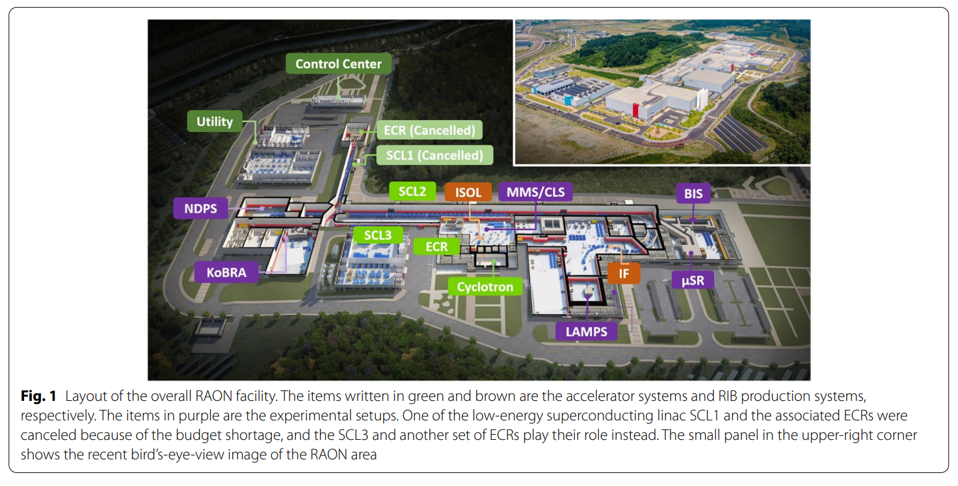
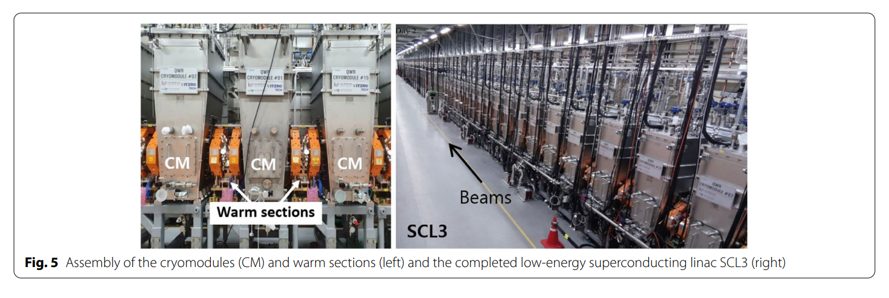
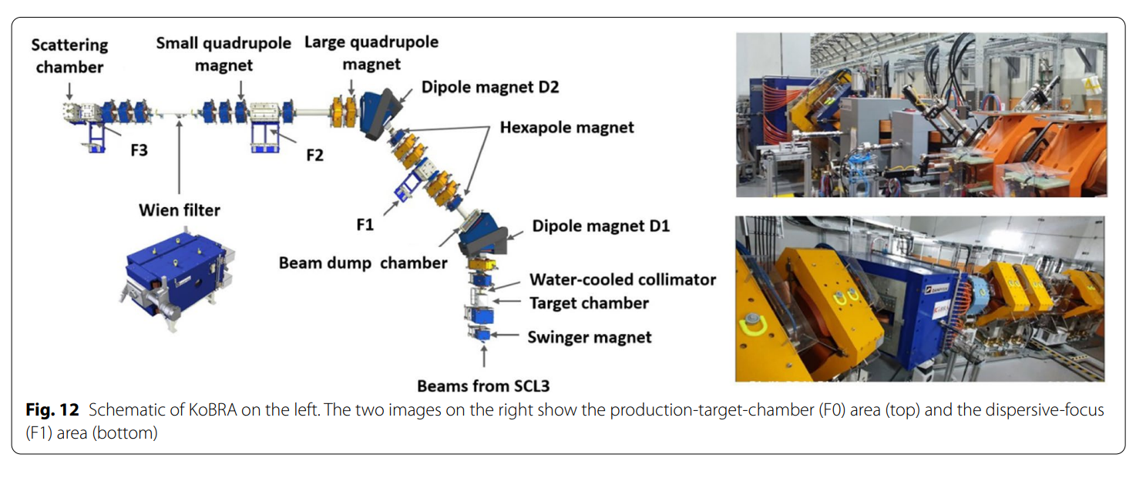

Slide 8
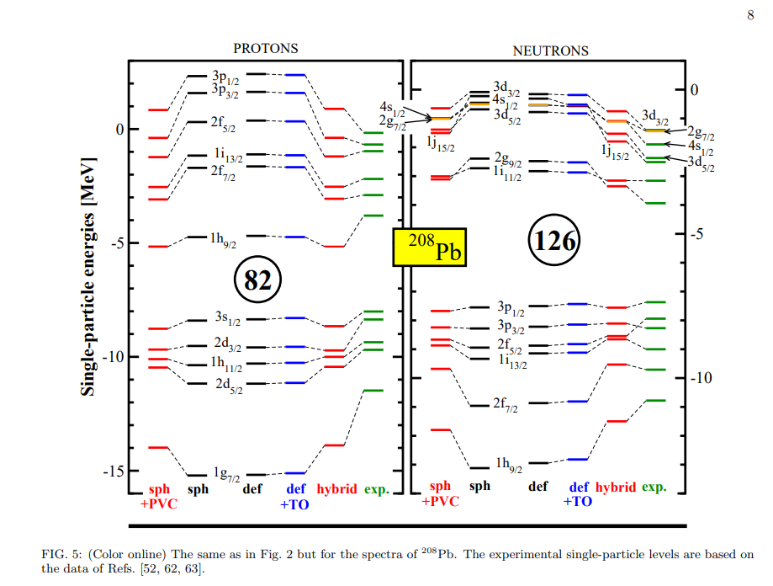

Slide 9
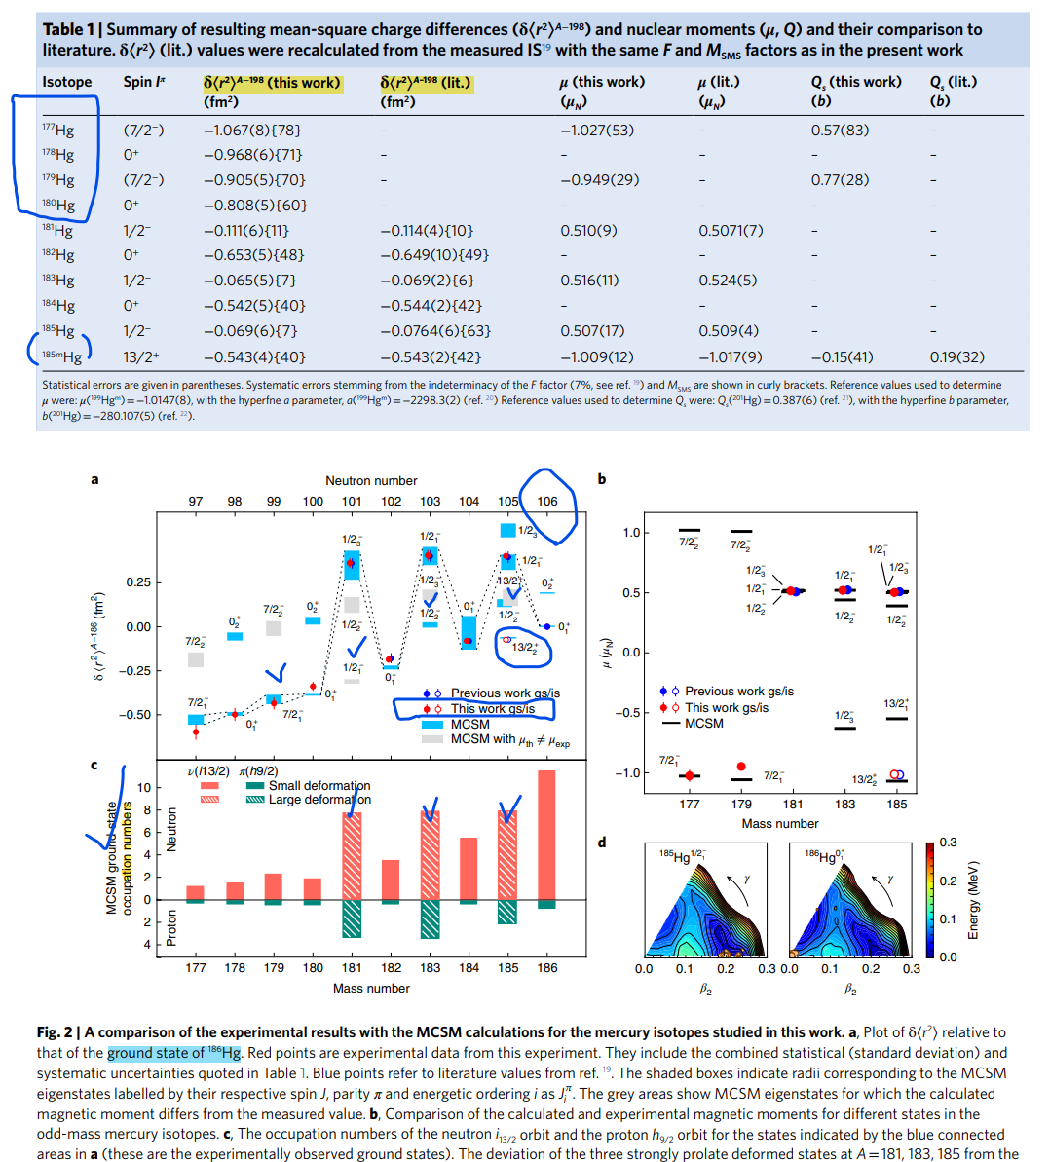
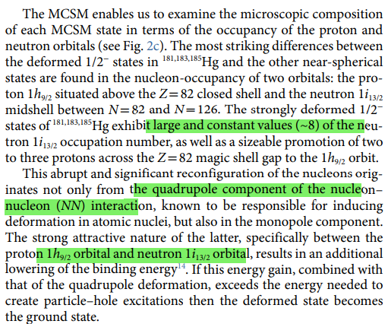
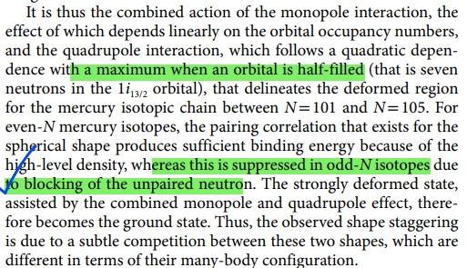





Slide 10
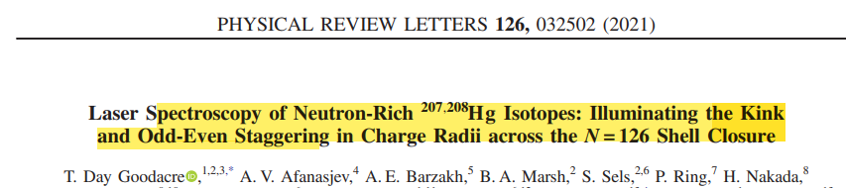
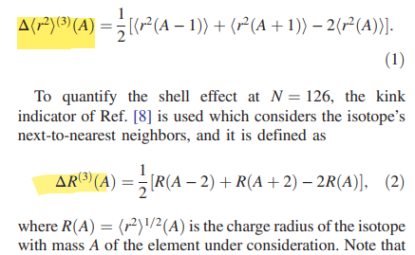
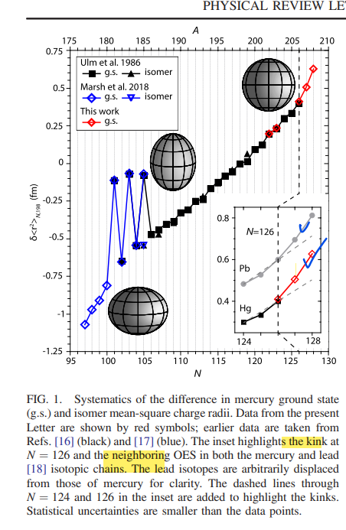
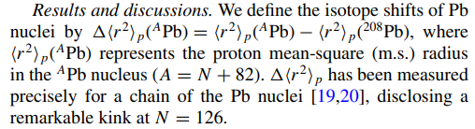
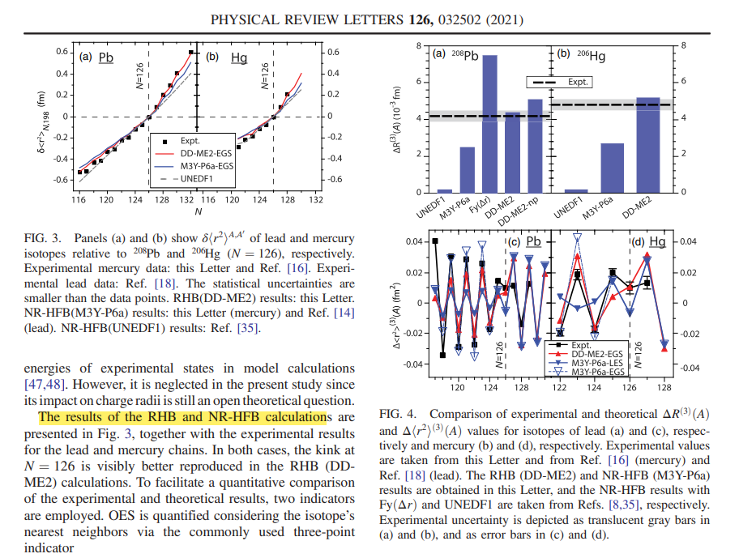
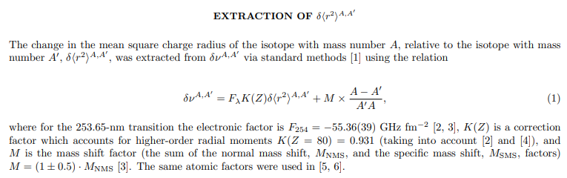
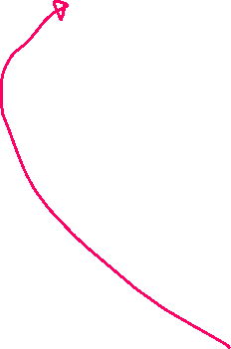



Slide 11
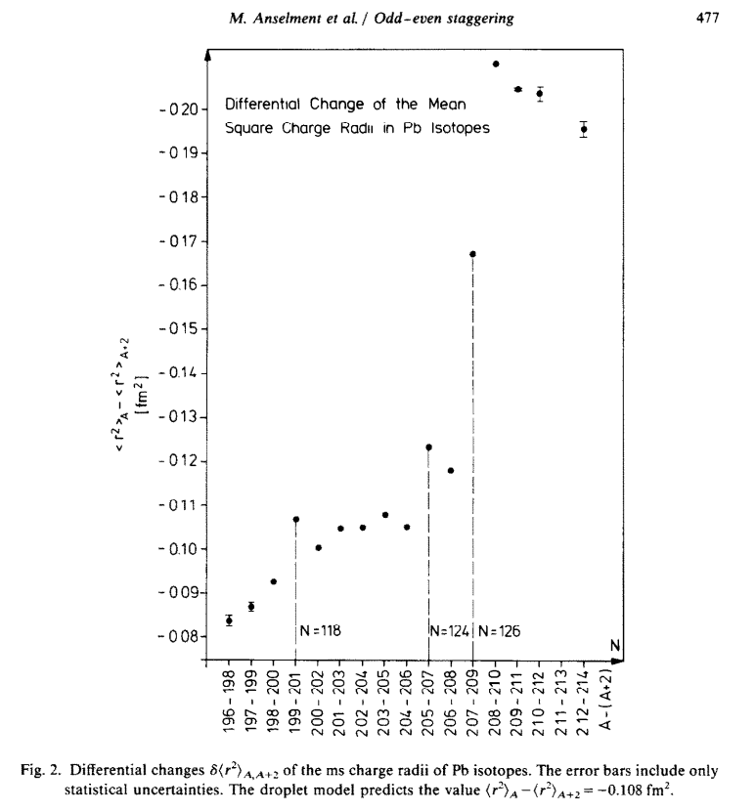
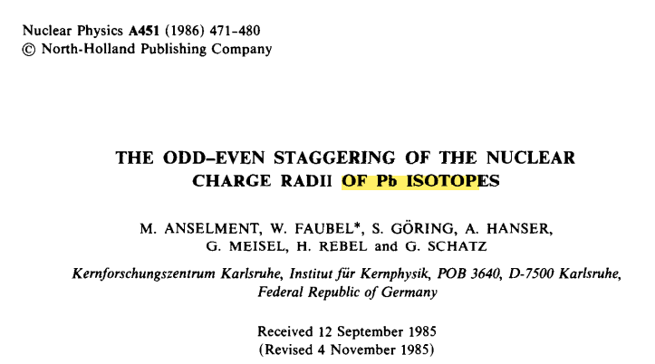
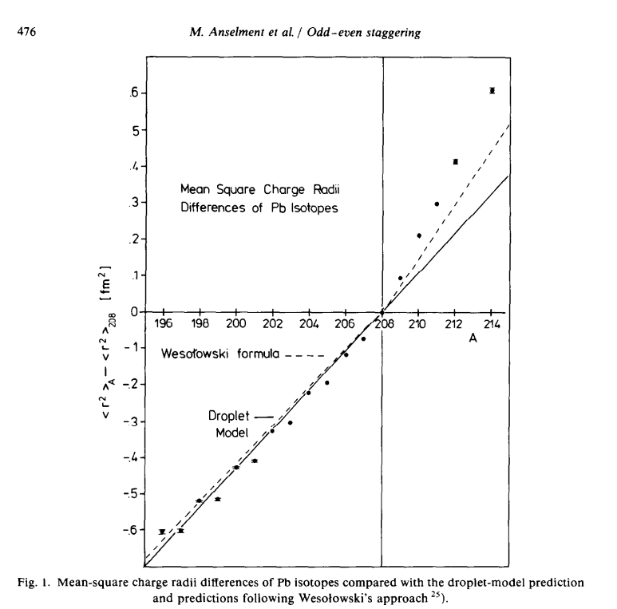
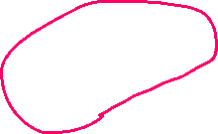
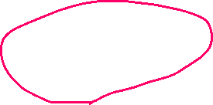

Odd-even staggering and Kink structure;
Change of mean square charge radii
in odd-even nuclei

Slide 12
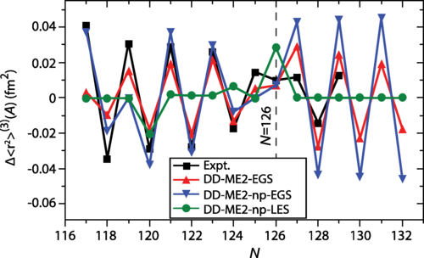
Three-point OES parameter
To facilitate a quantitative comparison of the experimental and theoretical results, OES is quantified considering the isotope’s nearest neighbors via the commonly used three-point indicator.
PHYSICAL REVIEW LETTERS 126, 032502 (2021)

Slide 13
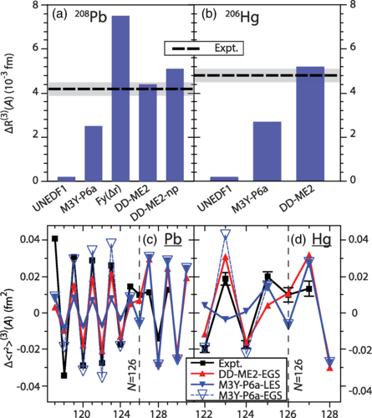
Three-point OES parameter
ΔR(3)(A)
 | EXP. | RHB (DD-ME) | NR-HBF (M3Y-p6a) | DRHBc
²⁰⁶Hg | 0.0048 | 0.0052 | 0.0027 | 0.0086
²⁰⁸Pb | 0.0042 | 0.0044 | 0.0025 | 0.0054
PHYSICAL REVIEW LETTERS 126, 032502 (2021)

Slide 14
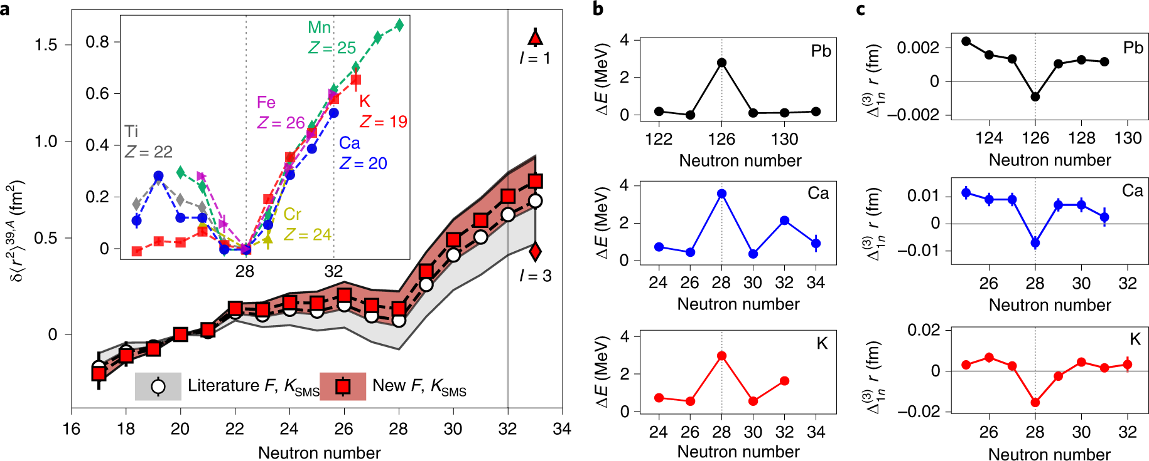
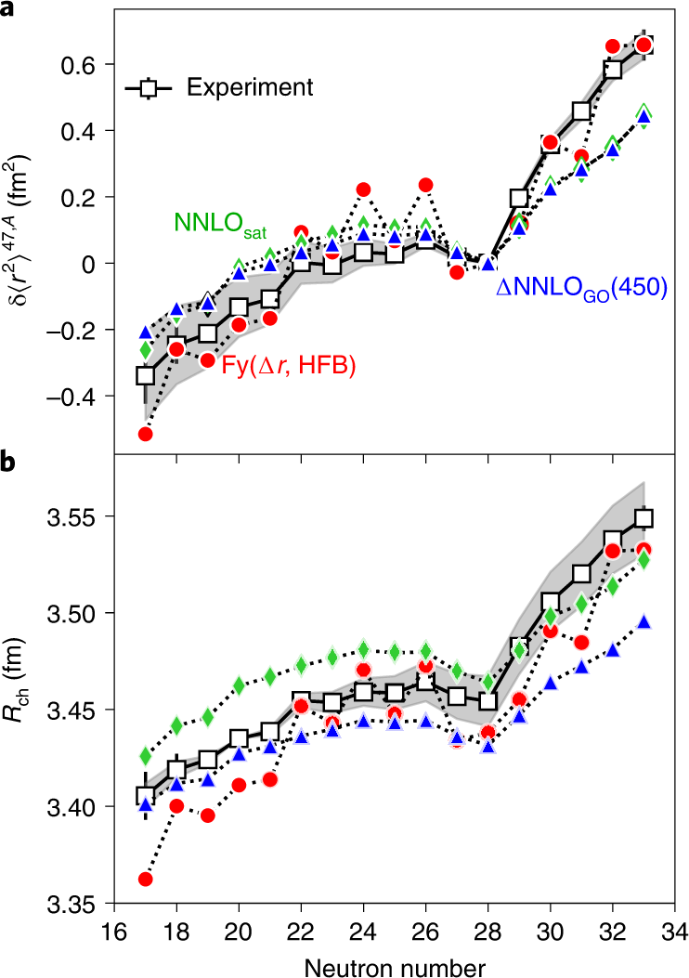
Relative differences by two-point and three-point
of mean square radii and binding energies of light nuclei around N = 28 and 32
Nature Physics volume 17, pages439–443 (2021)

Slide 15
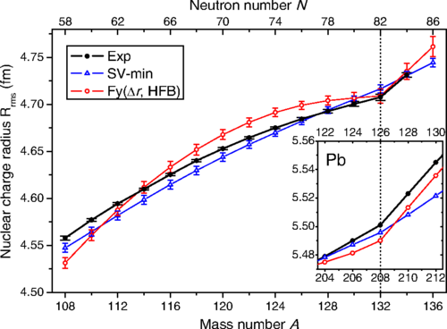
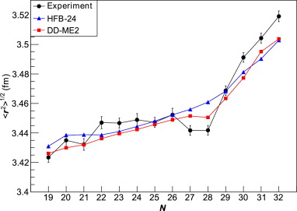



Kink
Indeed, charge radii reflect various nuclear structure phenomena such as halo structures, shape staggering and shape coexistence, pairing correlations, neutron skins and the occurrence of nuclear magic numbers.
The remarkably abrupt changes in charge radii are observed naturally across the neutron-closure shells, namely the kinks at N = 20, 28, 50, 82, 126 [1~4].
Phys. Rev. Lett. 122, 192502 (2019).
Phys. Lett. B 731, 97 – 102 (2014).
[1] Gorges, C. et al. Phys. Rev. Lett. 122, 192502 (2019).
[2] Anselment, M. et al. Nucl. Phys. A 451, 471 – 480 (1986).
[3] Farooq-Smith, G. J. et al. Phys. Rev. C 96, 044324 (2017).
[4] Kreim, K. et al. Phys. Lett. B 731, 97 – 102 (2014).

Slide 16
Brief summary
Thanks to the recent development of the laser spectroscopy, MR ToP
and RI accelerator facilities in the world
1. OES in Hg isotopes turns out to be significant compared to any other nuclei
,for example, Pb isotopes. How to understand it ?
2. Kink structures appear above any magic shell in light and heavy nuclear isotopes.
How to interpret this behavior ?
3. We need a more refined nuclear model, which has to explain main properties of
the whole nuclei in the nuclear chart by including the relativistic description,
deformation, continuum, driplines etc.

Slide 17
Contents
1. Experimental evidences of OES and Kink structures
1-1. Odd-Even Staggering (OES)
1-2. Kink
2. Deformed Relativistic Hartree Bogoliubov in Continuum
(DRHBc) mass model
3. OES and Kink of Hg by DRHBc mass model
3-1. OME of Hg
3-2. Kink of Hg and Pb
4. Summary

Slide 18
DRHBc theory
In order to explain deformed exotic nuclei, the deformed relativistic Hartree-Bogoliubov theory in continuum (DRHBc) was developed.
  It considers the effects of deformation, pairing correlations and continuum, at the same time.
The main goal of the DRHBc theory is a unified description of the most of nuclear chart and it has been successful in many studies on exotic nuclei.
  A complete mass table based on DRHBc theory
  Shell evolution of carbon isotopes [1]
  Deformed halos in magnesium isotopes [2] and neutron halos in ¹⁹B [3]
  Study of ground state properties: binding energies, separation energies, Fermi surfaces, quadrupole deformations, root-mean-square (rms) radii , etc
  Shape coexistence, bubble nuclei, neutron skin thickness
[1] X.-X. Sun, J. Zhao, S.-G. Zhou, Nuclear Phys. A 1003 (2020) 122011.
[2] S.-G. Zhou, J. Meng, P. Ring, E.-G. Zhao, Phys. Rev. C 82 (2010) 011301(R).
[3] X.-X. Sun, Phys. Rev. C 103 (2021) 054315.

Slide 19
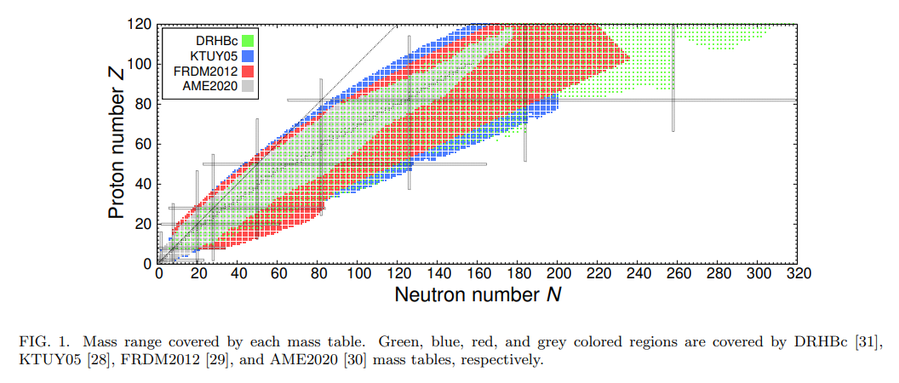
DRHBc mass table project
The DRHBc mass table project based on the DRHBc theory has begun in 2018 to develop a mass table that includes both paring and continuum effects with deformation.
  To provide the ground state properties about most nuclei of the nuclear chart
  To construct the first relativistic nuclear mass table with the deformation and continuum effects by the DRHBc theory
  To explore novel phenomena in nuclear physics by the DRHBc theory and various applications of the DRHBc mass table in nuclear astrophysics
The progress in the DRHBc mass table project
  2019-2020: Tests and numerical checks of code for even-even nuclei
  2020-2022: Mass Table calculations for even-even nuclei
  2021-2022: Code extension to odd nuclei
  2022- : Mass table calculations for even-odd nuclei

Slide 20
Theoretical framework
We start from the following point-coupling Lagrangian density¹⁾
[1] J. Meng (Editor). Relativistic Density Functional for Nuclear Structure (2016)

Slide 21
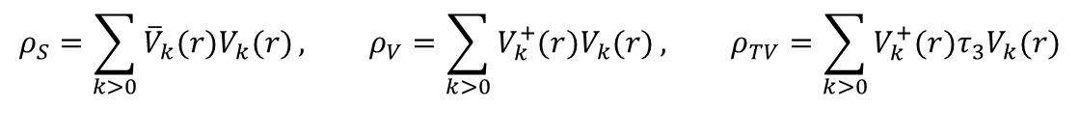
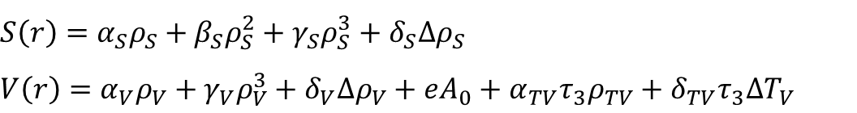

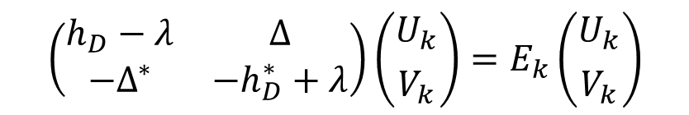
Theoretical framework
Relativistic Hartree-Bogoliubov (RHB) equation¹⁾
$$\left(\begin{matrix}h_{D}−λ & ∆ \\ −Δ^{∗} & −h_{D}^{∗}+λ\end{matrix}\right)\left({U_{k} \atop V_{k}}\right)=E_{k}\left({U_{k} \atop V_{k}}\right)$$
Dirac Hamiltonian
$$h_{D}=α⋅p+β\left(M+S(r)\right)+V(r)$$
where scalar and vector potentials
$$S\left(r\right)=α_{S}ρ_{S}+β_{S}ρ_{S}^{2}+γ_{S}ρ_{S}^{3}+δ_{S}{Δρ}_{S}$$
$$V\left(r\right)=α_{V}ρ_{V}+γ_{V}ρ_{V}^{3}+δ_{V}{Δρ}_{V}+eA_{0}+α_{TV}τ_{3}ρ_{TV}+δ_{TV}τ_{3}{ΔT}_{V}$$
with local densities
$$ρ_{S}=\sum_{k>0}{{\overline{V}}_{k}(r)V_{k}(r)}, ρ_{V}=\sum_{k>0}{V_{k}^{+}(r)V_{k}(r)}, ρ_{TV}=\sum_{k>0}{V_{k}^{+}(r)τ_{3}V_{k}(r)}$$
[1] Kucharek and Ring, Z. Phys. A 339, 23 (1991)

Slide 22
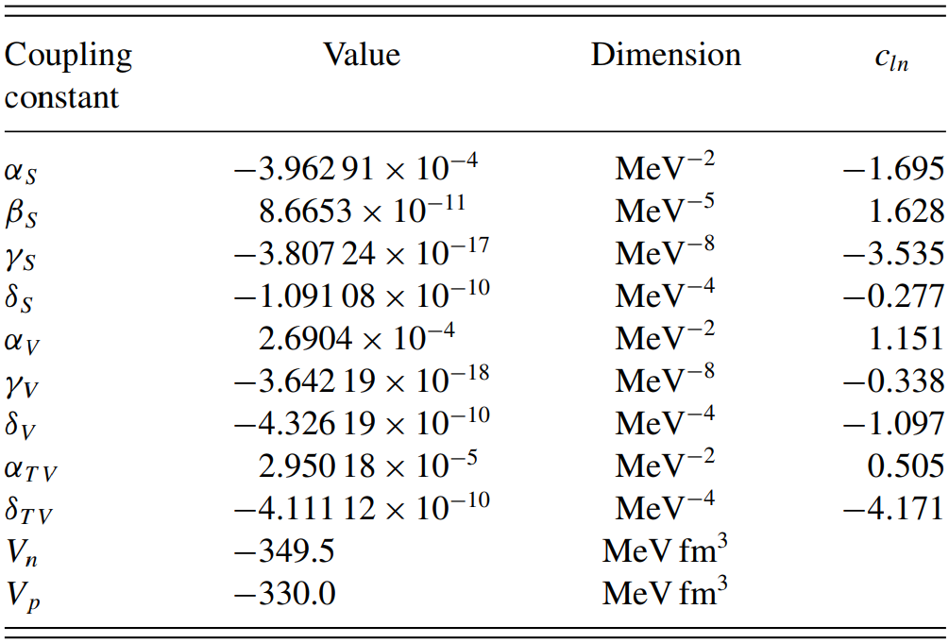
Point-coupling constants (PC-PK1)
The point-coupling constants of PC-PK1 set¹⁾ fitted to observables of 60 selected spherical nuclei, including the binding energies, charge radii, and empirical pairing.
The successful PC-PK1 is adopted to calculate the DRHBc mass table.
[1] Zhao, Li, Yao, Meng, PRC 82, 054319 (2010)

Slide 23

Numerical details
Object nuclei:
  O, Ne, Mg, Si, S, Ar and Ca isotopes (8 ≤ Z ≤ 20)
  Hf, W, Pt, Os, Hg, Pb, Po, Ra, Rn and Th isotopes (72 ≤ Z ≤ 90)
Box size: R_{box} = 20 fm
Mesh size: Δr = 0.1 fm
Energy cutoff :E_{cut} = 300 MeV
Angular moment cutoff: J_{max} = 23/2 ħ
Legendre expansion order:
  λ_{max} = 6 (8 ≤ Z ≤ 20)
  λ_{max} = 8 (72 ≤ Z ≤ 90)
Density functional: PC-PK1
Pairing strength: - 325.0 MeV fm³
Initial deformation: β₂ = -0.40, -0.20, 0.00, 0.20, 0.40, 0.6

Slide 24
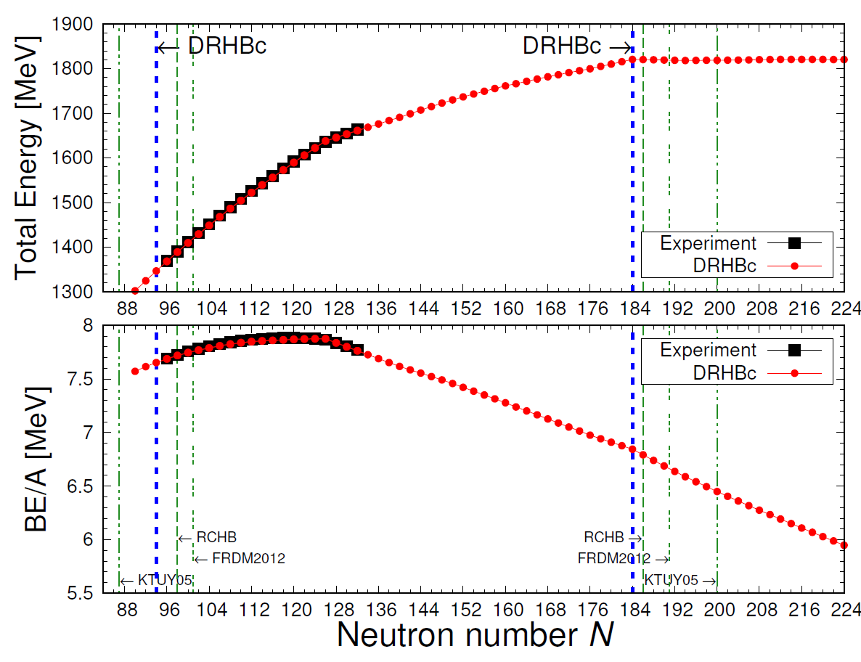
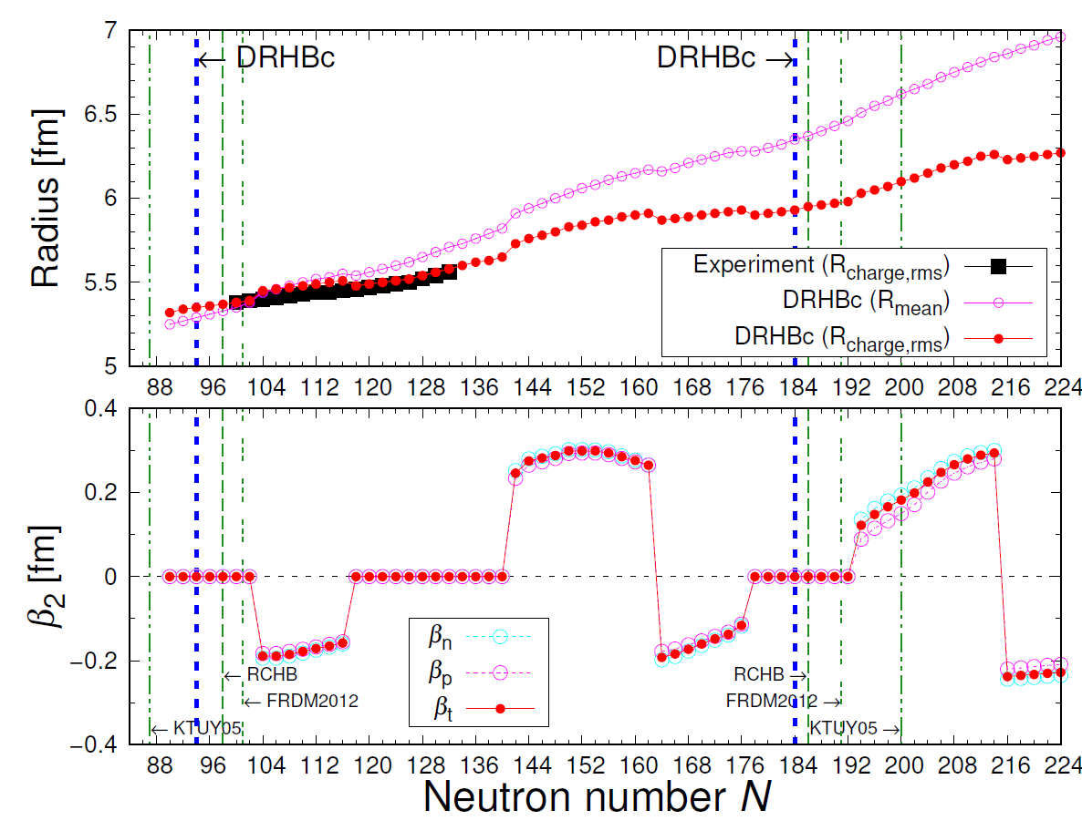
Calculation results: Pb (Z = 82)
Binding Energy & BE/A
Nuclear Radii & Deformation
Binding Energy [MeV]
Courtesy of Seonghyun Kim

Slide 25
Separation energy & Fermi surface
Pb
Po
Ra
S_{2n} and $λ$_{n} have a strong relationship with quadrupole deformation.
It seems to extend the position of neutron drip line for Polonium isotopes.
Courtesy of Seonghyun Kim

Slide 26
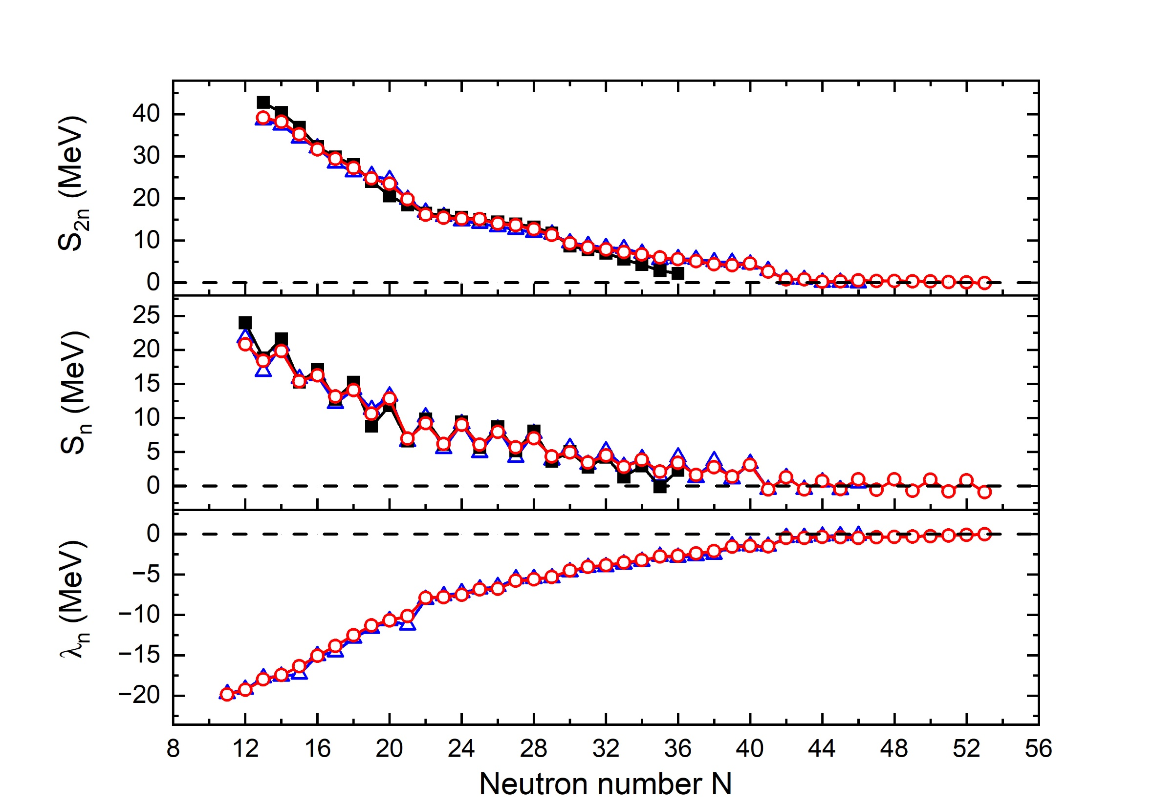
Separation energy & Fermi surface
Preliminary
Ar
RCHB
DRHBc

Slide 27
Example of mass table with DRHBc
Z = 18 (Ar) isotopes
Preliminary

Slide 28
Mass table with DRHBc
The neutron number of the most neutron-rich even-even nuclei predicted to be bound in the RCHB [1] and DRHBc [2] theory
Element (Z) | Neutron number |  |  | Element(Z) | Neutron number
 | RCHB (No Pairing) | RCHB | DRHBc |  | RCHB (No Pairing) | RCHB | DRHBc
O (8) | 20 | 20 | 20 | Os (76) | 184 | 184 | 184
Ne (10) | 20 | 32 | 30 | Pt (78) | 184 | 184 | 184
Mg (12) | 34 | 34 | 34 | Hg (80) | 184 | 184 | 184
Si (14) | 34 | 38 | 38 | Pb (82) | 184 | 184 | 184
S (16) | 40 | 40 | 38 | Po (84) | 184 | 184 | 224
Ar (18) | 40 | 44 | 52 | Rn (86) | 184 | 184 | 232
Ca (20) | 40 | 60 | 60 | Ra (88) | 184 | 258 | 258
Hf (72) | 184 | 184 | 184 | Th (90) | 184 | 258 | 258
W (74) | 184 | 184 | 184
[1] X.W.Xia, et al., At. Data Nucl. Data Tables 121-122 (2018) 1-215
[2] Kaiyuan Zhang, et al., At. Data Nucl. Data Tables 144 (2022) 101488

Slide 29
Shape coexistence
Shape coexistence is another important exotic nuclear property.
The shape coexistence is being extensively discussed through many theoretical nuclear models and experiments.
For example, in the nuclei having neutron number N = 20 and 28, two-particle two-hole (2p-2h) configurations of neutrons are shown to be capable of inducing a coexistence shape of some 0+ states [1].
There are 38 nuclei with shape coexistence in 72 ≤ Z ≤ 80 even-even nuclei (with the criterion: |ΔE| < 0.5 MeV) [2].
[1] P. Mantica, Physics 2, 18 (2009)
[2] Yong-Beom Choi, Myeong-Hwan Mun, Chang-Hwan Lee, Youngman Kim, PRC 105, 024306 (2022)
Courtesy of Yong-Beom Choi

Slide 30
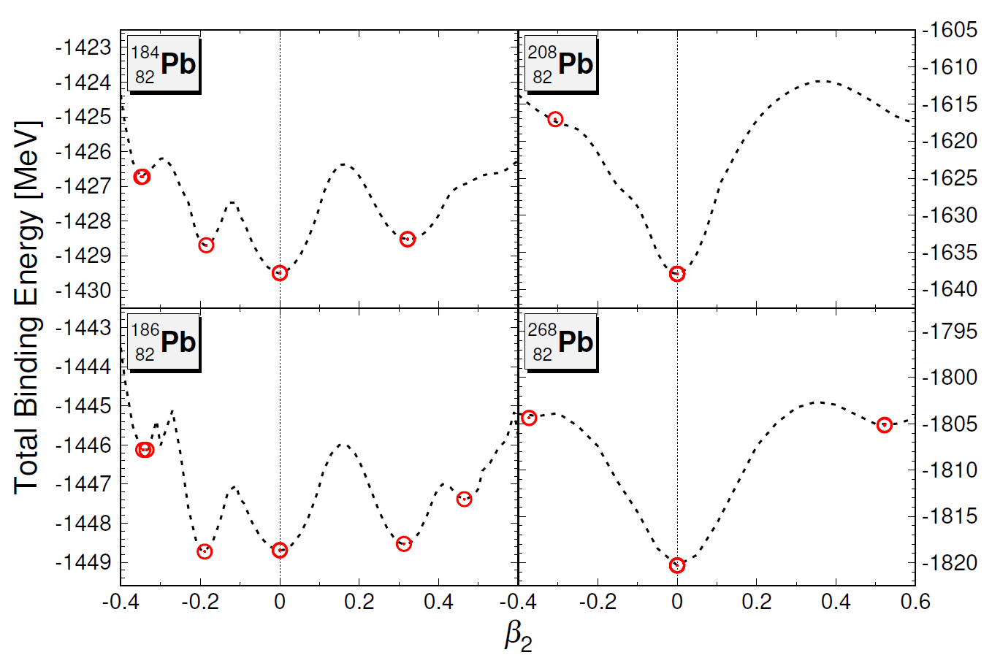
Shape coexistence
N = 102
N = 126
N = 104 (¹⁸⁶Pb₁₀₄)
Three minimum points (ΔE < 1 MeV)
Shape coexistence
Oblate / Spherical / Prolate shapes
N = 104
N = 186
Seonghyun Kim , Myeong-Hwan Mun, Myung-Ki Cheoun and Eunja Ha, PRC 105, 034340 (2022)

Slide 31
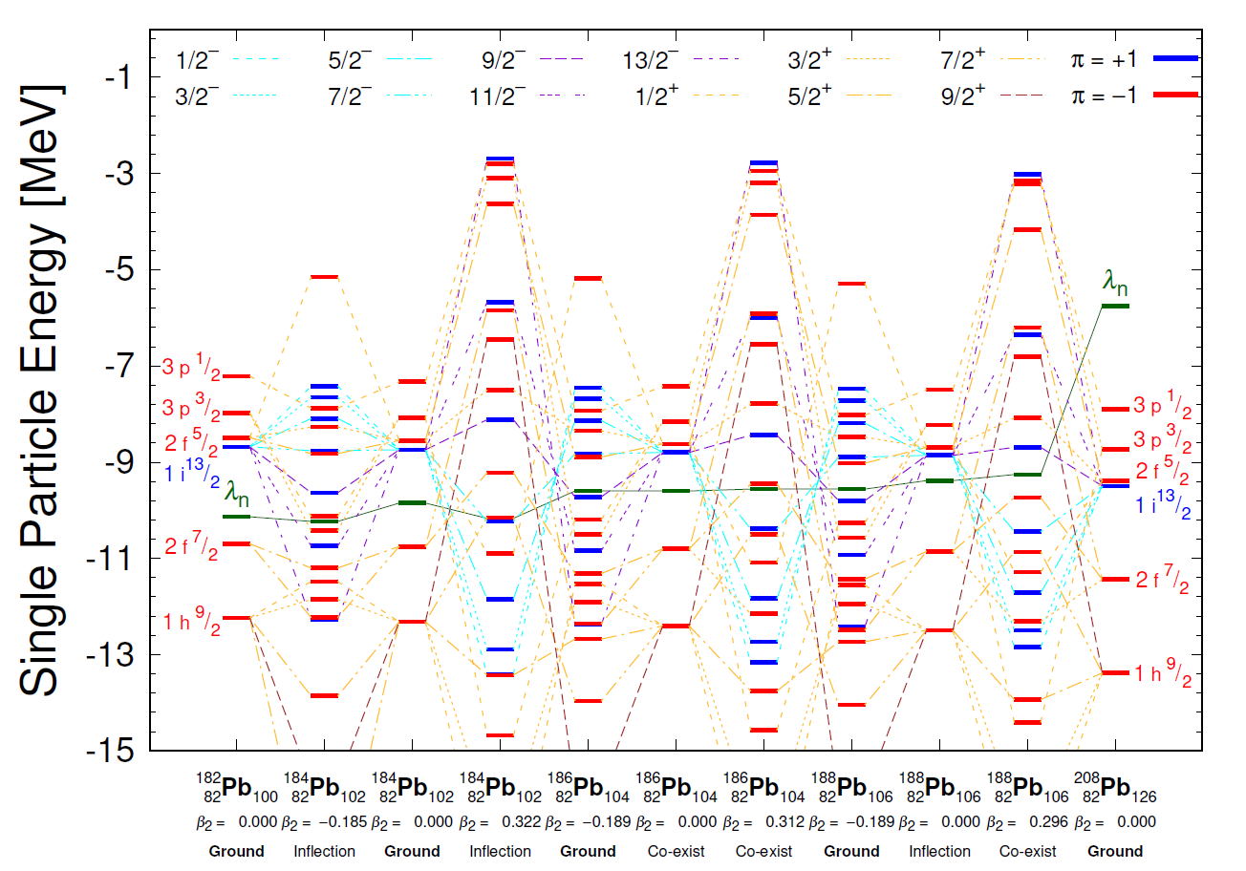
Shape coexistence
Spherical single particle energies are similar with near isotopes.
The four valence neutrons in the 1i_{13/2} shell above the core are allocated to many projection states split from the 1i_{13/2} shell due to the deformation.
For the prolate case, the lower 1/2⁻ ~ 7/2⁻ (higher 11/2⁻ ~ 13/2⁻) projection states of the 1i_{13/2} state are shifted to the lower (higher) energy states. The shifts are reversed for the oblate case.
As a result, both low and high energy splitting effects by the deformation are compensated with each other and give rise to almost the same Fermi energies within ΔE < 1 MeV leading to the shape coexistence.
Seonghyun Kim , Myeong-Hwan Mun, Myung-Ki Cheoun and Eunja Ha, PRC 105, 034340 (2022)

Slide 32
Bubble & shape coexistence
Focusing on nuclear shapes, we survey our results for candidates of shape coexistence with bubble nuclei and propose potential candidate isotopes.
  We searched for isotopes with bubble structure and shape coexistence and found candidate isotopes ^{202,234,236,240,250}Hf, ^{194,204,254}W, ^{196,206,208,256}Os, and ^{210,212}Pt.
  It can be seen from the table that some nuclei have both prolate and oblate bubble, while some of them have only prolate bubble structure.
Yong-Beom Choi, Myeong-Hwan Mun, Chang-Hwan Lee, Youngman Kim, PRC 105, 024306 (2022)

Slide 33
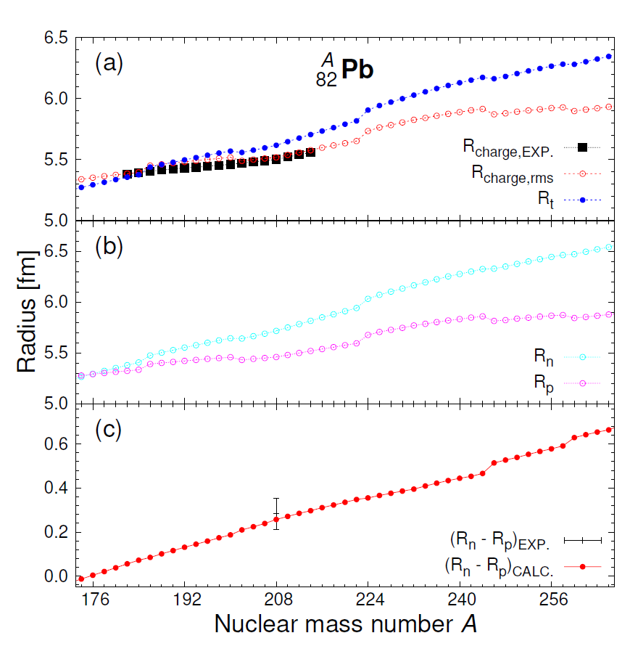
Neutron Skin Thickness
Neutron Skin Thickness (NST)
  Neutron Skin Thickness (R_{n} – R_{p}) is one of the important nuclear properties.
  It is related with many physical phenomena.
  Object : ²⁰⁸Pb
PREX-1 experiment (2012)
  R_{n} – R_{p} = 0.302 ± 0.175 (exp) [fm]
PREX-2 experiment (2021)
  R_{n} – R_{p} = 0.278 ± 0.078 (exp) [fm]
DRHBc
  R_{n} – R_{p} = 5.717 [fm] – 5.460 [fm] = 0.257 [fm]
The NST evolution monotonically increases along with the neutron number.
Seonghyun Kim , Myeong-Hwan Mun, Myung-Ki Cheoun and Eunja Ha, PRC 105, 034340 (2022)

Slide 34
Contents
1. Experimental evidences of OES and Kink structures
1-1. Odd-Even Staggering (OES)
1-2. Kink
2. Deformed Relativistic Hartree Bogoliubov in Continuum
(DRHBc) mass model
3. OES and Kink of Hg by DRHBc mass model
3-1. OME of Hg
3-2. Kink of Hg and Pb
4. Summary

Slide 35
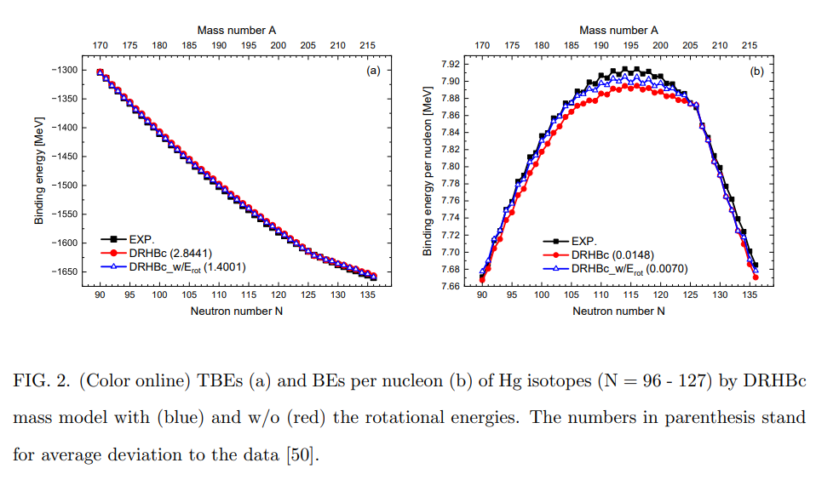
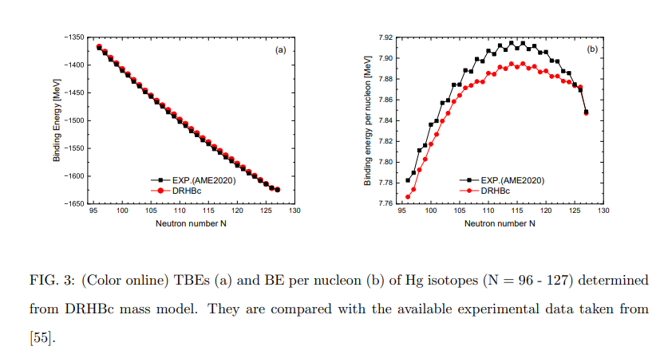
Binding energies and binding energies per nucleon by DRHBC
∆E/A < 0.02 MeV !!!

Slide 36
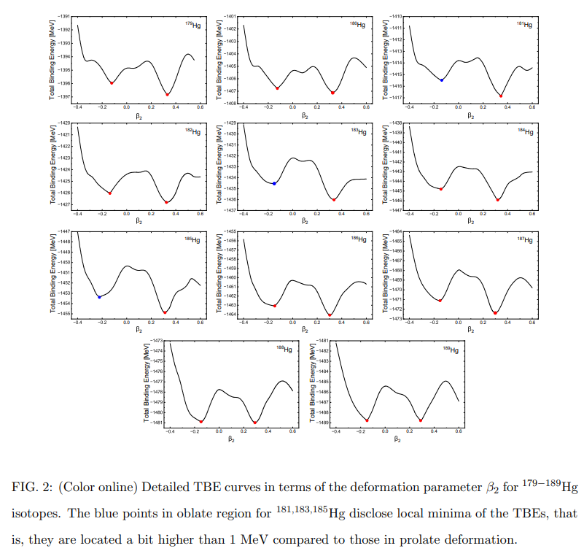
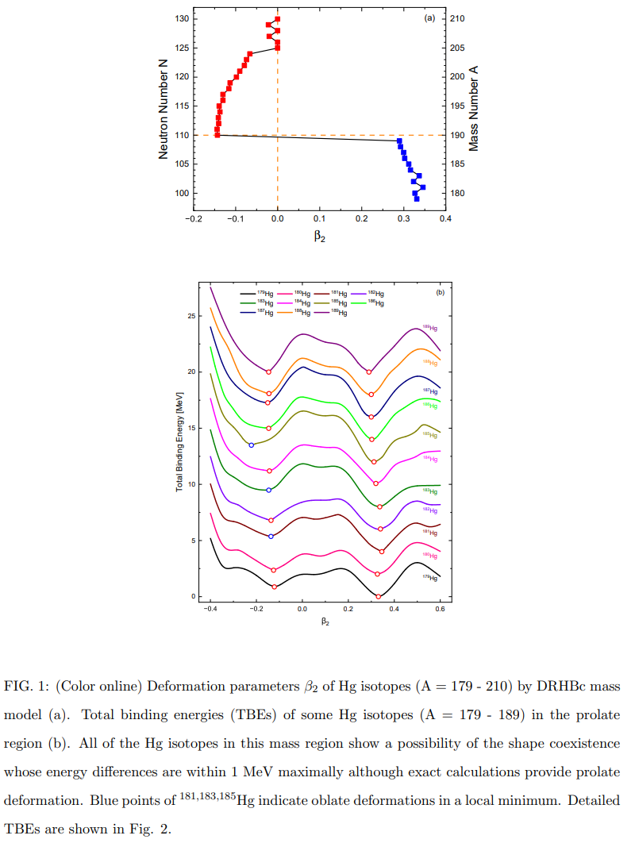
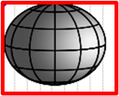

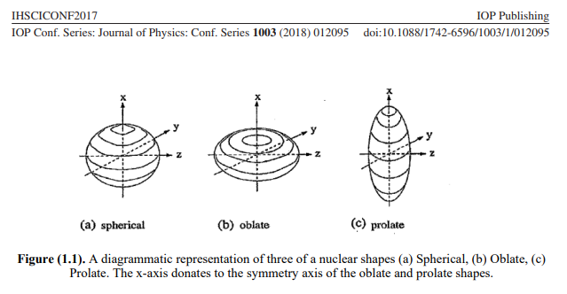











Evolution of total binding energies with deformation
by DRHBC

Slide 37

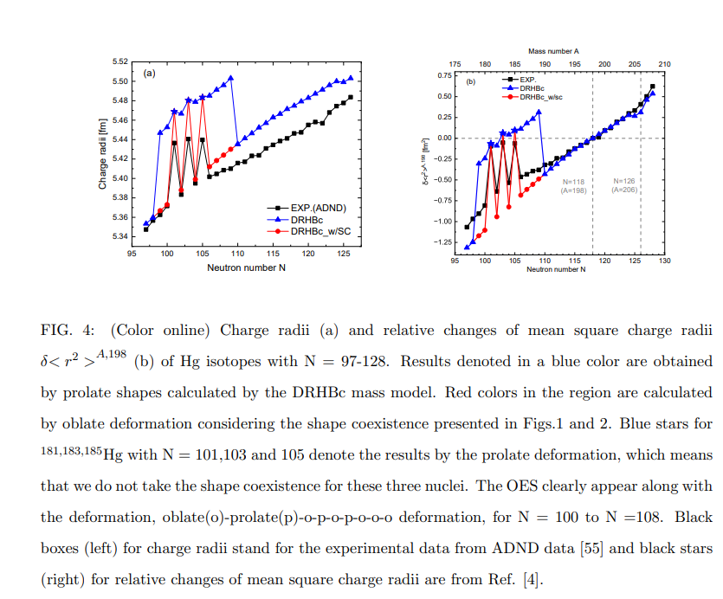


OES by the shape coexistence
and the nuclear shape transition !
Blue points are obtained by DRHBc
w/o considering shape coexistence !
=>We could not explain the OES data
as well as small charge radii !!
If we take into account
the shape coexistence,
we obtained the red points by oblate deformation!!
Can explain small charge radii !!
But still, we cannot explain the OES
data of 181,183 and 185 of Hg.
However, remember the oblate minima of
181,183,185 of Hg are 2nd local minima.
We have to take prolate deformation.
Then the OES (blue stars) can be
explained clearly.

Slide 38
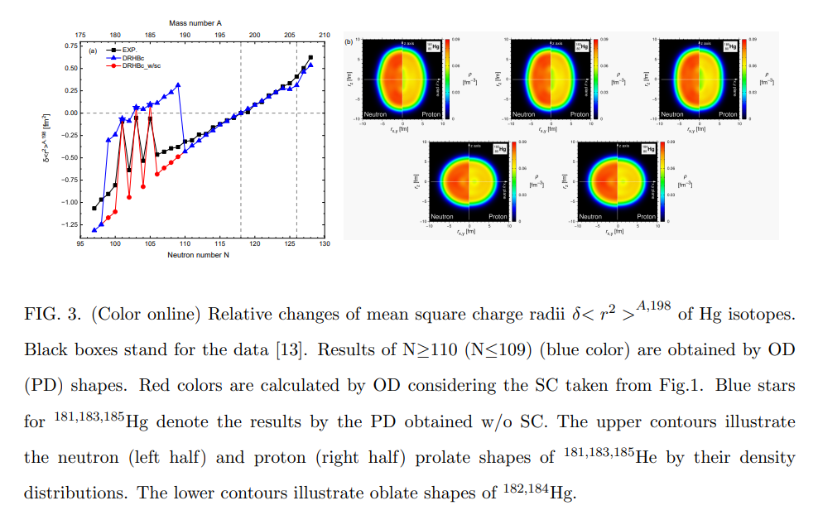
Nuclear shape transition of Hg isotopes by DRHBC

Slide 39
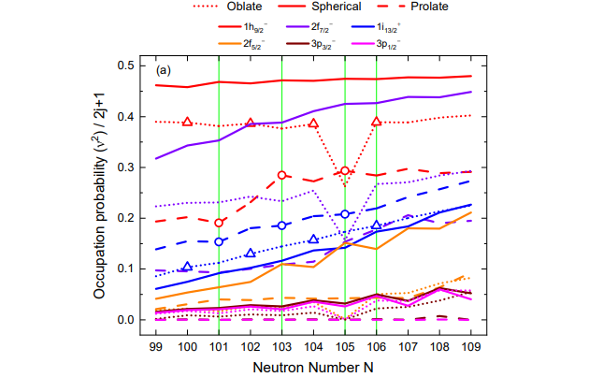


Red lines are for 1h9/2 shell,
which decrease
with the oblate and prolate deformation.
But those of 1i13/2 shell disclose
the increase with spherical, oblate and prolate
deformation
However, the increase behave like seasaw
from even to odd nuclei !!

Slide 40

Nuclear shape transition by the occupation probabilities
Red lines are for neutron 1h9/2 shell,
which increase (decrease)
with the oblate (prolate) deformation.
Those of 1i13/2 shell disclose
the increase (decrease) with prolate (oblate)
deformation
=> like a seasaw from even to odd nuclei !!
Proton OC
of 1h9/2 increases
with
prolate deformation,
which increase
charge radii
by the symmetry energy
due to
the n-p interaction !

Slide 41

Hg_101 = 3/2 (-)
Hg_103 = 5/2 (-)
Hg_105 = 1/2 (-)
f and h -> -
100
100
100
100
100

Slide 42


Slide 43

PHYSICAL REVIEW LETTERS 126, 032502 (2021)
²⁰⁸Pb
²⁰⁶Hg

Slide 44

How to understand Kink structure around N = 126 shell ?
OC of 1i11/2 and 2g9/2 of neutrons
Increase above N=126 shell.
But OC of protons do not change !
The Kink is to be understood by
the swelling of neutrons
in the symmetric core,
not by the swelling of protons !!

Slide 45
Summary and Conclusion
1. Our findings highlight the significance of Shape Coexistence in understanding the OES observed
in the Hg isotopes.
2. It is clear that taking into account Oblate Deformation for most Hg isotopes, except for 181,183,185Hg,
considering the SC is crucial for explaining the OES phenomenon.
3. These three prolate-shaped odd nuclei are excluded from the SC present in the neighboring nuclei and
exhibit larger charge radii, indicating that the OES can serve as a useful tool
for identifying the SC in Hg isotopes, or vice versa.
4. The seesaw-like behavior of nuclear shape and OPs of corresponding SPSs in the range of 180-186Hg isotopes
is essential for understanding the prominent OES observed in the Hg isotopes.
5. Furthermore, the DRHBc model employed in the present study successfully reproduces the kink structure
observed around the N = 126 shell.
6. This kink structure arises from the increase in the OPs of i_{11/2} and 2 g_{9/2} states beyond the magic shell,
influenced by the multi-particle and multi-hole interactions.
7. This swelling effect pushes the proton states to the outer nuclear surface with the symmetry energy
residing on the symmetric core surface. It would be interesting to further investigate the OES and
the kink structures of charge radii and matter radii in Ca, K, and Pb isotopes
in the vicinity of each magic shell using the DRHBc model in future studies.

Slide 46







How is the results for 187Pb ! Next work !!

Slide 47

경청해주셔서
대단히 감사합니다 !!
Thanks for your attention !!

