Slide 1
FRG for dense matter, exotic nuclei and neutron stars
Youngman Kim
CENS, IBS
14th APCTP-BLTP JINR workshop

Slide 2
Beyond the mean field approximation: FRG
The FRG combines functional approach with the renormalization group idea and deals with the fluctuations not all at once but successively from scale to scale or shell by shell.
FRG is a good way to handle the fluctuations and a handy tool for those who are familiar with relativistic quantum field theory.
My goal is to use the FRG method for dense matter, exotic nuclei, neutron stars and heavy ion collisions using an extended Walecka type model.

Slide 3
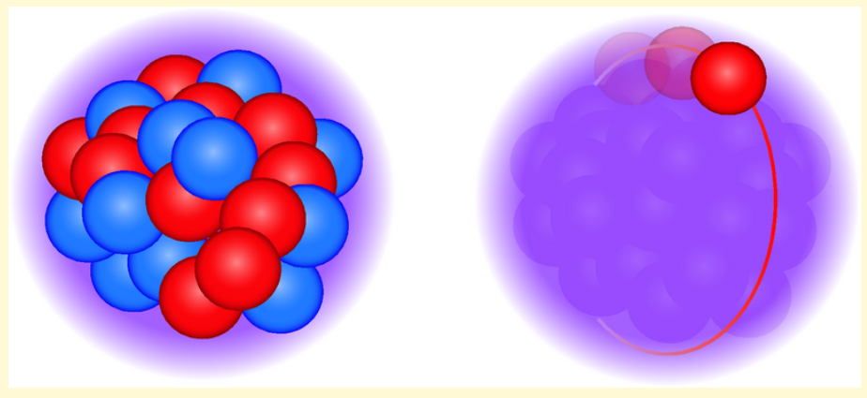
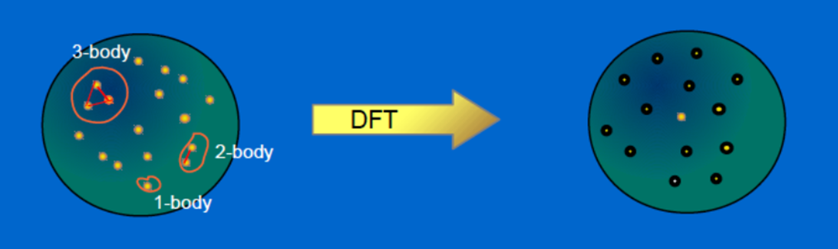
Mean field Approximation

Slide 4
Fluctuations
Nucleons, though massive, can fluctuate near the Fermi surface as p-h excitations.
The pion and sigma mesons can fluctuate.
Vector mesons such as omega mesons may not fluctuate because they are massive. Only as mean field.

Slide 5
Renormalization group method with different goals
To remove infinities (UV divergences)
To describe the scale dependence of physical parameters
To re-sum the perturbation expansion in QFT
To solve strongly coupled theories
…

Slide 6
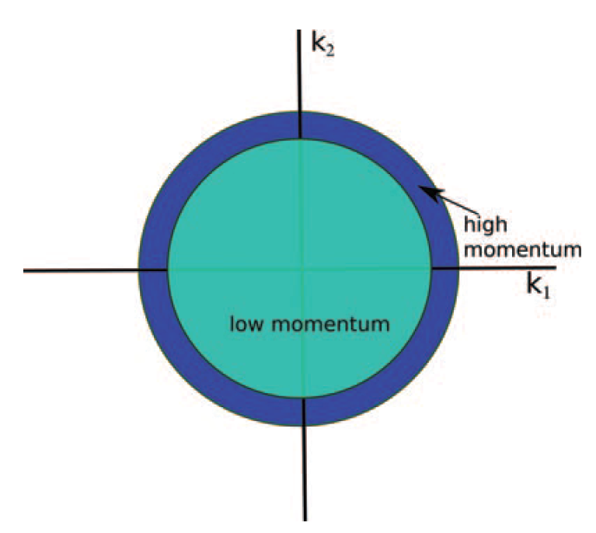
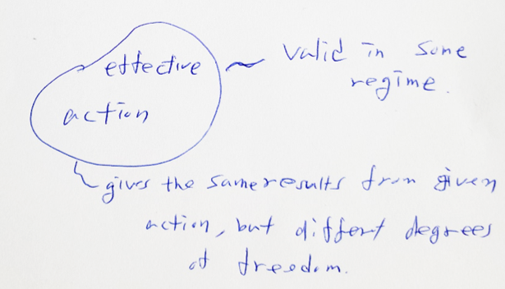
Wilsonian (effective action) approach
It is about how a theory changes as we scale down the momentum scale.

Slide 7
In practice, however, non-local interactions are generated and a derivative expansion is not possible.
In FRG, the scale dependence (or flow) of the effective action, provides a better analytical and numerical accessibility and stability. Also, it is a practical realization of the Wilson (-Kadanoff) RG idea.

Slide 8
Let’s obtain the flow equation of the average action, called Wetterich equation,

Slide 11
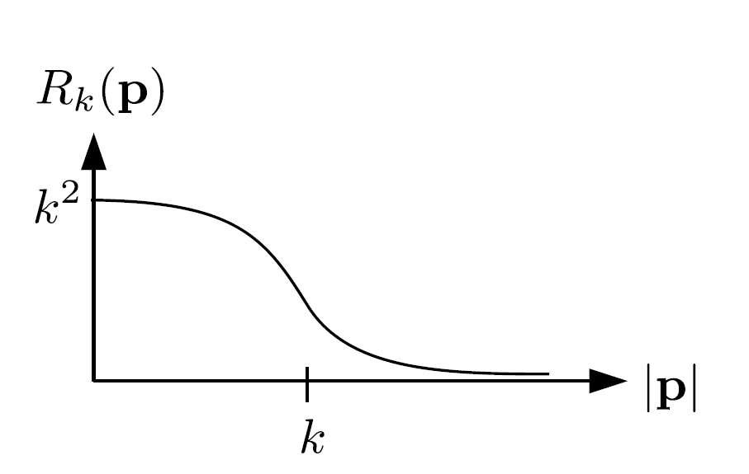
Momentum-dependent mass-like term that gives a mass of order k² to the low-energy modes and thus suppresses their fluctuations.

Slide 16
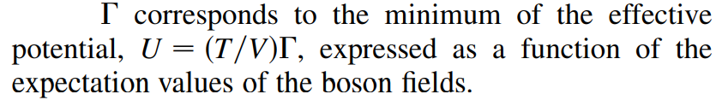
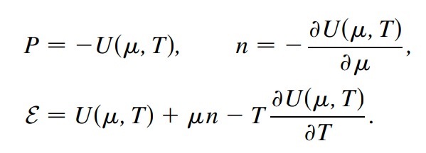
This method has been mainly used in a model with chiral symmetry.

Slide 17
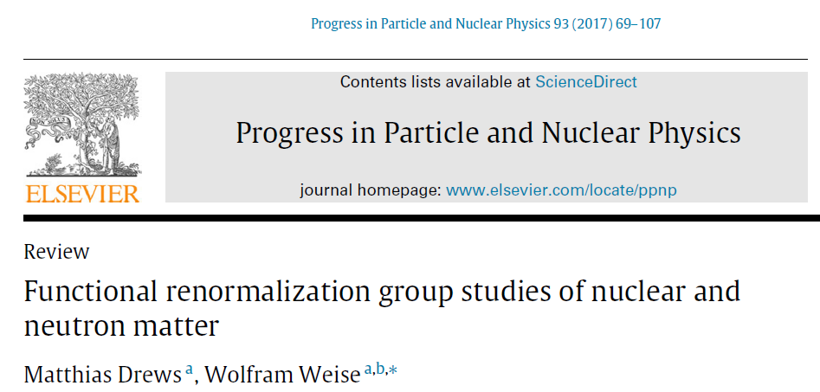


Slide 18
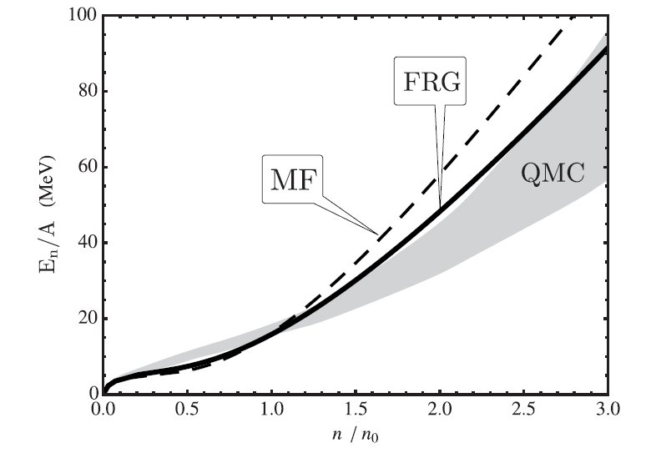

Slide 19
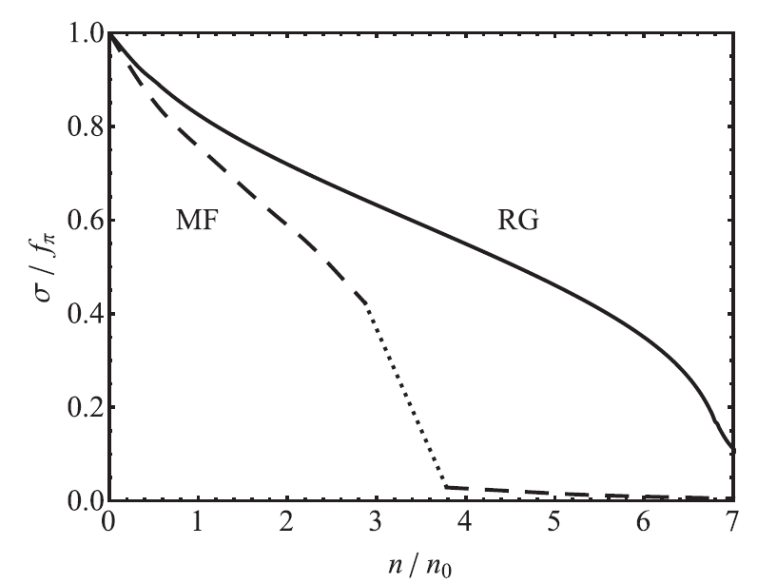

Slide 20
As a warm-up, …

Slide 21
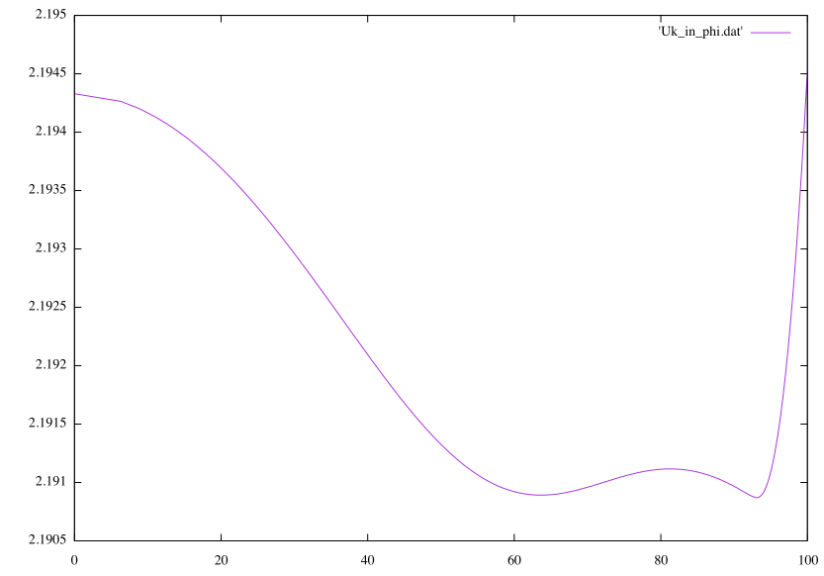
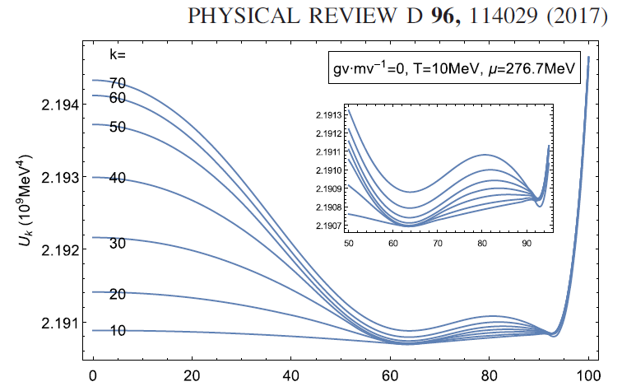
Y. M. Kim, C.-H. Lee, S. Jeon and YK

Slide 22
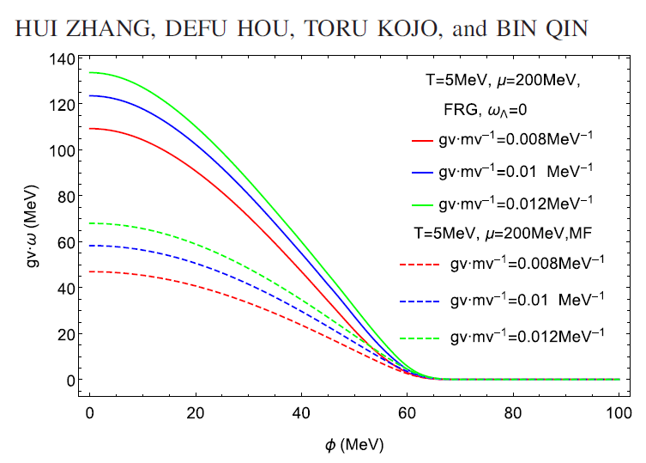
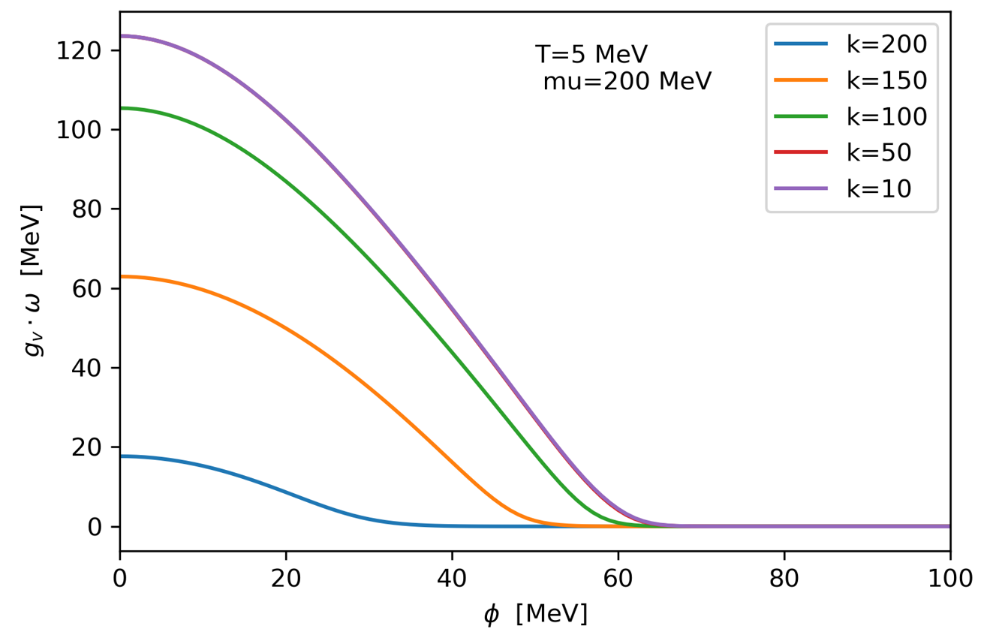
Y. M. Kim, C.-H. Lee, S. Jeon and YK

Slide 23
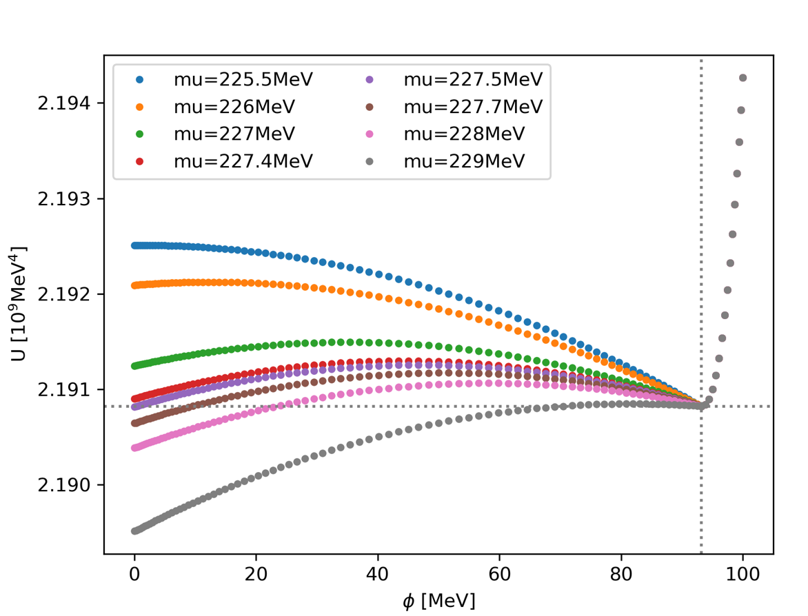
T = 5 MeV, g_v/m_v = 0.008/MeV, g_s = 3.2, lambda = 8

Slide 24
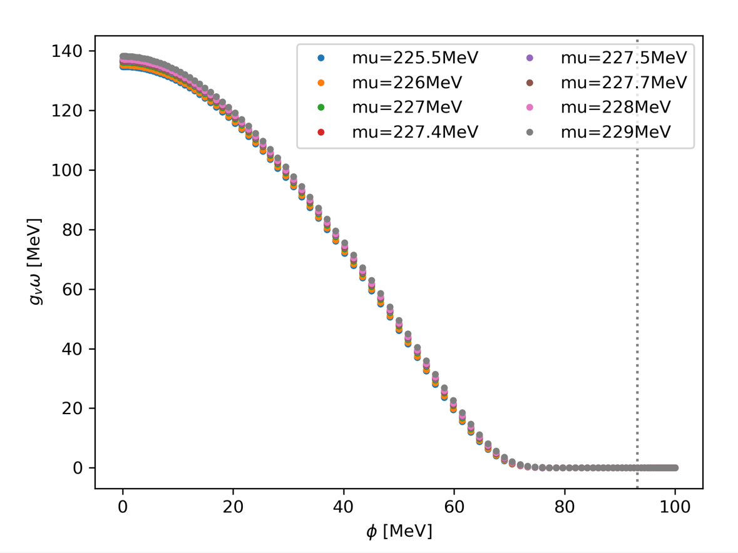

Slide 25
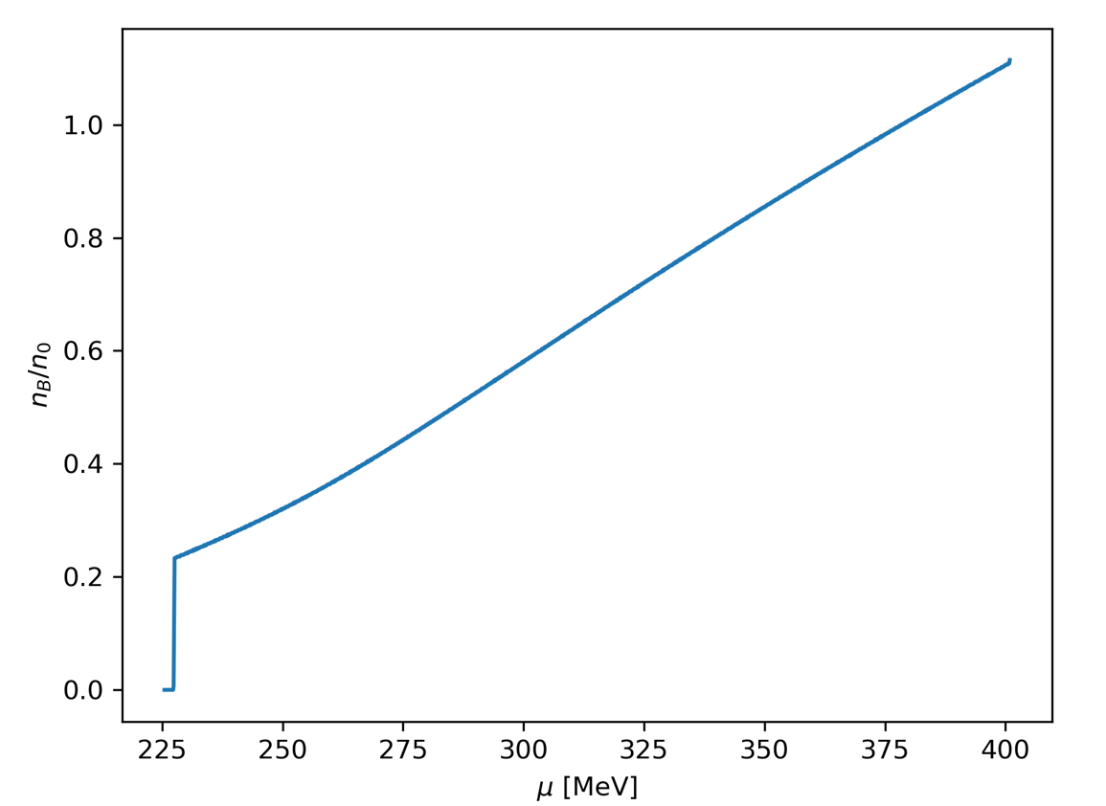

Slide 26
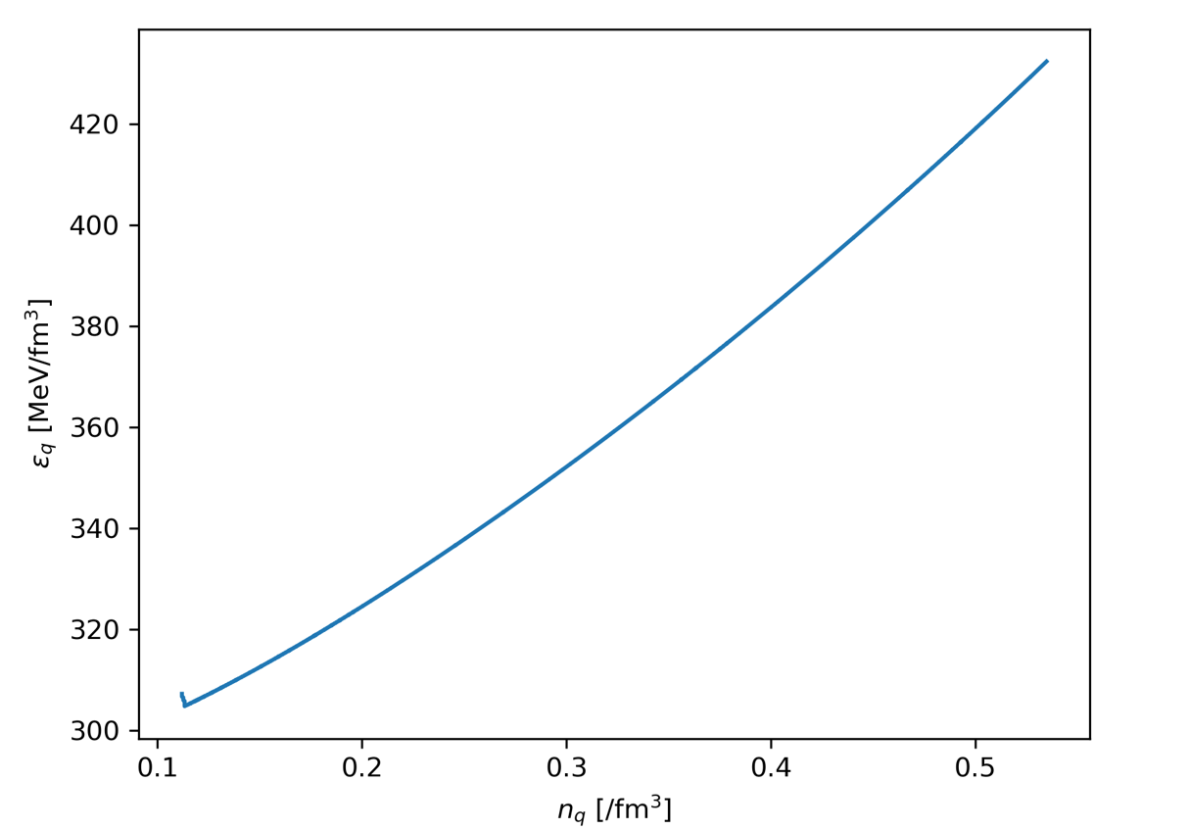
“Quark droplets,” Qiang Zhao, Young Min Kim et al, “in progress”

Slide 27
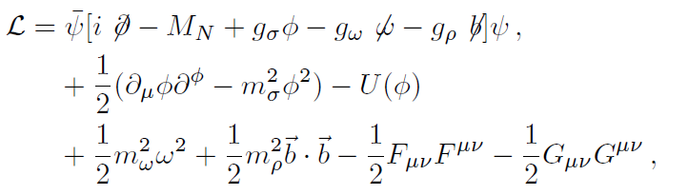

Walecka model : widely used in MFA for dense matter, nuclear structure, etc.
Here, the sigma is not a chiral partner of the pion.

Slide 28
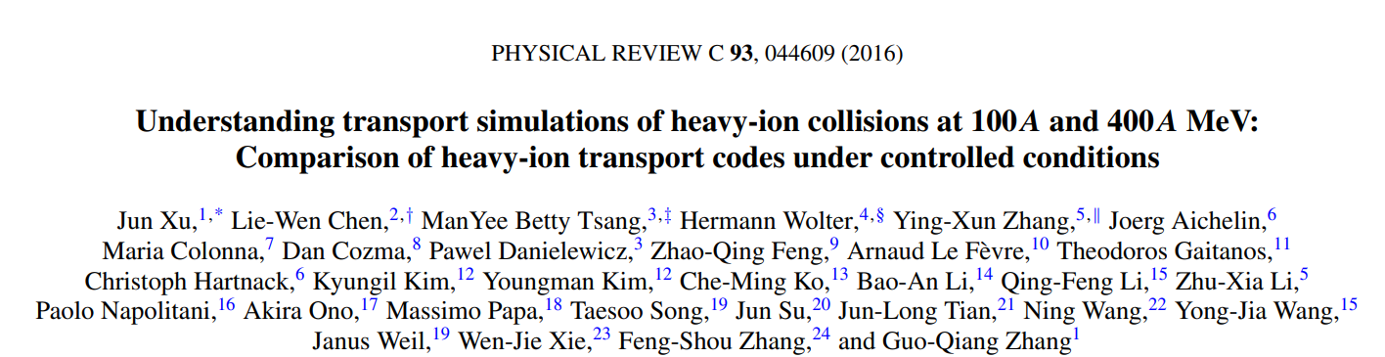
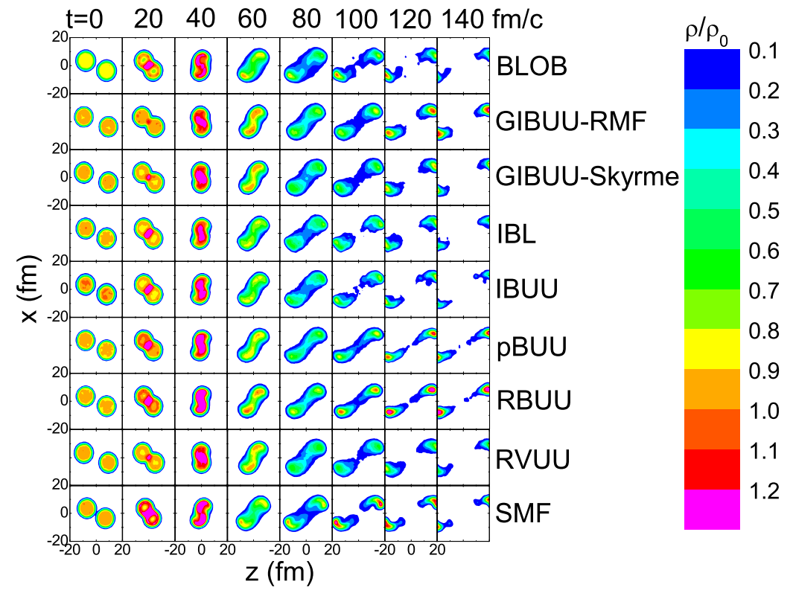

Slide 29
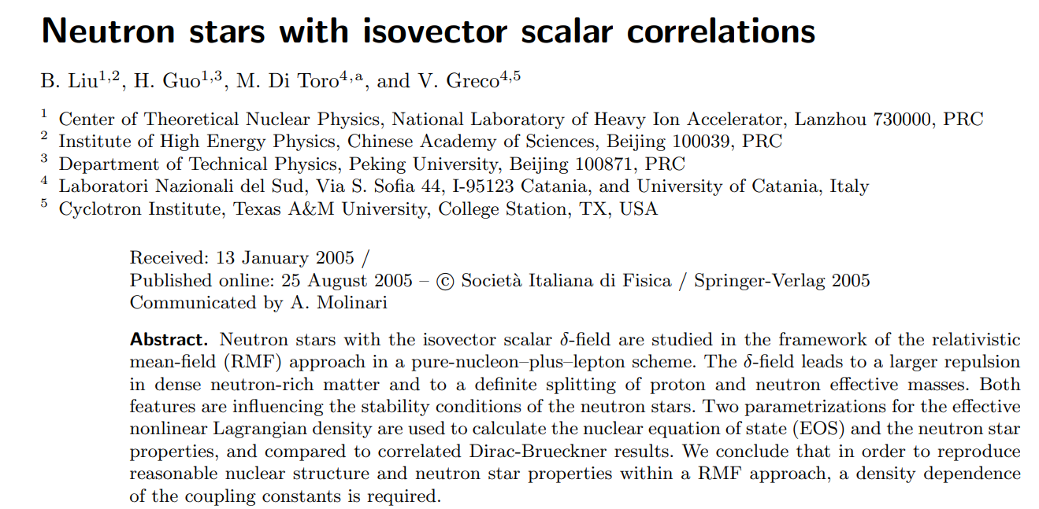

Slide 30
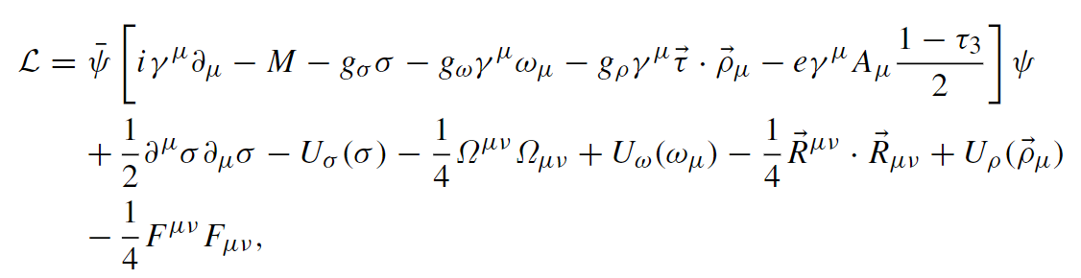
Meng J, Toki H, Zhou S G, et al. Relativistic continuum Hartree-Bogoliubov theory for ground-state properties of exotic nuclei. Prog Part Nucl Phys, 2006, 57: 470–563

Slide 31
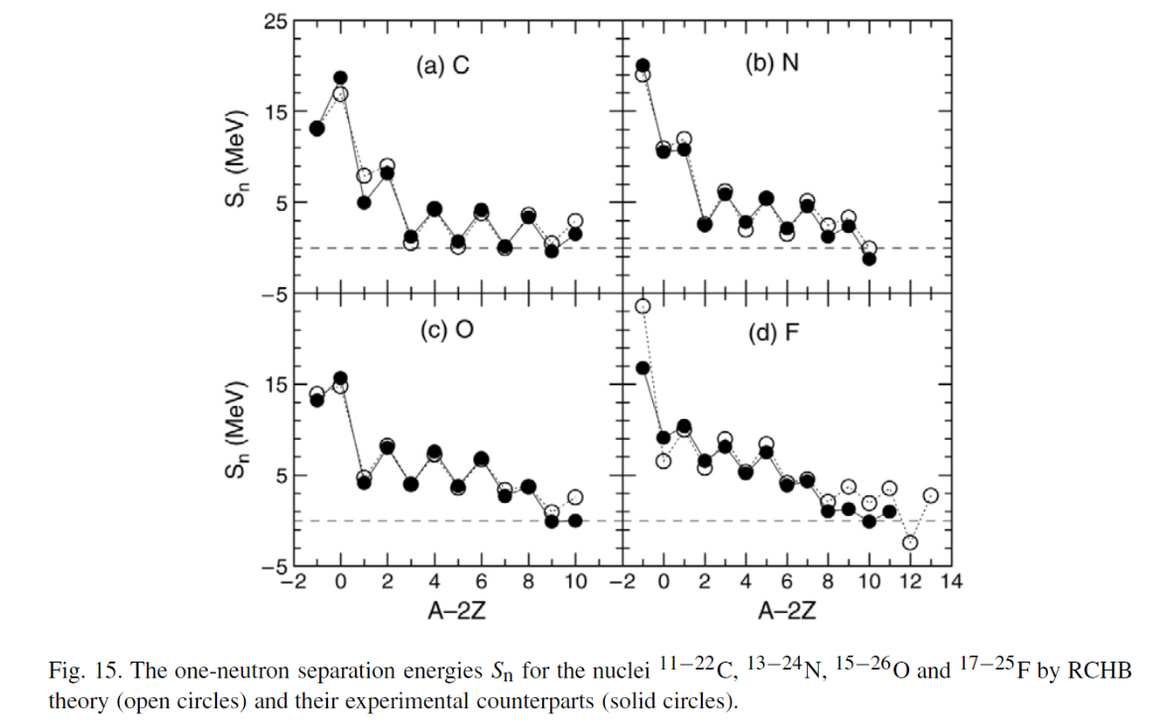

Slide 32
We use the Walecka model since there are a lot of results from the MFA to be compared with our FRG results.
Downside is that we have more parameters compared to models with chiral symmetry.

Slide 33
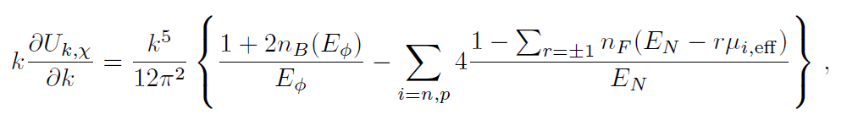

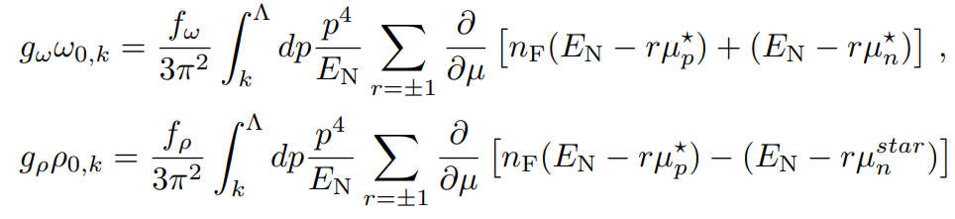


Slide 34


Y. M. Kim, C.-H. Lee, S. Jeon and YK, in progress

Slide 35
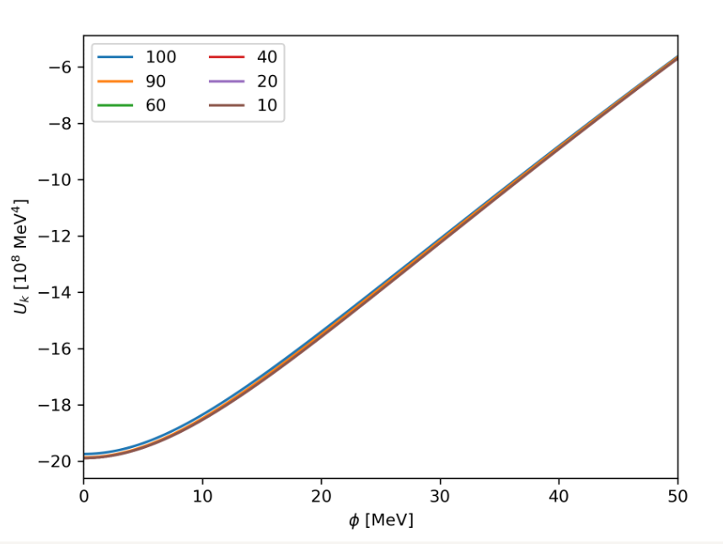
Very preliminary
T=5 MeV, mu=900 MeV
Y. M. Kim, C.-H. Lee, S. Jeon and YK, in progress

Slide 36
Summary
The FRG method has been widely used in dense nuclear matter to deal with fluctuations. (also in various fields in physics such as electroweak phase transitions, ultra-cold atoms, etc. )
We have developed a numerical code to solve the FRG equations in a linear sigma model with quarks and extensively calculated quark matter properties to study quark droplets.
Neutron stars will be studied in our framework.
The effect of the fluctuations on spherical nuclei will be addressed by combing FRG and DFT.
The effect of the fluctuations on heavy ion collisions will be also investigated by combing FRG and DJBUU (DaeJeon Boltzmann-Uehling-Uhlenbeck) transport code.

