Slide 1
In memory of Yongseok
Byung-Yoon Park
(chungnam National University)

Slide 2
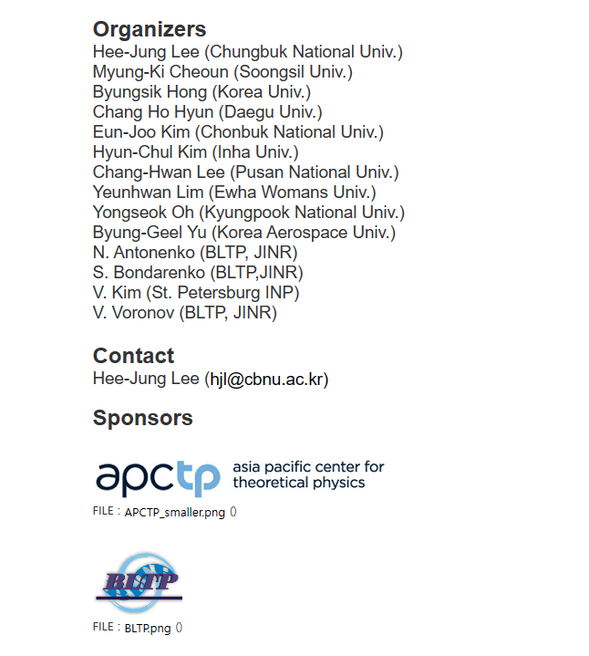




Slide 3
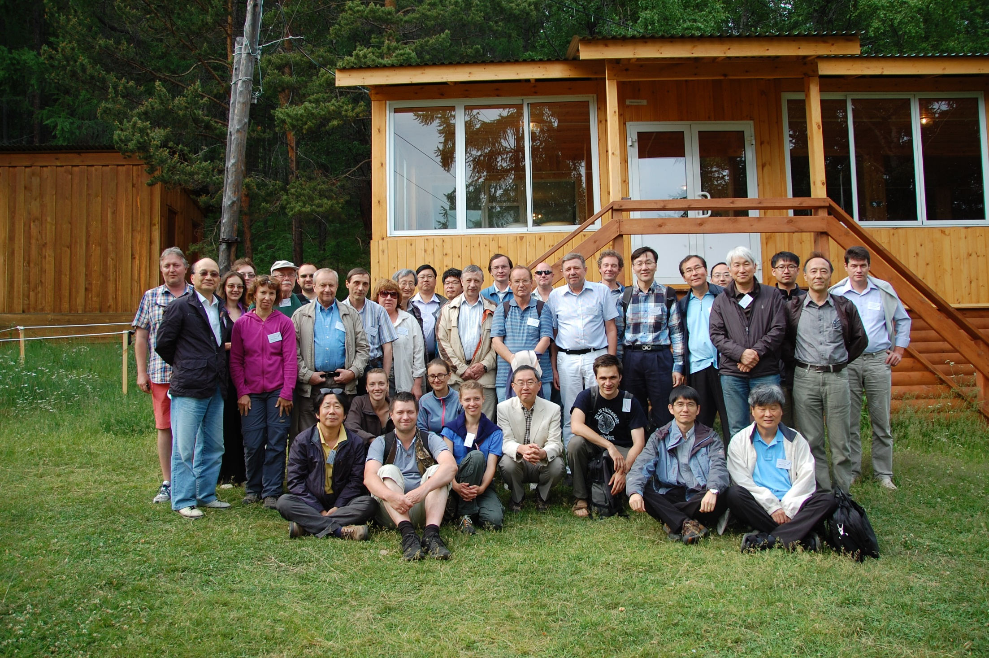
2013, Bolshiye Koty

Slide 4
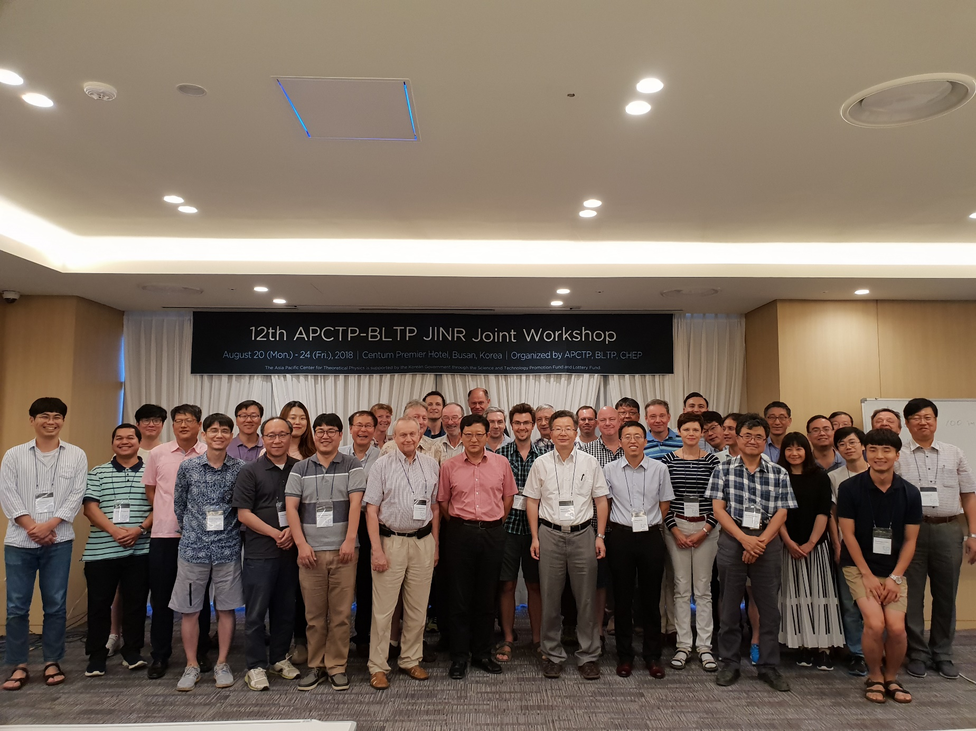
2018 at Busan

Slide 5
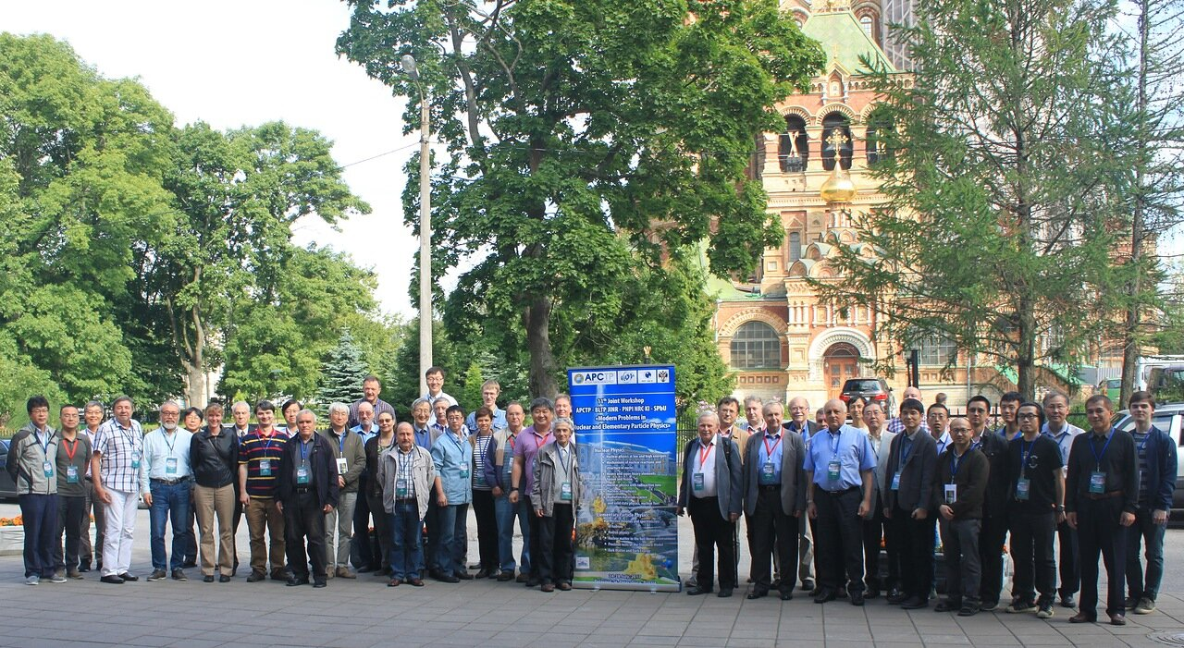
2017 Petersburg

Slide 6
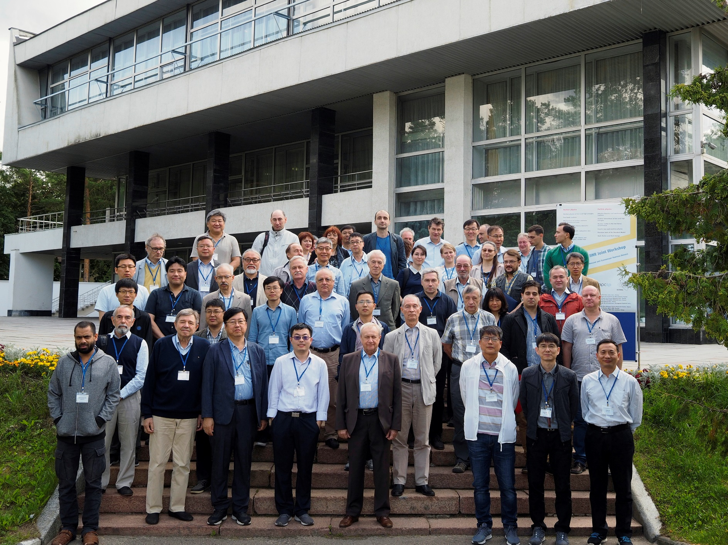
2019 at Dubna

Slide 7
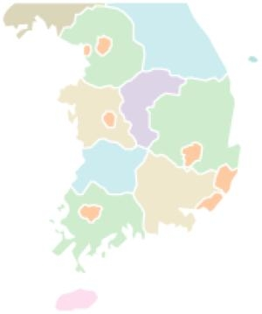
He was born in 1965
You
are
HERE
Mokpo

Slide 8
Seoul National University (1983-1993)
Seoul National University
Department of Physics
Mokpo

Slide 9
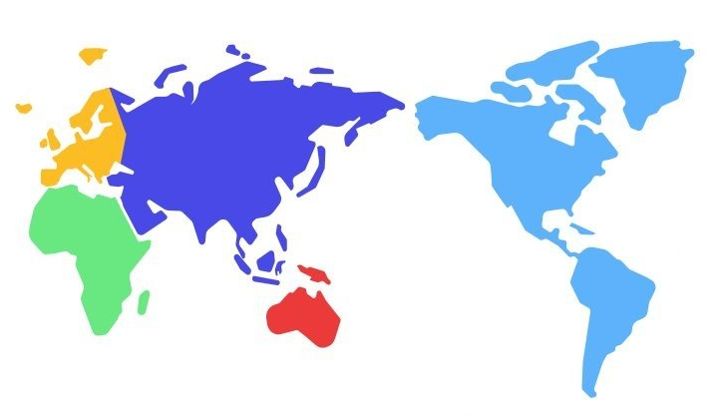
Post doc. & Visiting Scholar(1993-2010)
Technische
Universität
München
Yonsei University
Georgia University
Taiwan
National
University
Texas A & M

Slide 10
Kyungpook Nat’l University (2010- )
Seoul National University
Department of Physics
Kyungpook National University
Department of Physics
Mokpo

Slide 11
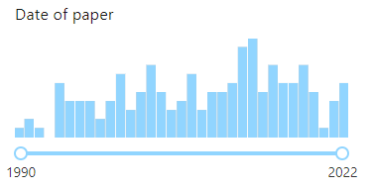
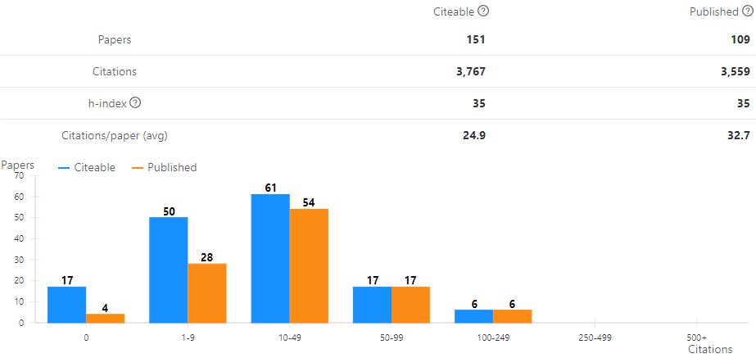
Research Works
159 research works

Slide 12
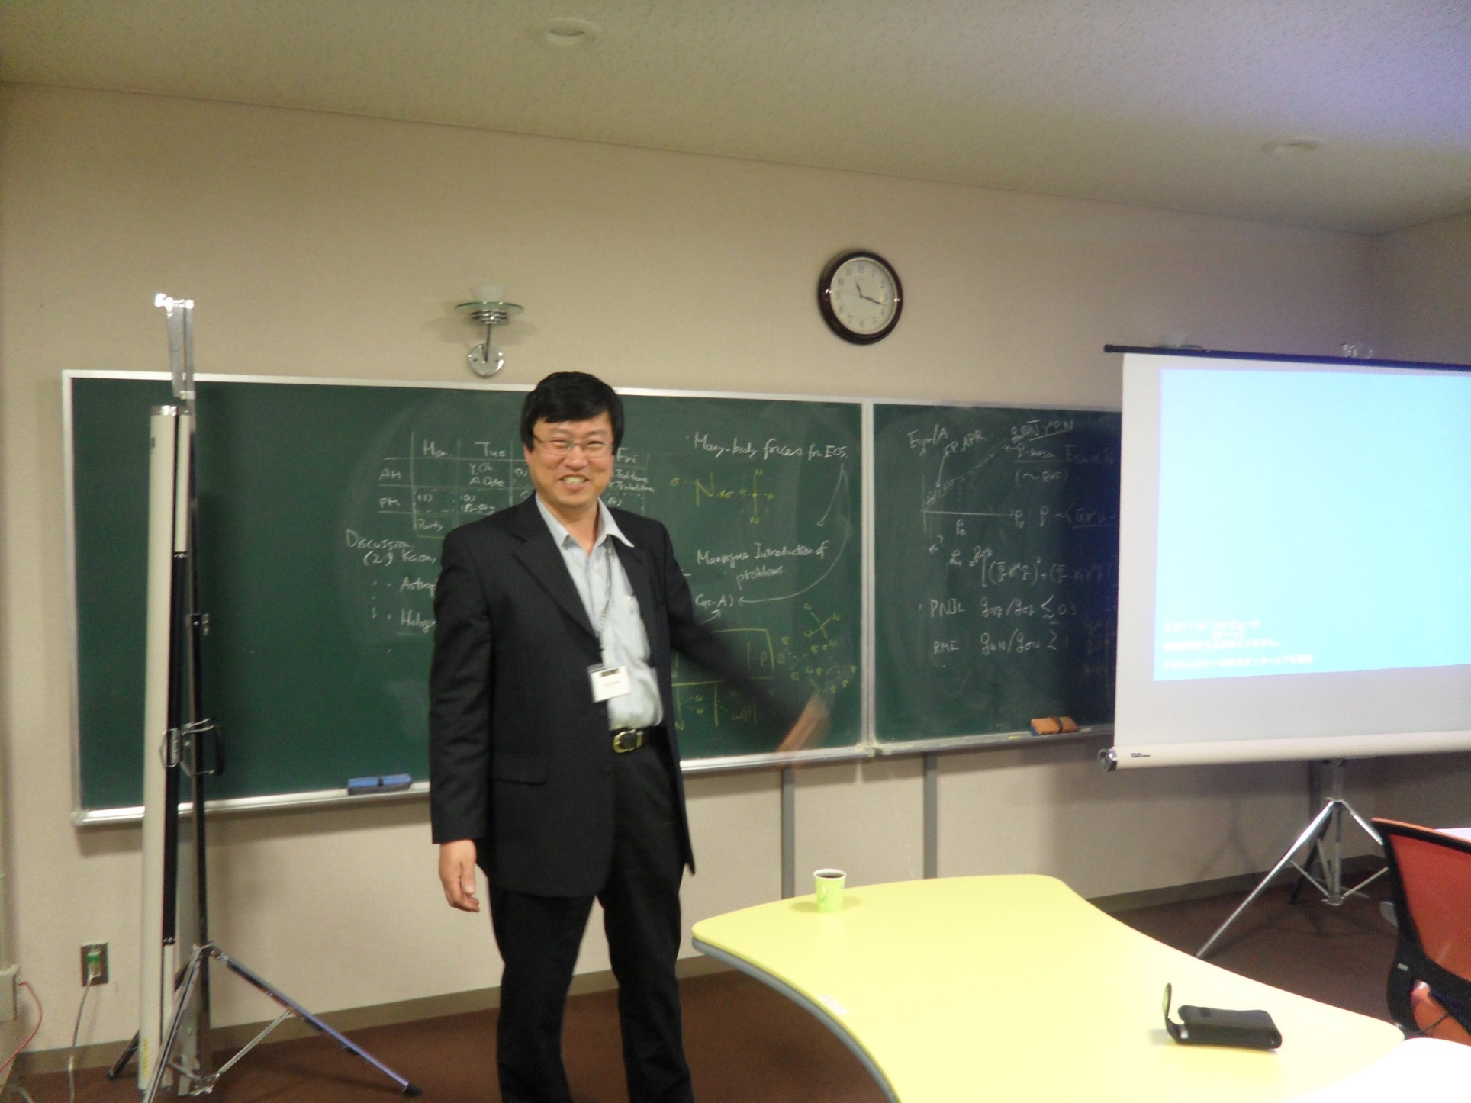

Slide 13
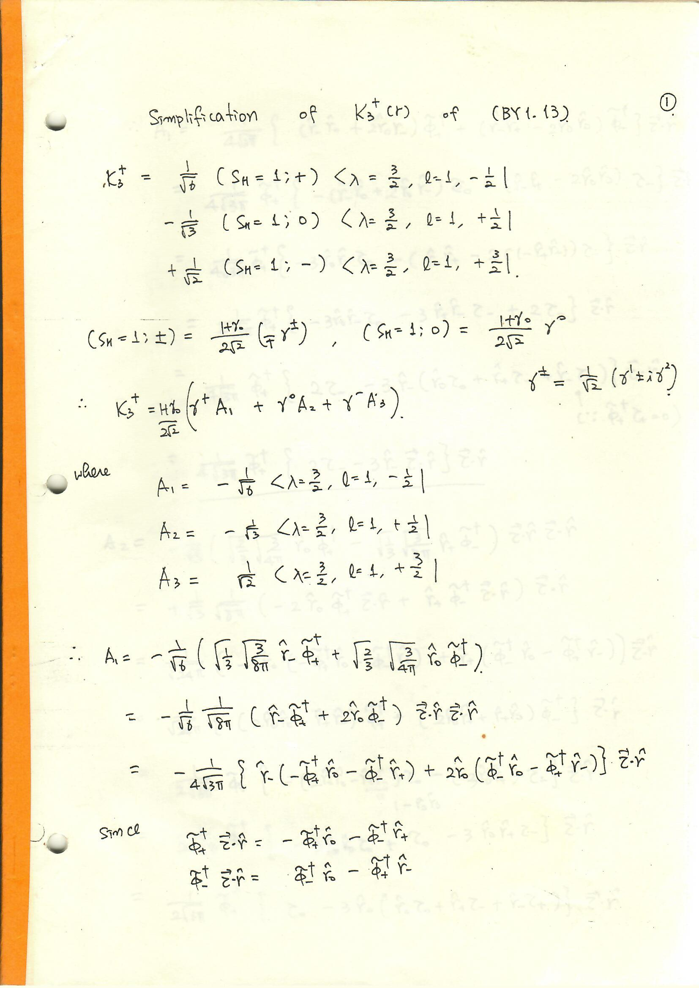
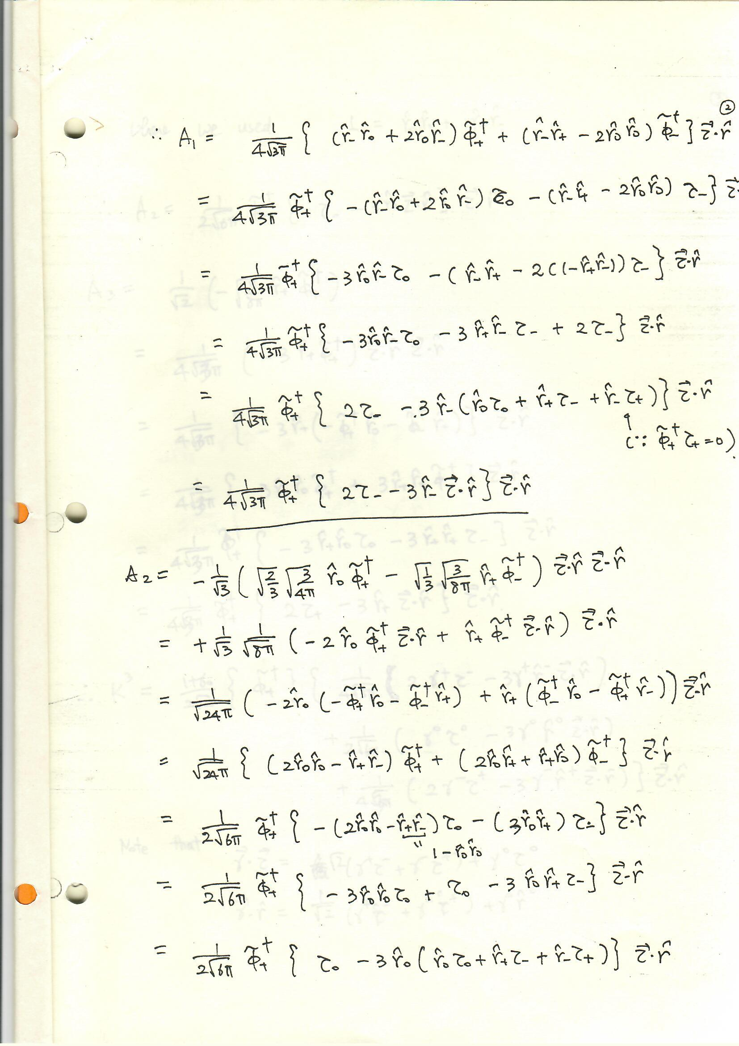

Slide 14
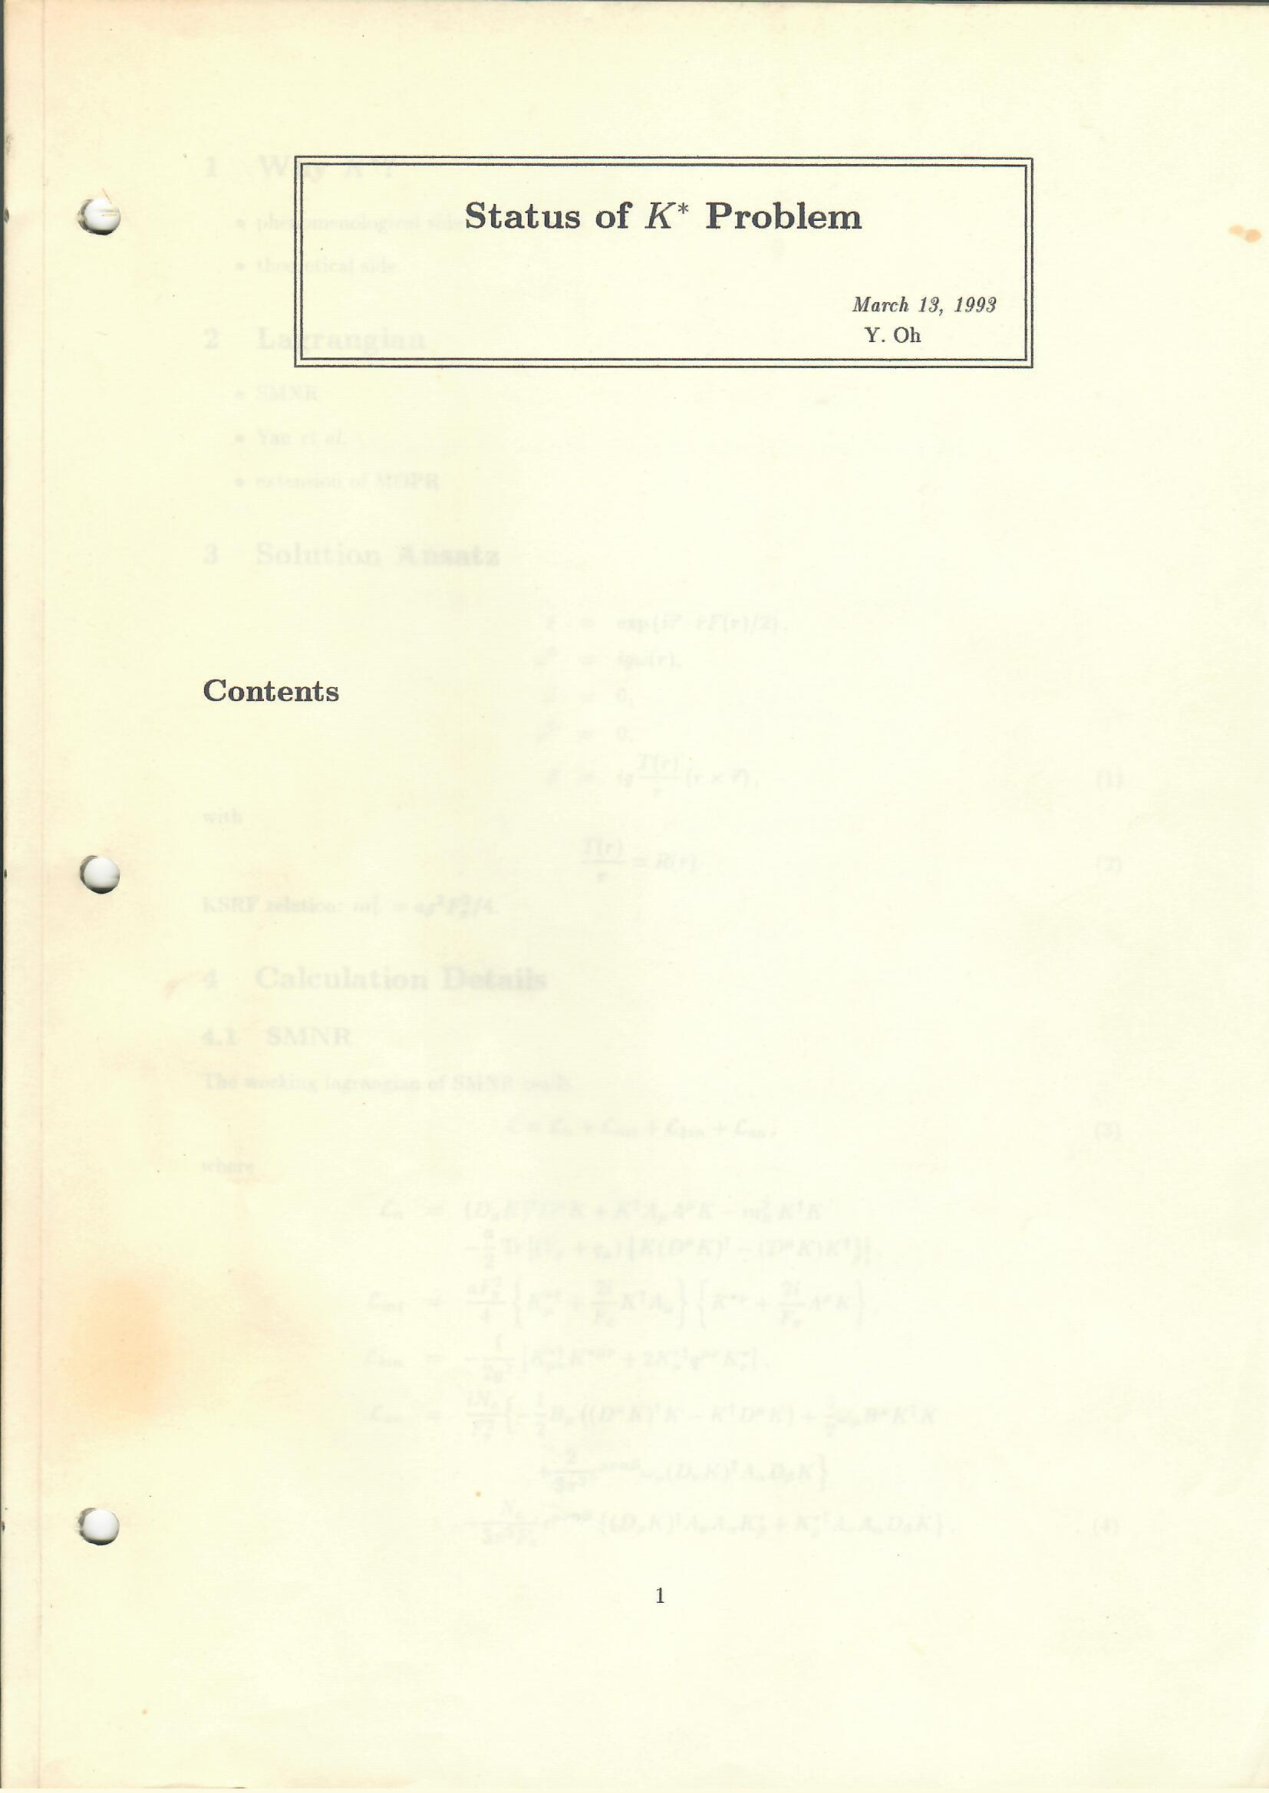
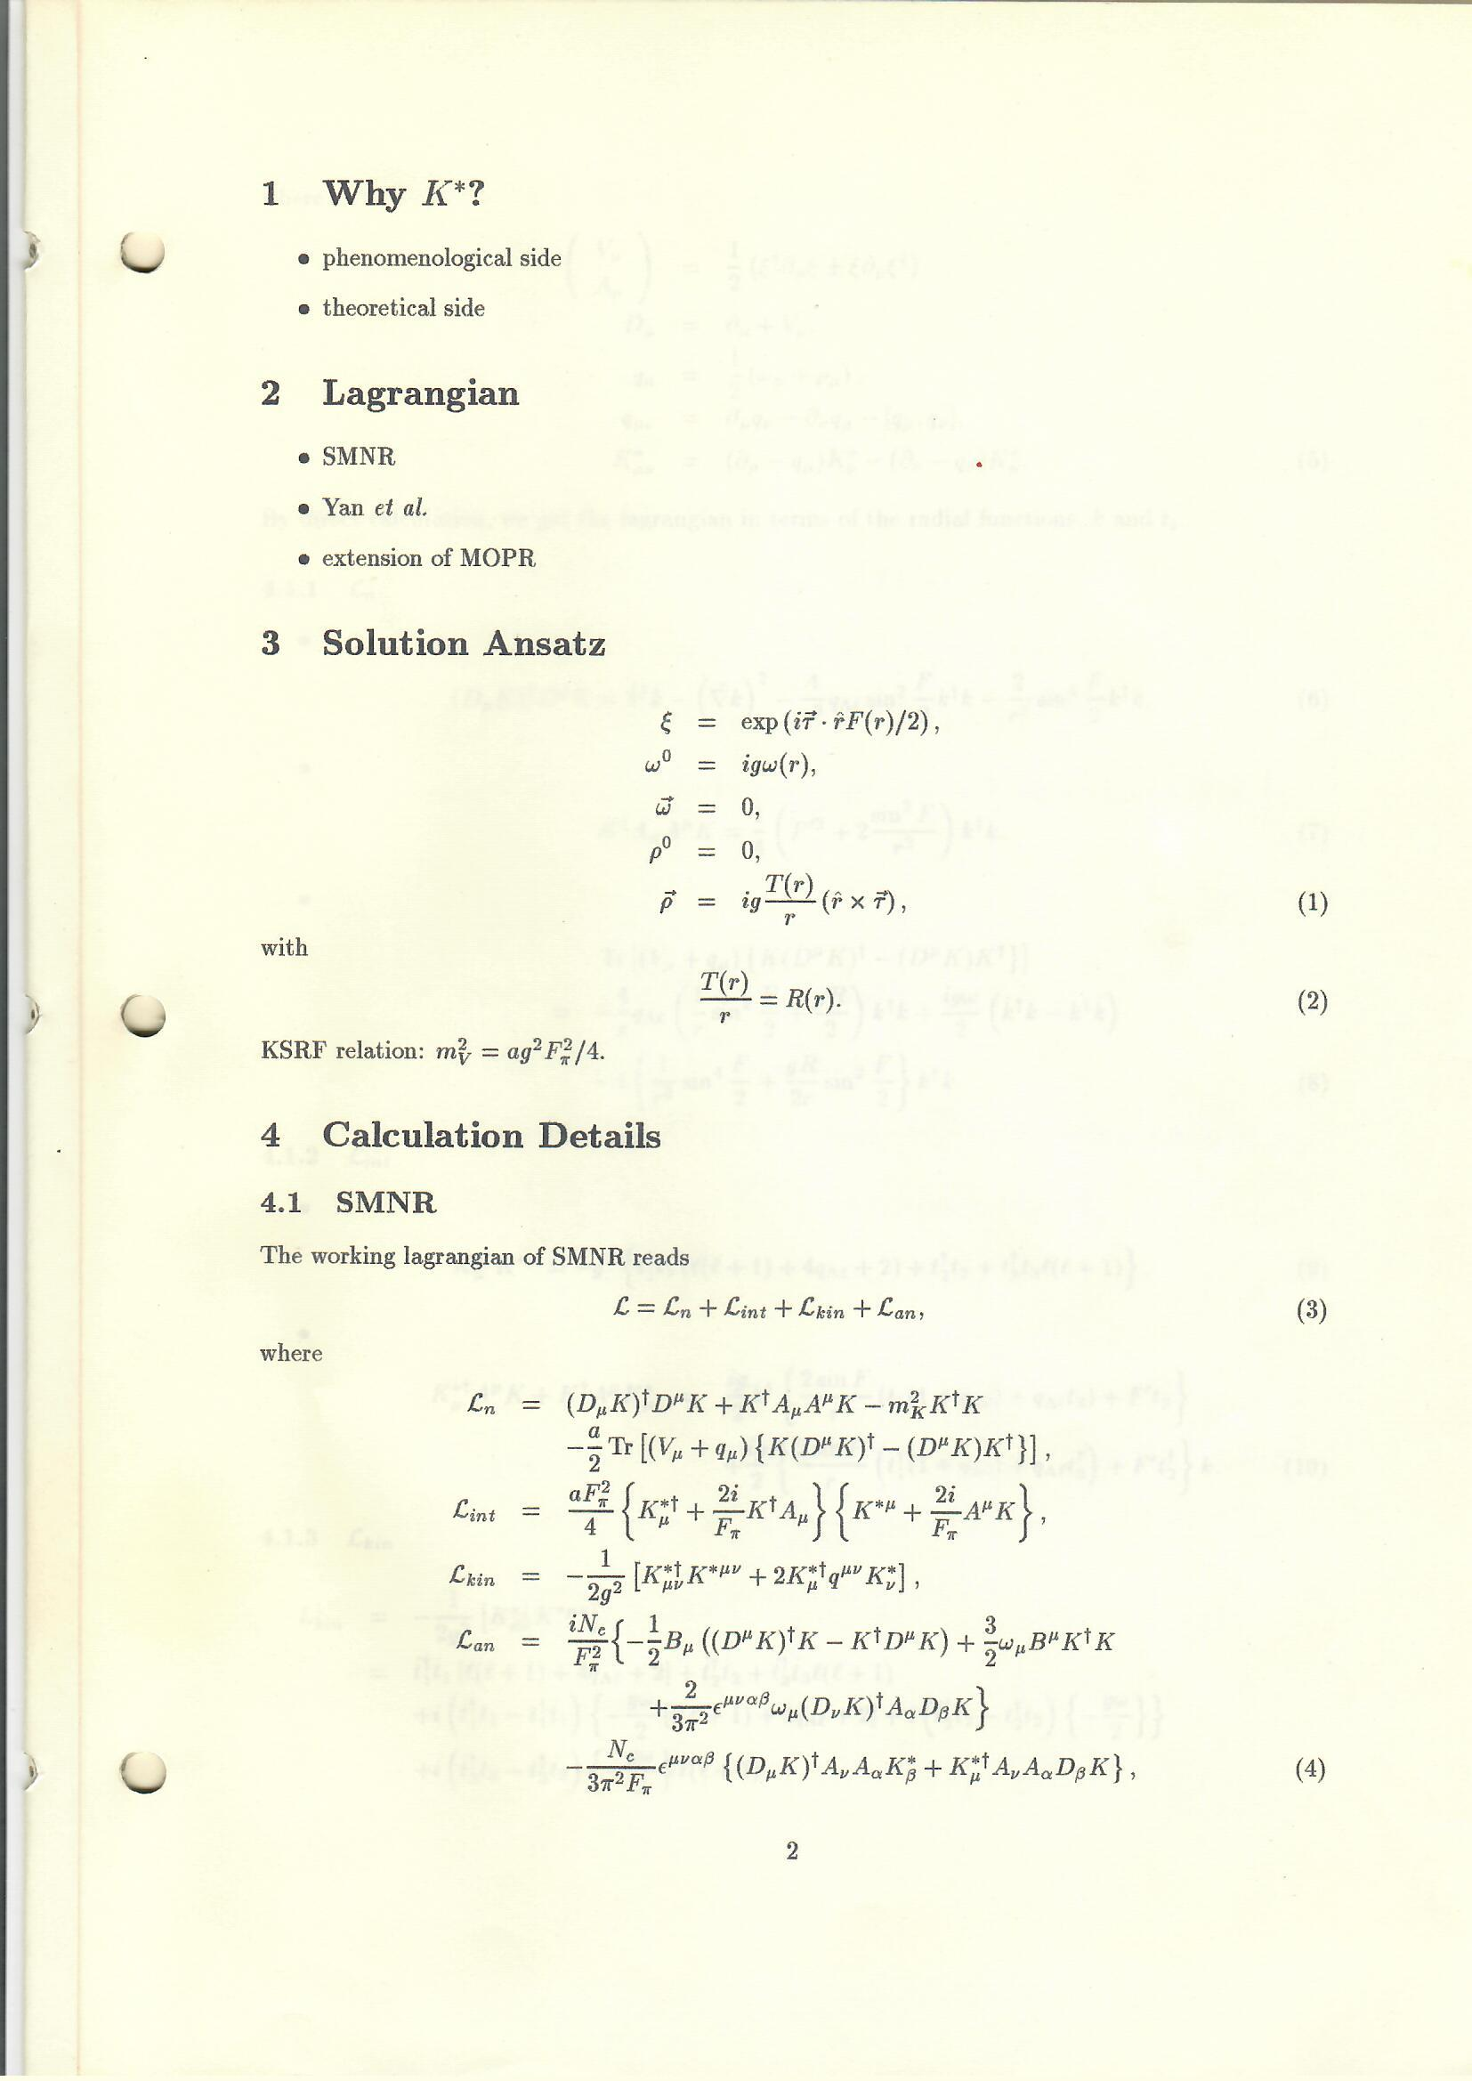
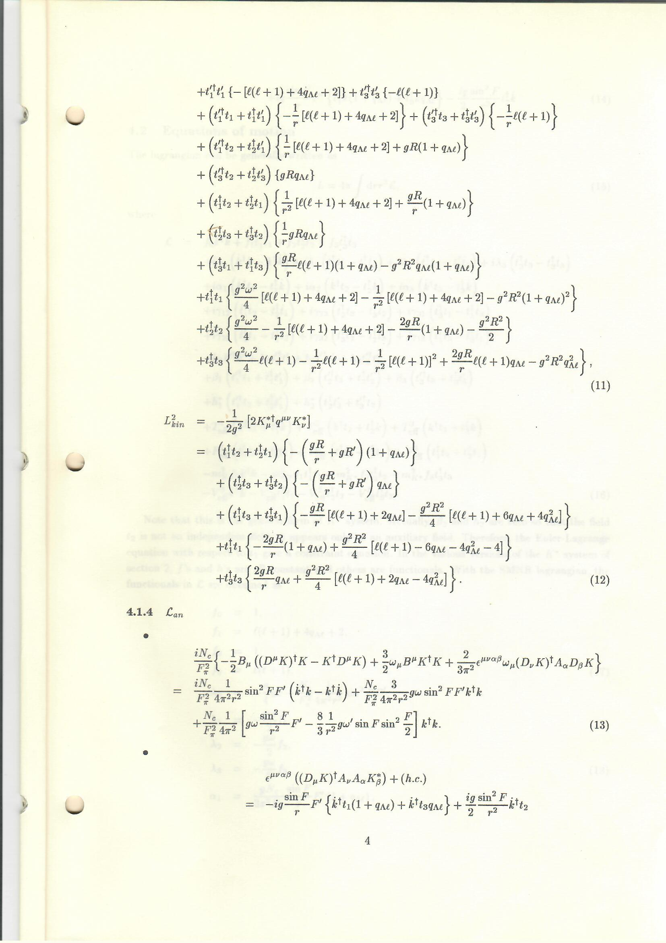

Slide 15
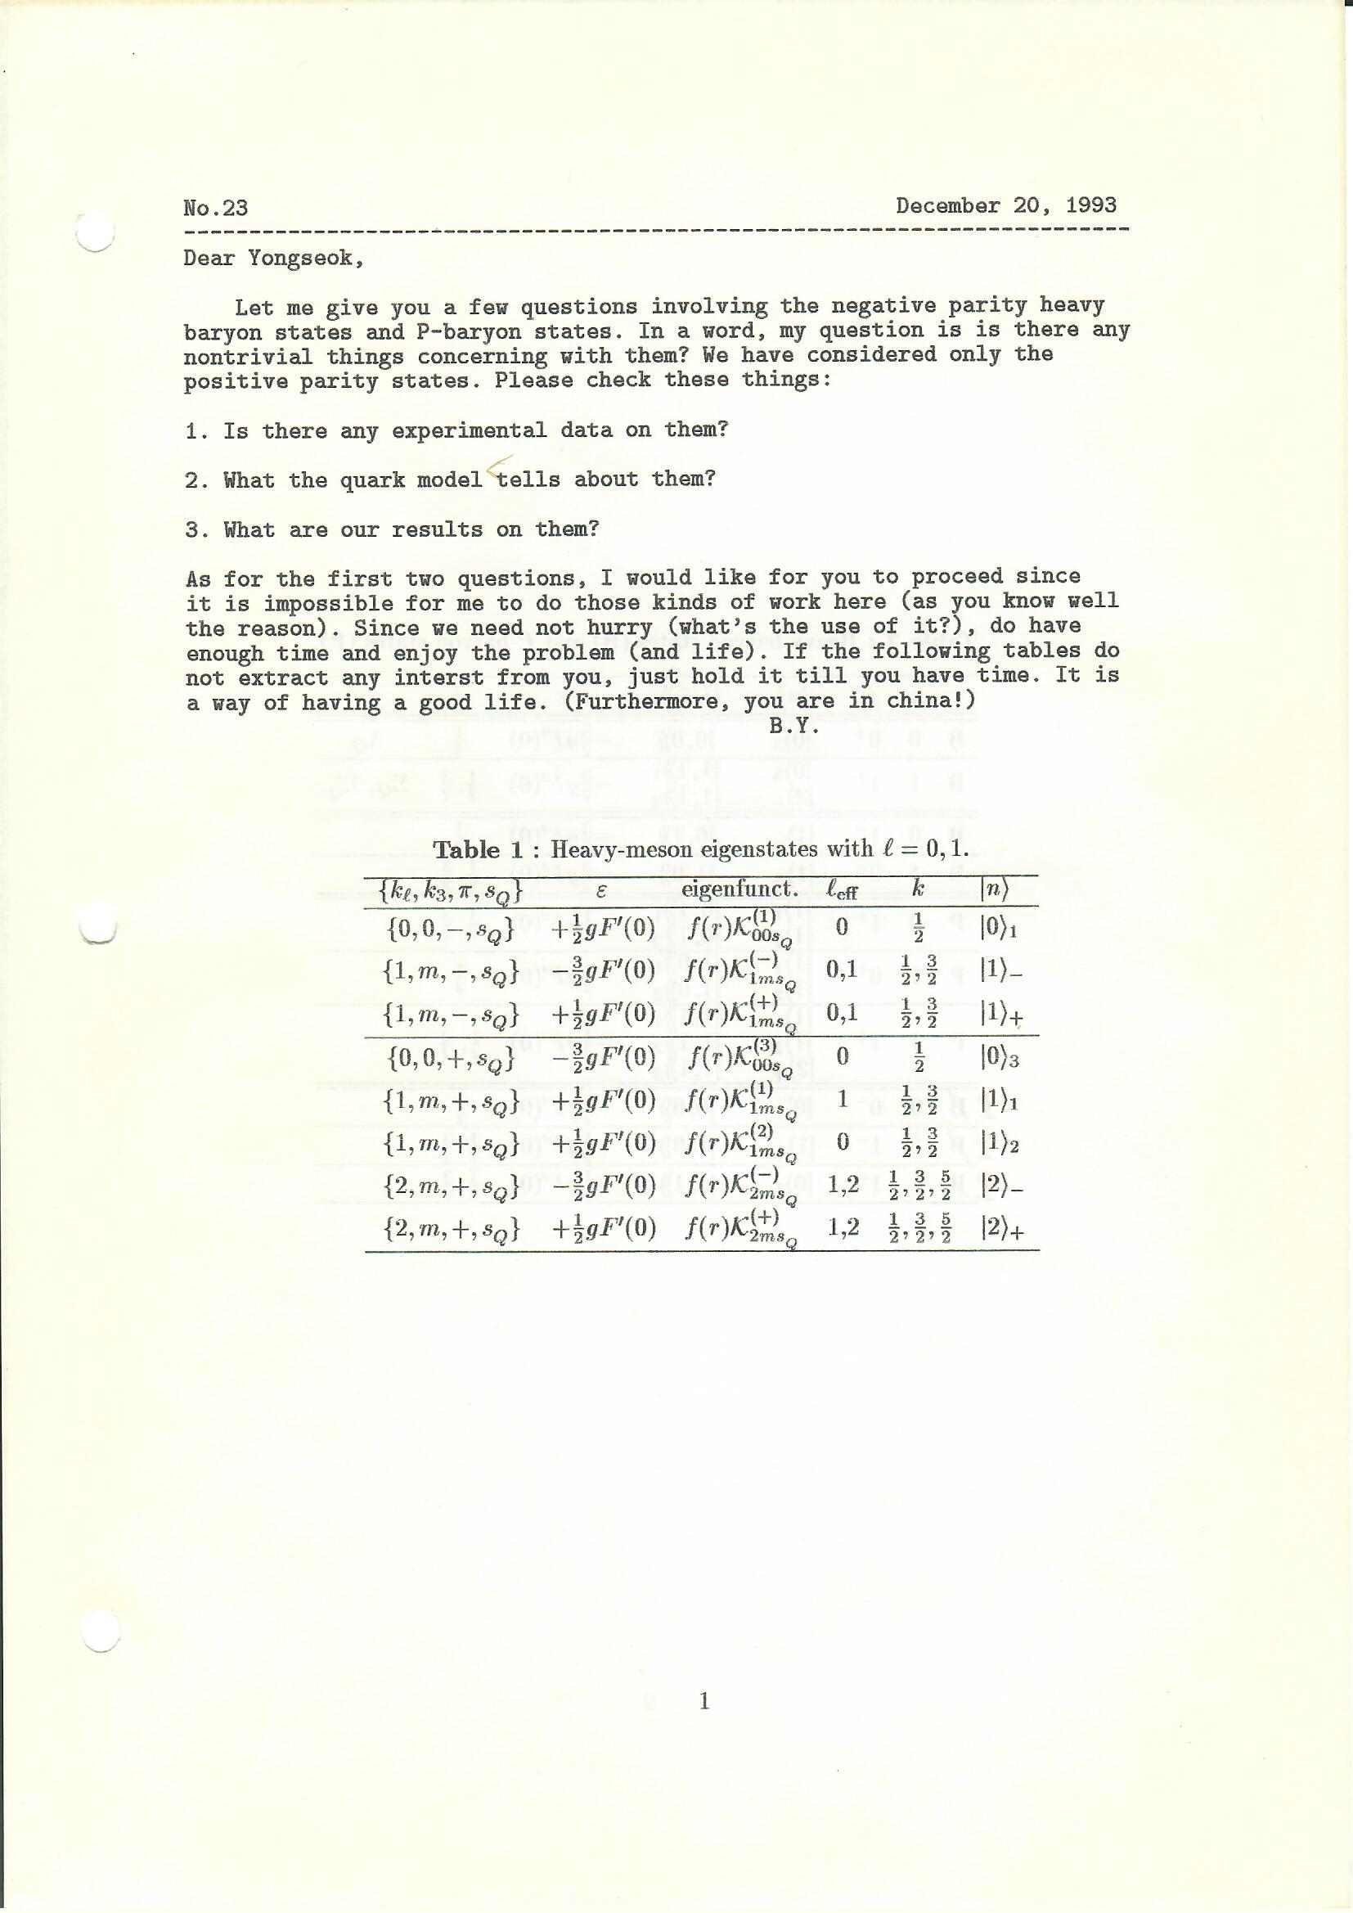
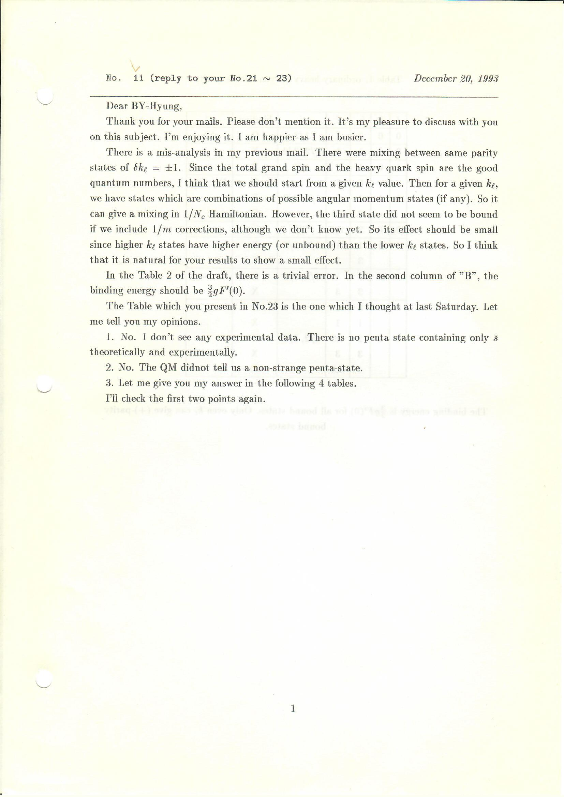

Slide 16
8th Asia-Pacific Conference on Few-Body Problems in Physics, 2021.05.01. ~ 05.05., Kanazawa, Japan
APCTP Focus Program in Nuclear Physics 2021. Hadron properties in a nuclear medium from the quark and gluon degrees of freedom, 2021.07.14. ~ 07.24., online.
2nd Precision Studies on QCD at Electron Ion Collider, 2021.07.19. ~ 07.23., Gyeongju.
KFCC brainstorming workshop: Research Trends with Future High-Energy and Nuclear Physics Facilities, 2021.11.12. ~ 11.14., Gyeongju.
LIGHT CONE 2020/2021: Physics of Hadrons on the Light Front(LC 2021), 2021.11.9. ~ 12.04., Jeju.
APCTP Workshop on Nuclear Physics: Physics of Excited Hadrons in the Present and Future Facilities, 2022.07.11. ~ 07.16., Jeju

Slide 17
APCTP Focus Program in Nuclear Physics 2022: Hadron Physics Opportunities with JLab Energy and Luminosity Upgrade, 2022.07.18. ~ 07.23., Pohang
2nd Joint Canada-APCTP Meeting on Nuclear Theory, 2022.08.08. ~ 08.12., TRIUMF, Vancouver, Canada
Workshop on Exotics and Exotic Phenomena in Heavy Ion Collisions, 2022.09.29. ~ 10.01, Pohang
Reimei Workshop: Polarization Phenomena and Lorentz Symmetry Violation in Dense Matter, 2022.10.06.~10.08, Seoul
APCTP Workshop on the Physics of Electron Ion Collider, 2022.11.02.~11.04, Incheon
Baryons 2022: International Conference on the Structure of Baryons, 2022.11.07.~11.11, Sevilla, Spain

Slide 18
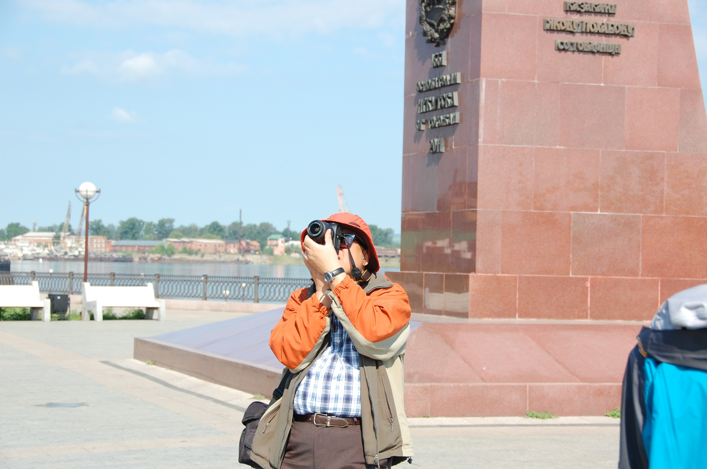

Slide 19
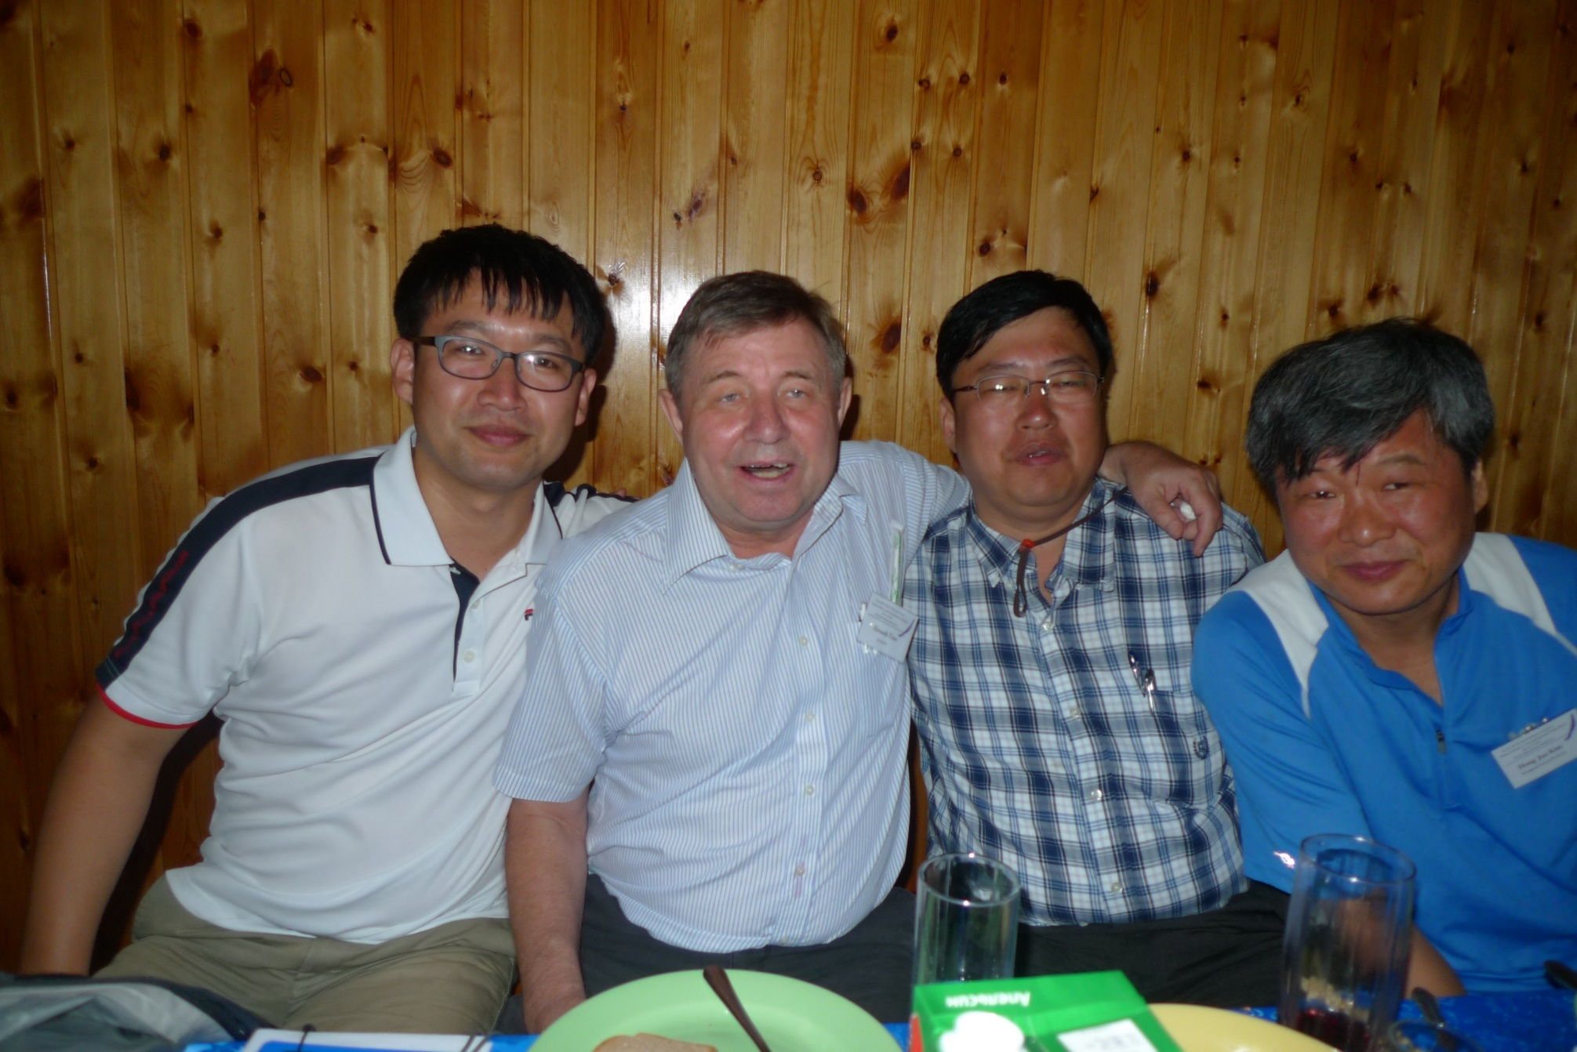

Slide 20
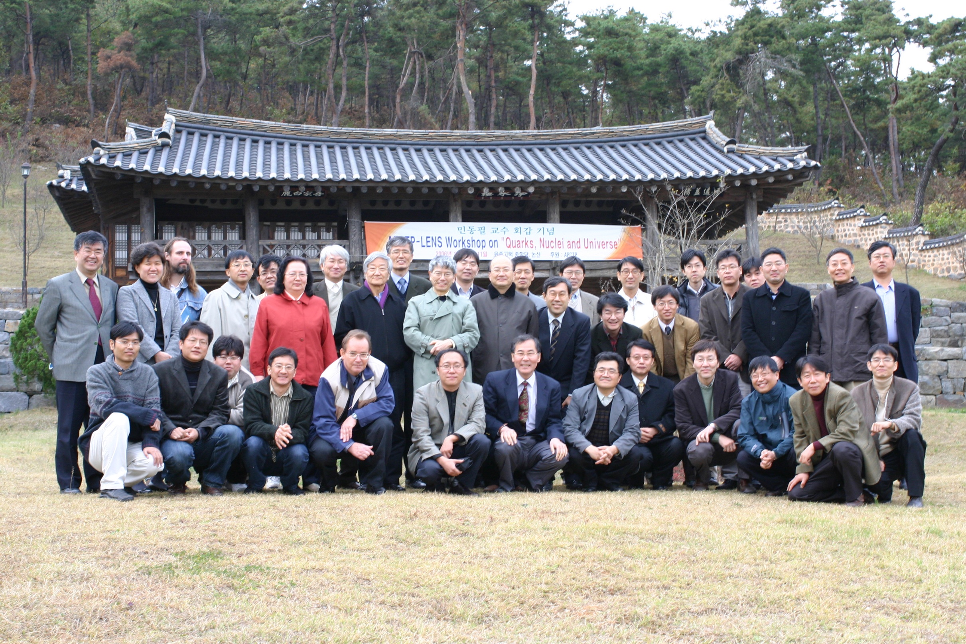

Slide 21
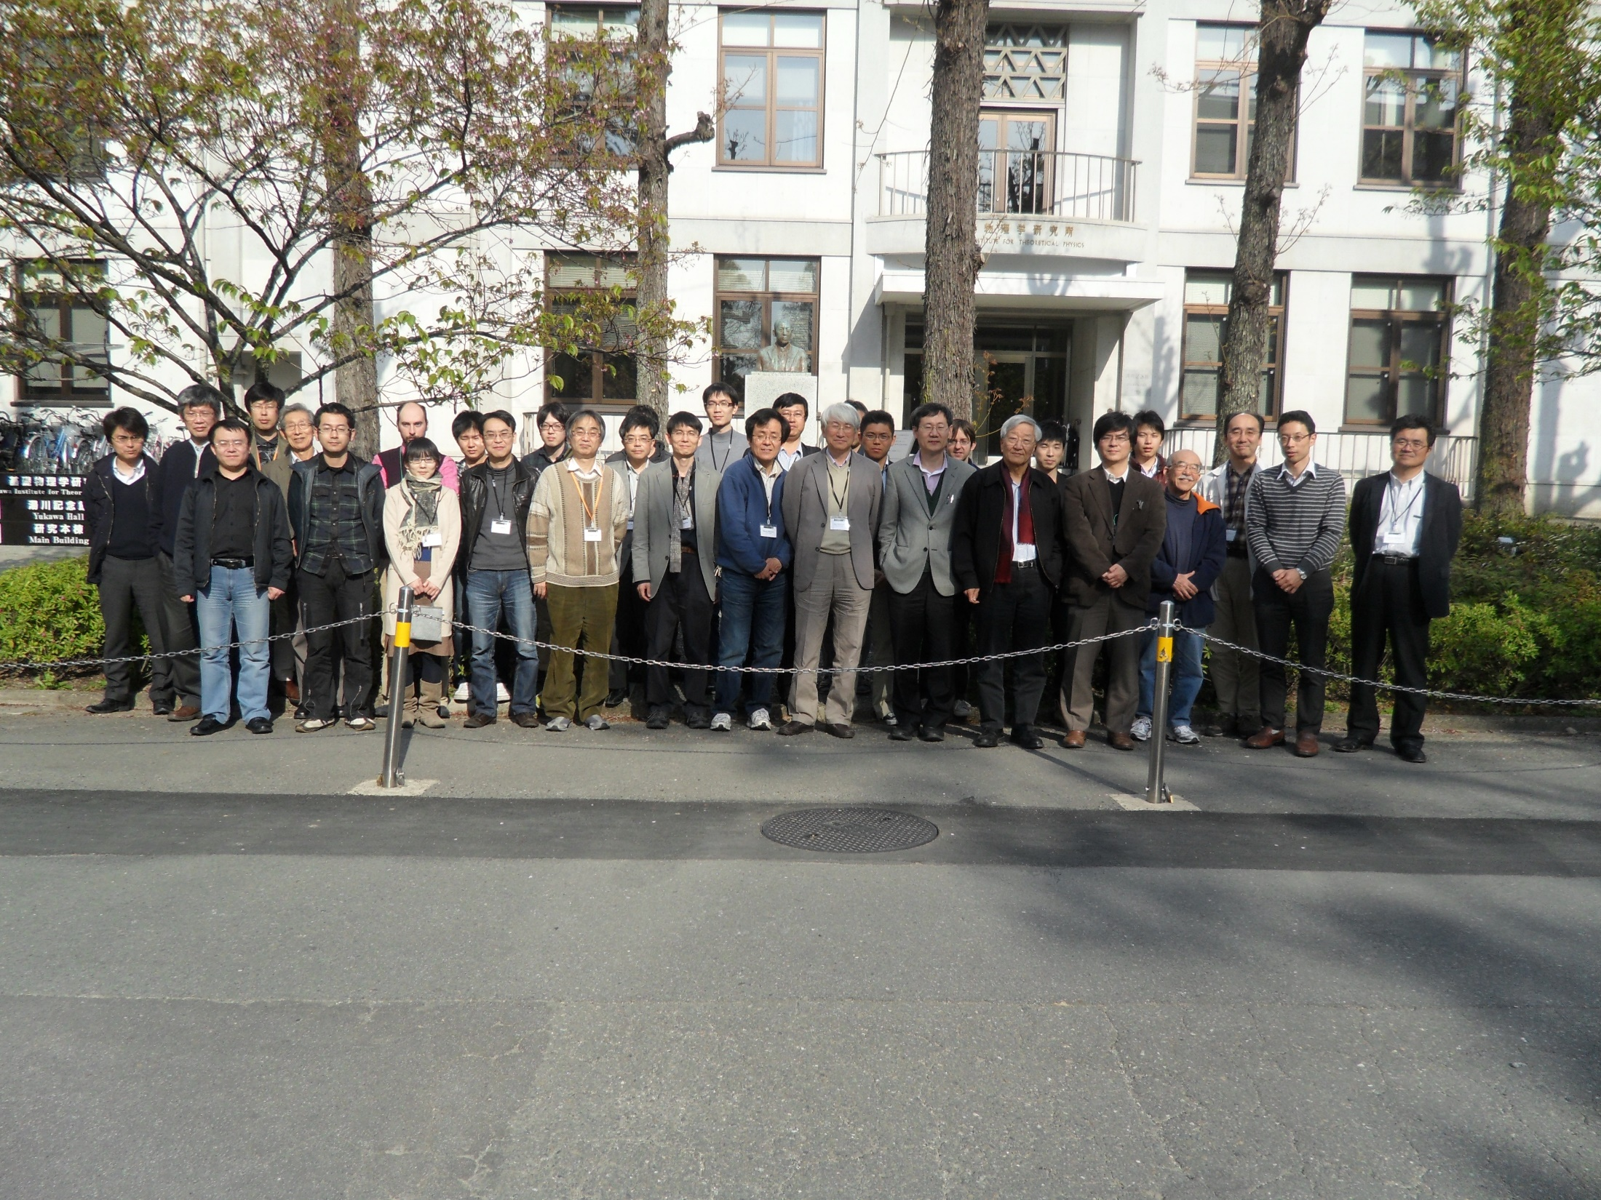

Slide 22
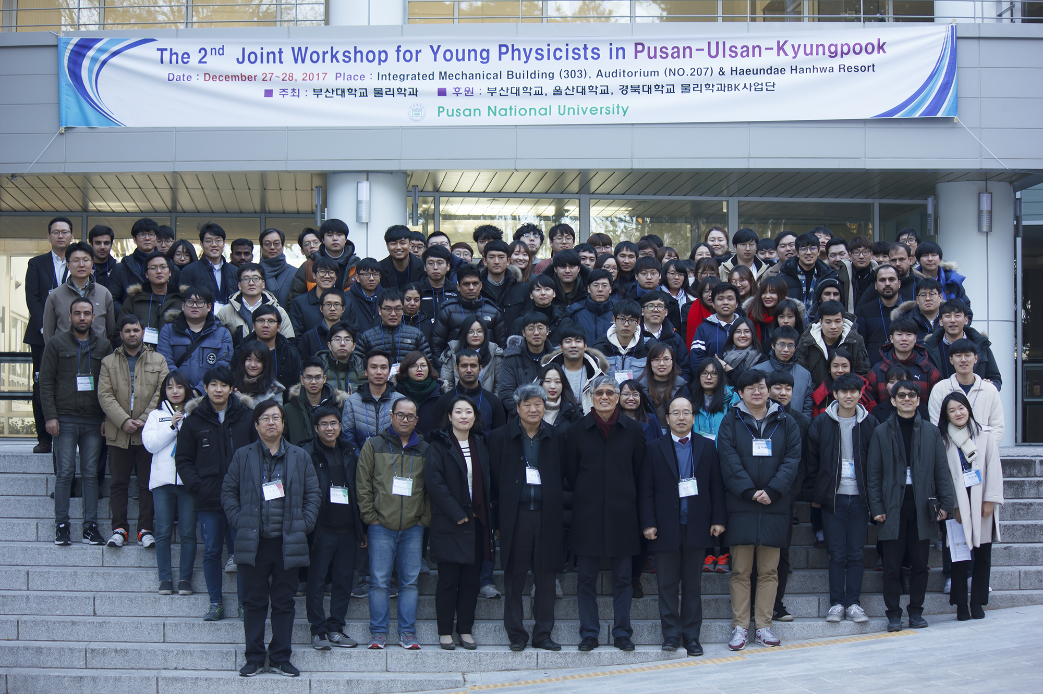

Slide 23

Чем люди живы
Лев Николаевич Толстой
What dwells in man?
What is not given to man?
What do men live by?

Slide 24
May he rest in Peace!

