Slide 1

Introducing International Workshop
for Exotic & Heavy hadrons
Hyun-Chul Kim
Department of Physics, Inha University
Incheon, Korea
Organizers Meeting@APCTP, Feb. 10, 2026

Slide 2
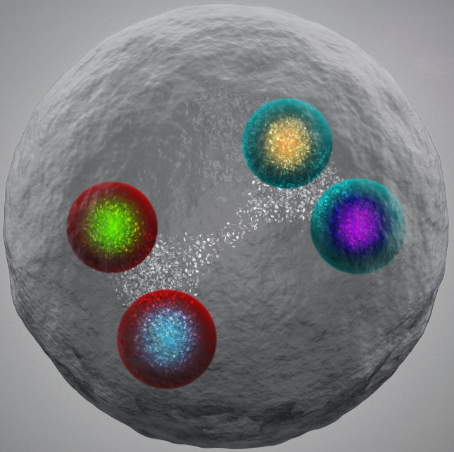
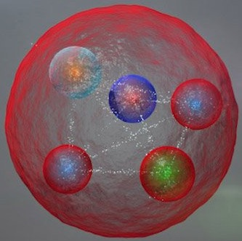
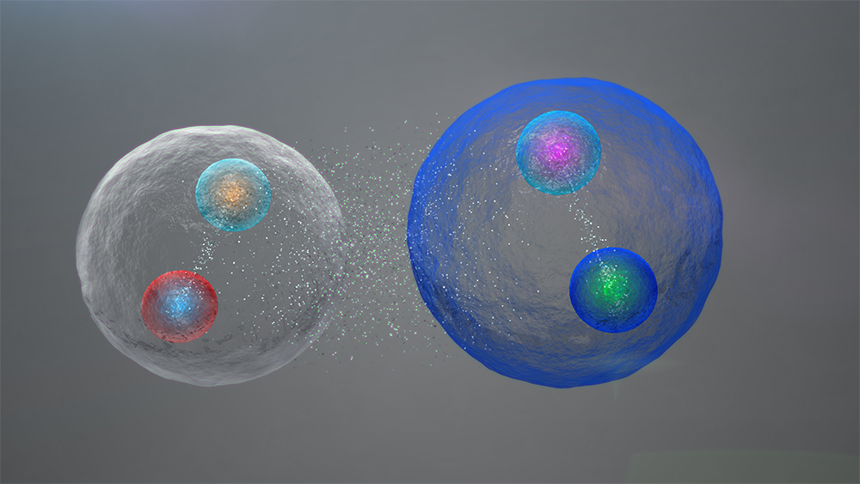
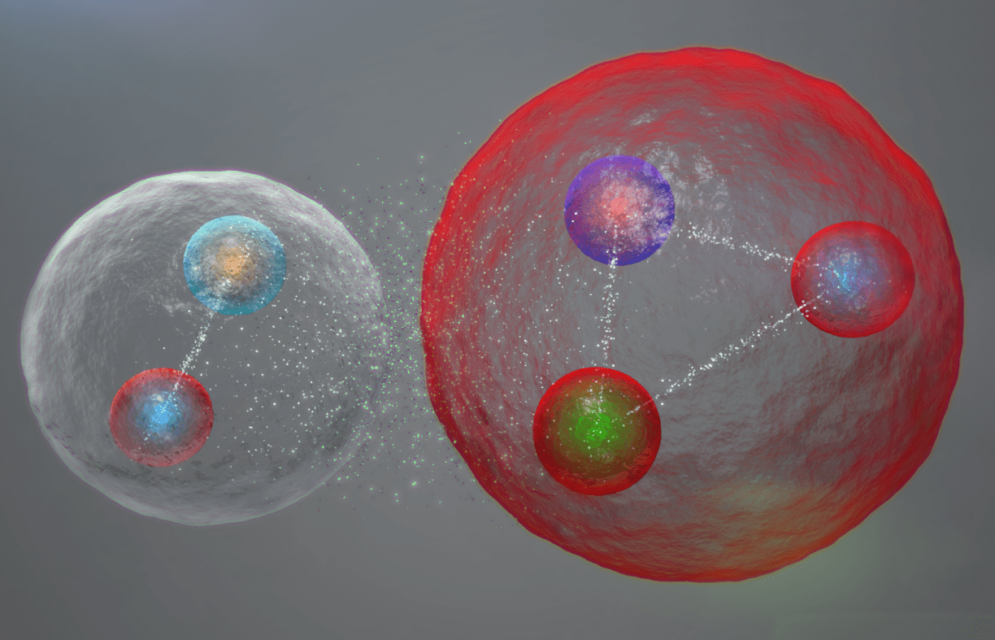
Exotic Hadrons (별난 강입자)
Origin of matter
Understanding of the strong interaction

Slide 3
International Workshop on Exotic & Heavy Hadrons
Title: New Perspectives on exotic and heavy hadrons
Dates: August 25, 2026 - August 28, 2026 (Tentative)
Venue: Inha University, Incheon, Korea
Financial support: APCTP and NRF
Total Budget: 15,000,000KRW including 12,500,000KRW (personal grants through NRF)
2,500,000KRW (APCTP)
Participants: 30-40 (International participants) + 20-30 (Local participants)

Slide 4
International Workshop on Exotic & Heavy Hadrons
Organizers
Jung-Keun Ahn (Korea U.)
Yongwoo Choi (Inha U.)
Samson Clymton (APCTP)
Ki-Hoon Hong (Inha U.)
Hee-Jin Kim (Inha U.)
Hyun-Chul Kim (Inha U., Chair)
Shin-Hyung Kim (Kyungpook Nat’l U.)
Seung-il Nam (Pukyung Nat’l U.)
Nurmukhammad Rakhimov (Inha U.)
Sunyoung Ryu (RCNP)
Hyeon-Dong Son (Inha U.)
Ulugbek Yakhshiev (Inha U.)
Ghil-Seok Yang (Hoseo U.)
We are grateful to the APCTP for the financial support.

