Slide 1
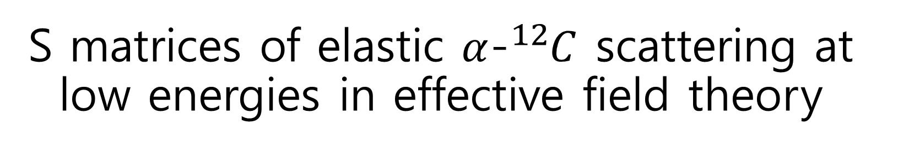
S matrices of elastic $α$-${}_{ }^{12}C$ scattering at low energies in effective field theory
Shung-Ichi Ando
Sunmoon University
APCTP-BLTP_JINR_Joint_WS@Pohang, Korea, July 9-14, 2023
PRC107, 045808 (2023), arXiv:2208.020404

Slide 2
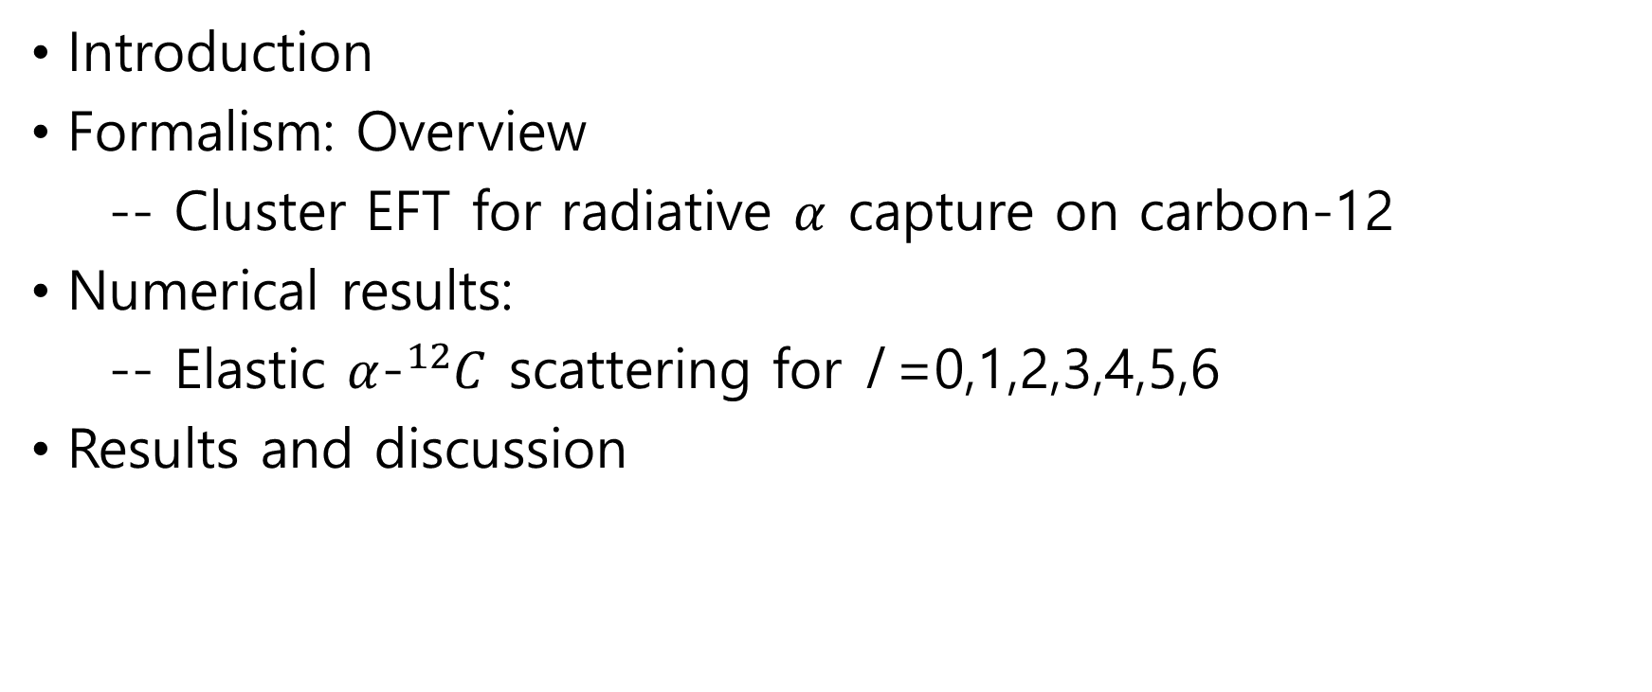
Outline of talk
Introduction
Formalism: Overview
-- Cluster EFT for radiative $α$ capture on carbon-12
Numerical results:
-- Elastic $α$-${}_{ }^{12}C$ scattering for l =0,1,2,3,4,5,6
Results and discussion

Slide 3
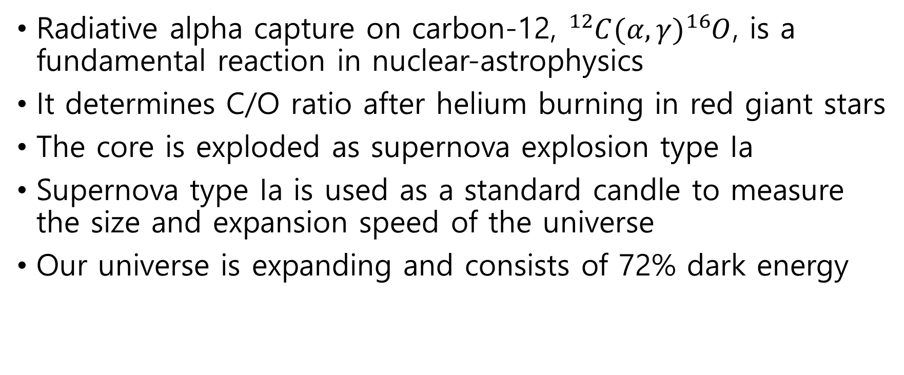
Introduction
Radiative alpha capture on carbon-12, ${}_{ }^{12}{C(α,γ){}_{ }^{16}O}$, is a fundamental reaction in nuclear-astrophysics
It determines C/O ratio after helium burning in red giant stars
The core is exploded as supernova explosion type Ia
Supernova type Ia is used as a standard candle to measure the size and expansion speed of the universe
Our universe is expanding and consists of 72% dark energy

Slide 4
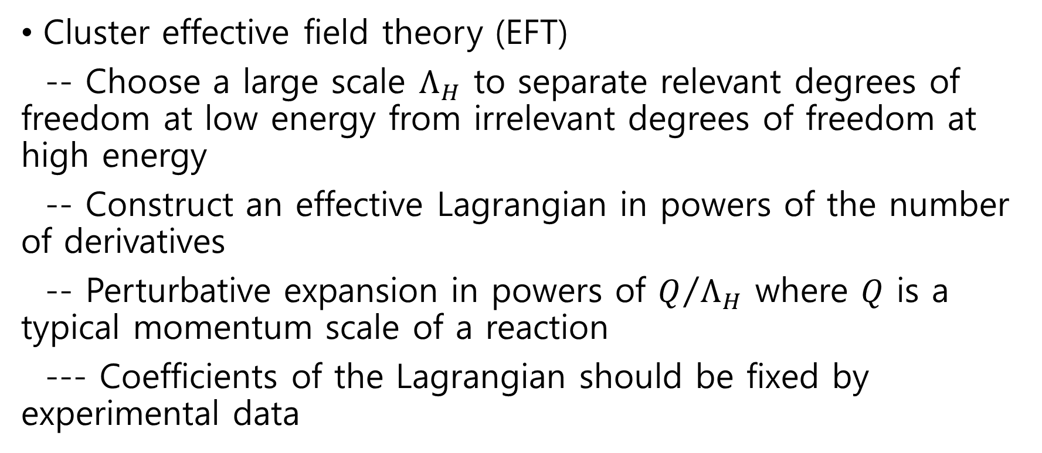
Formalism: overview
Cluster effective field theory (EFT)
-- Choose a large scale $Λ_{H}$ to separate relevant degrees of freedom at low energy from irrelevant degrees of freedom at high energy
-- Construct an effective Lagrangian in powers of the number of derivatives
-- Perturbative expansion in powers of $Q/{Λ_{H}}$ where $Q$ is a typical momentum scale of a reaction
--- Coefficients of the Lagrangian should be fixed by experimental data

Slide 5
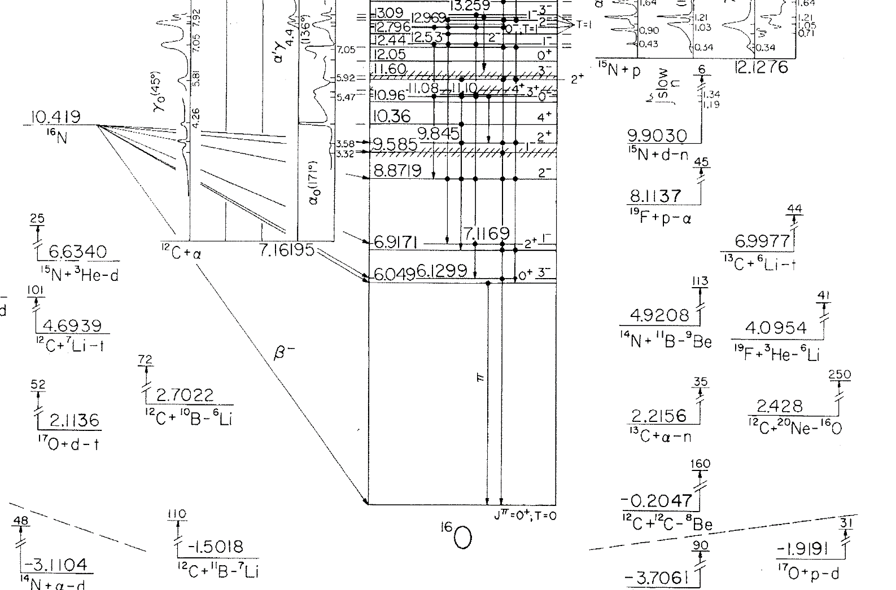

Slide 6
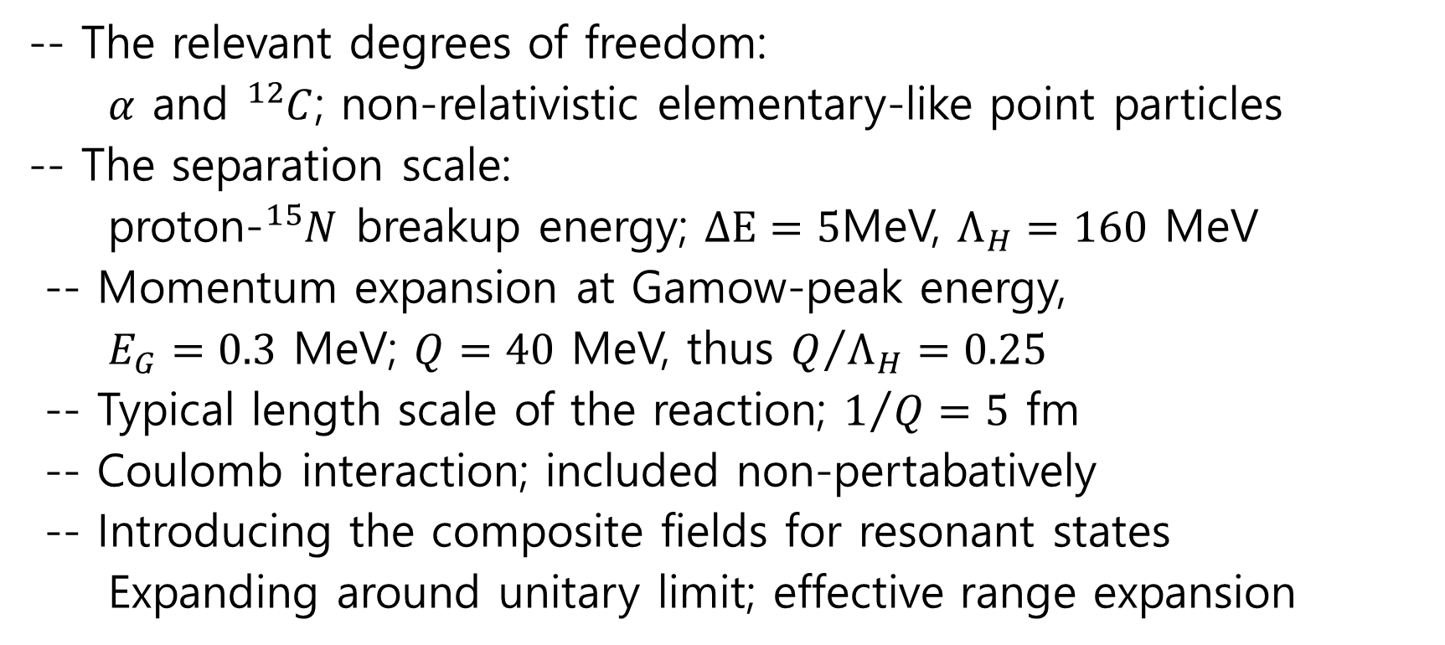
Cluster EFT for radiative alpha capture on carbon-12
-- The relevant degrees of freedom:
$α$ and ${}_{ }^{12}C$; non-relativistic elementary-like point particles
-- The separation scale:
proton-${}_{ }^{15}N$ breakup energy; $∆E=5$MeV, $Λ_{H}=160$ MeV
-- Momentum expansion at Gamow-peak energy,
$E_{G}=0.3$ MeV; $Q=40$ MeV, thus $Q/{Λ_{H}}=0.25$
-- Typical length scale of the reaction; $1/{Q=5}$ fm
-- Coulomb interaction; included non-pertabatively
-- Introducing the composite fields for resonant states
Expanding around unitary limit; effective range expansion

Slide 7
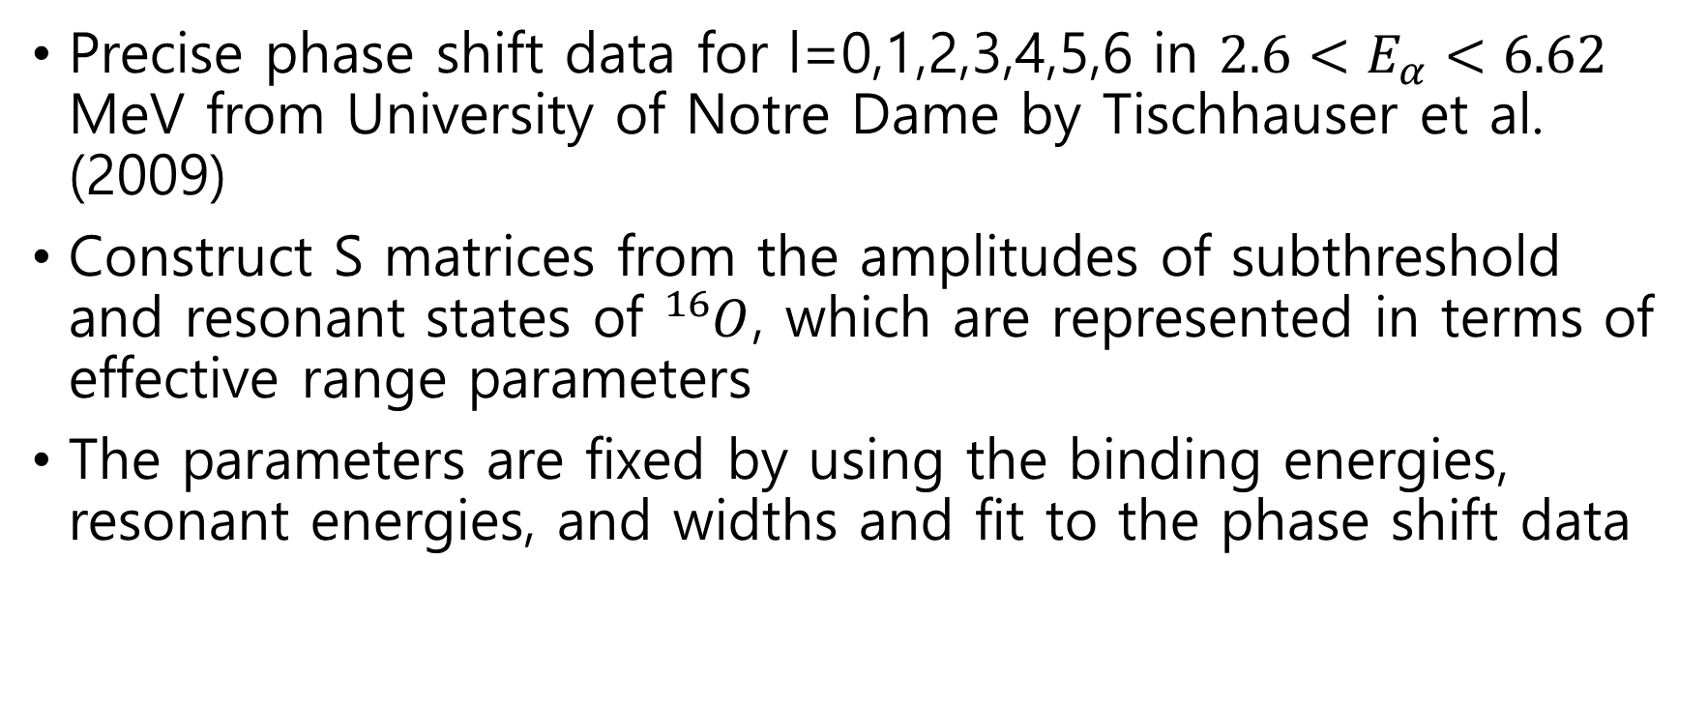
Elastic alpha-cabon-12 scattering
Precise phase shift data for l=0,1,2,3,4,5,6 in $2.6<E_{α}<6.62$ MeV from University of Notre Dame by Tischhauser et al. (2009)
Construct S matrices from the amplitudes of subthreshold and resonant states of ${}_{ }^{16}O$, which are represented in terms of effective range parameters
The parameters are fixed by using the binding energies, resonant energies, and widths and fit to the phase shift data

Slide 8
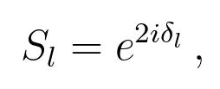
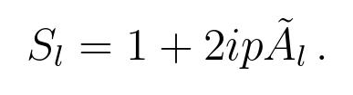
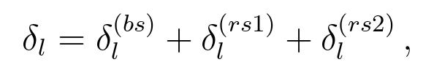
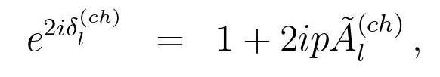
Formalism for the elastic scattering
S matrix

Slide 9
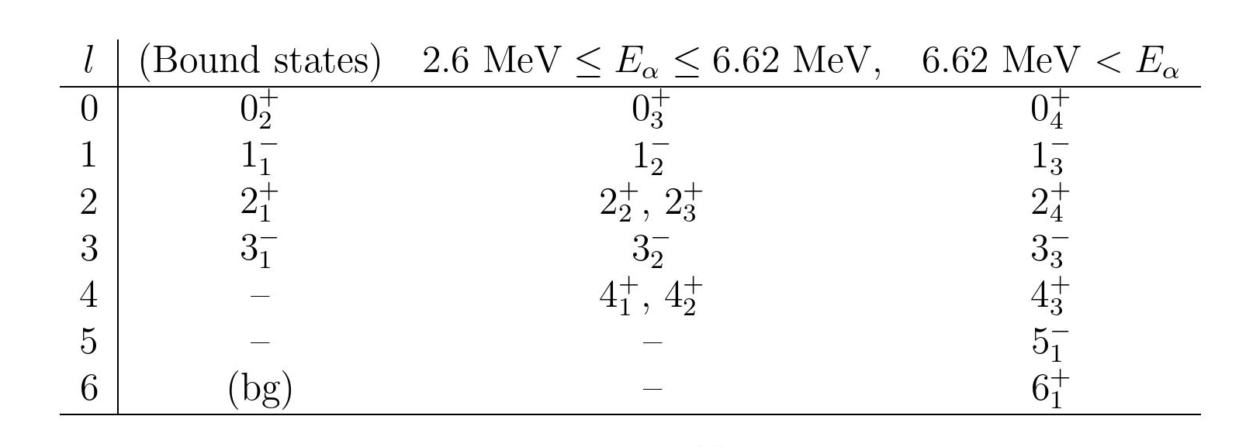

Slide 10
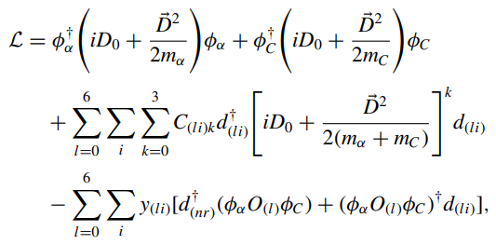
Effective Lagrangian

Slide 11
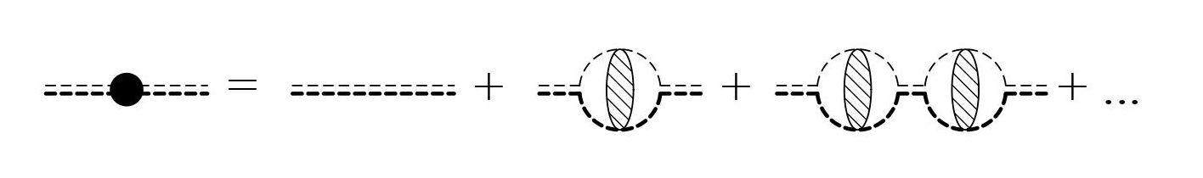
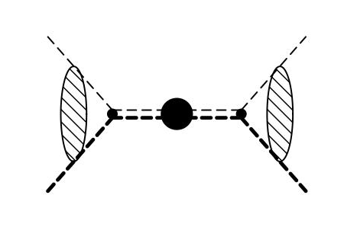
Amplitudes

Slide 12
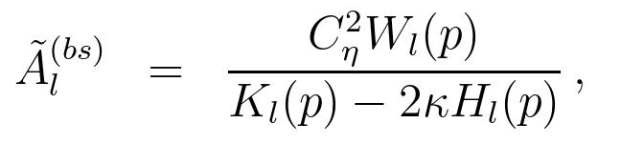
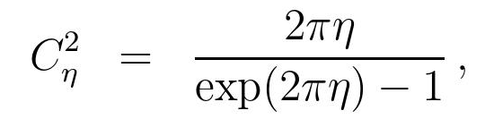
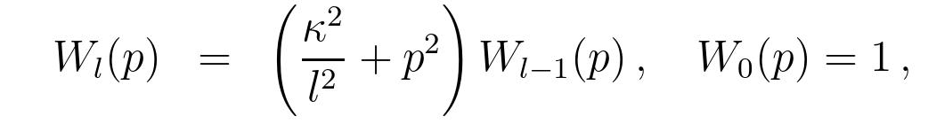
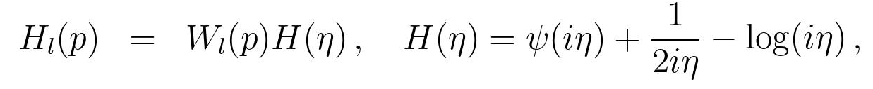
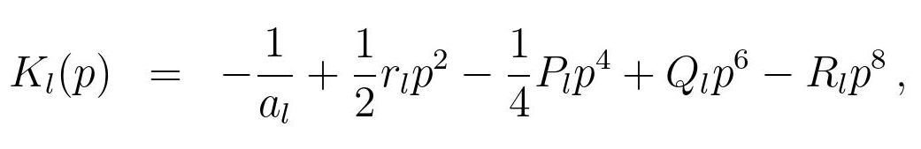
Amplitude for bound states

Slide 13
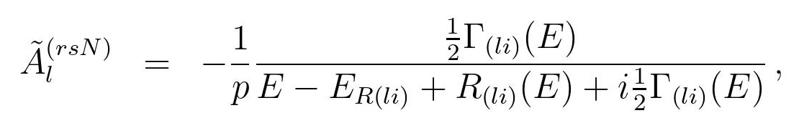
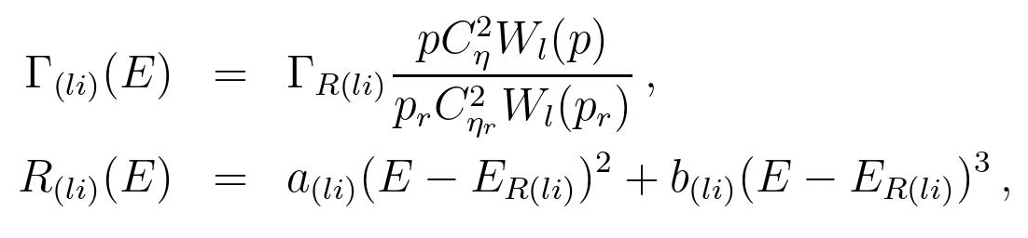
Amplitudes for resonant states

Slide 14
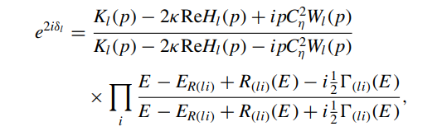
S matrices

Slide 15
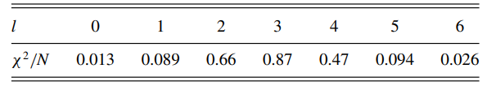
Numerical results
Chi-square per # of data: Thichhauser et al. (2009)

Slide 16
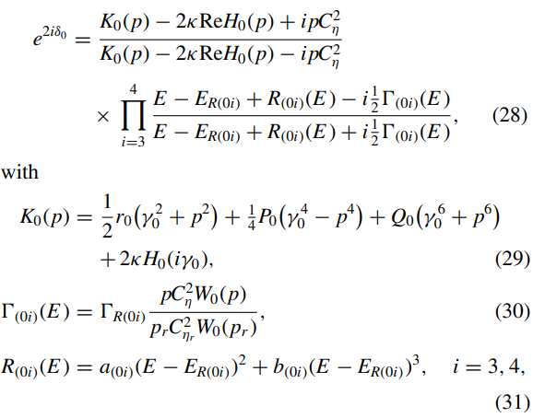
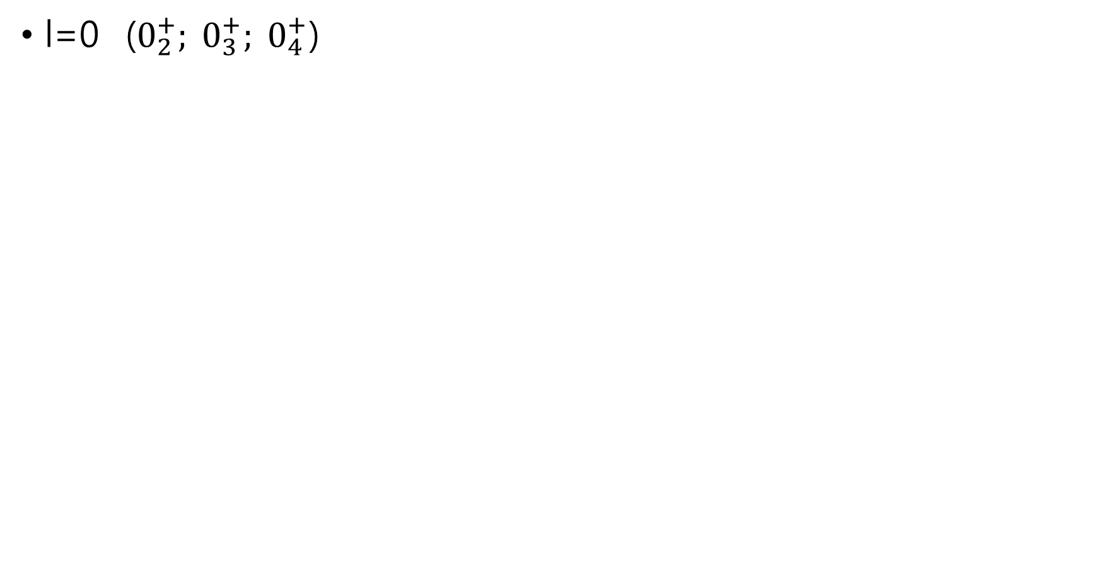
l=0 ($0_{2}^{+}; 0_{3}^{+}; 0_{4}^{+}$)

Slide 17
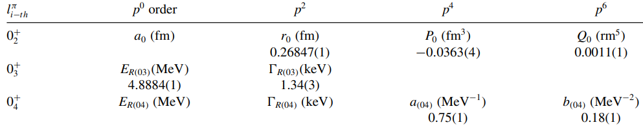

Slide 18
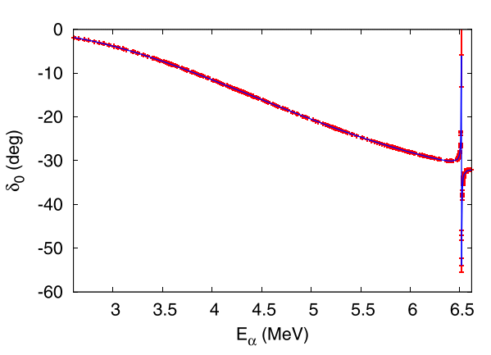

Slide 19

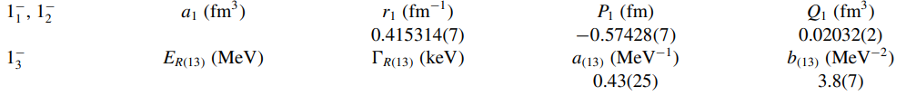
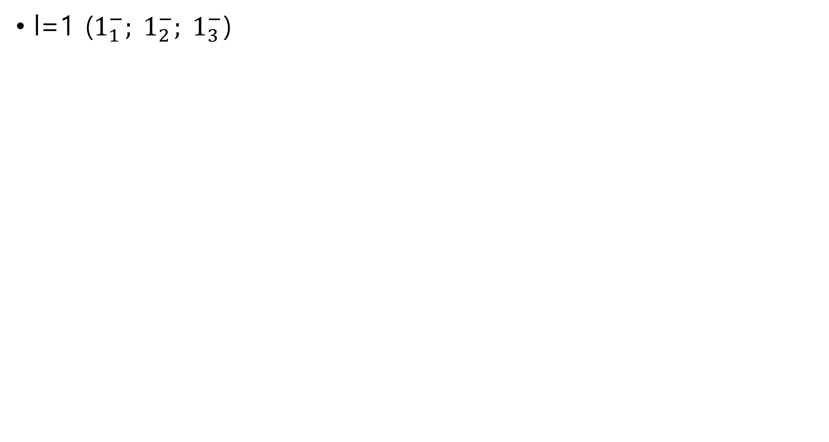
l=1 ($1_{1}^{−}; 1_{2}^{−}; 1_{3}^{−}$)

Slide 20
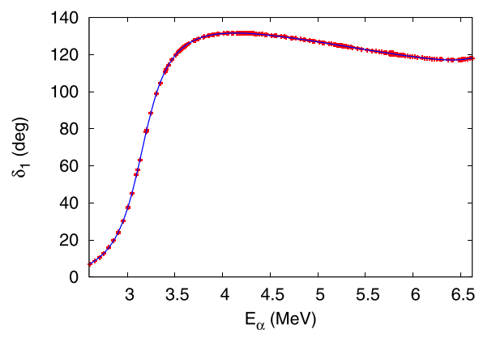

Slide 21
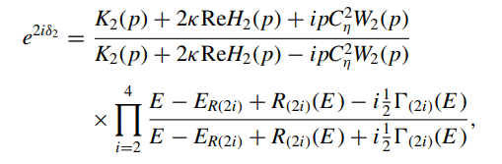
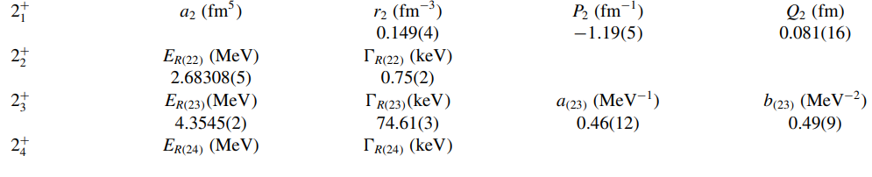
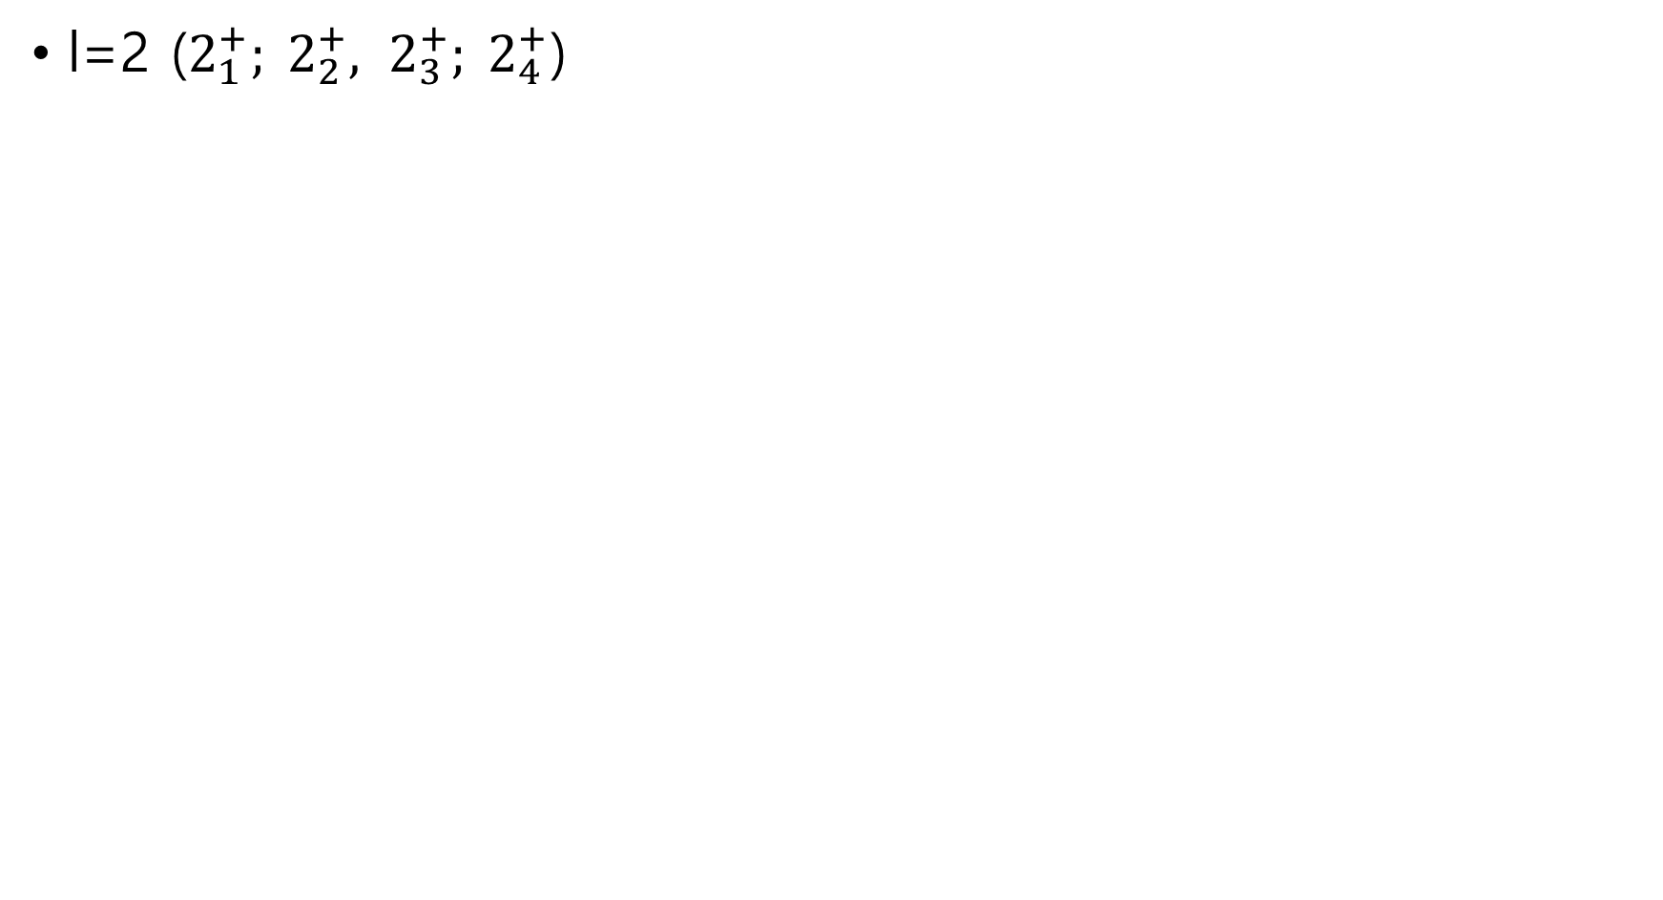
l=2 ($2_{1}^{+}; 2_{2}^{+}, 2_{3}^{+}; 2_{4}^{+}$)

Slide 22
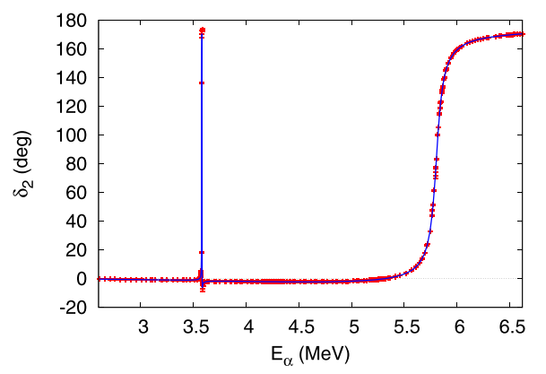

Slide 23
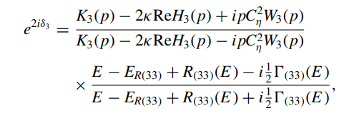
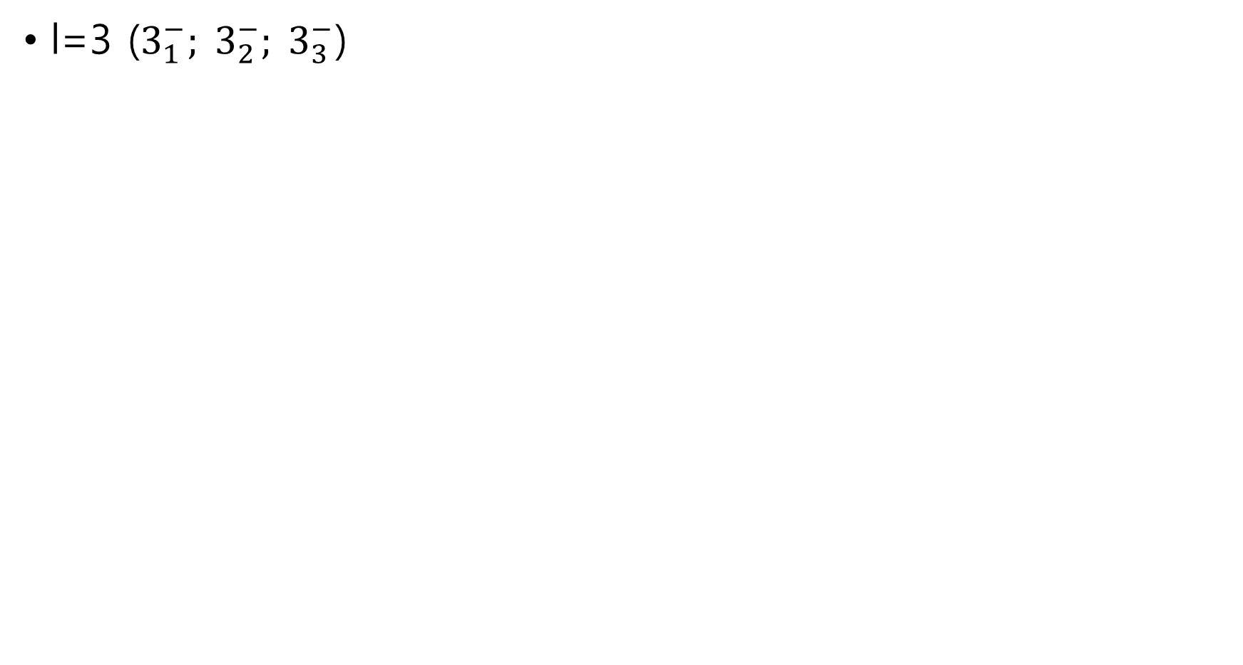
l=3 ($3_{1}^{−}; 3_{2}^{−}; 3_{3}^{−}$)

Slide 24
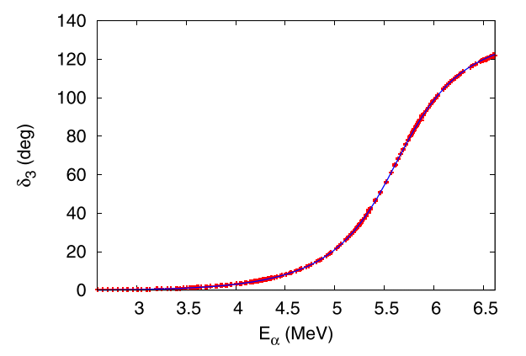

Slide 25

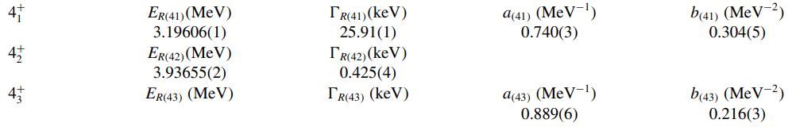
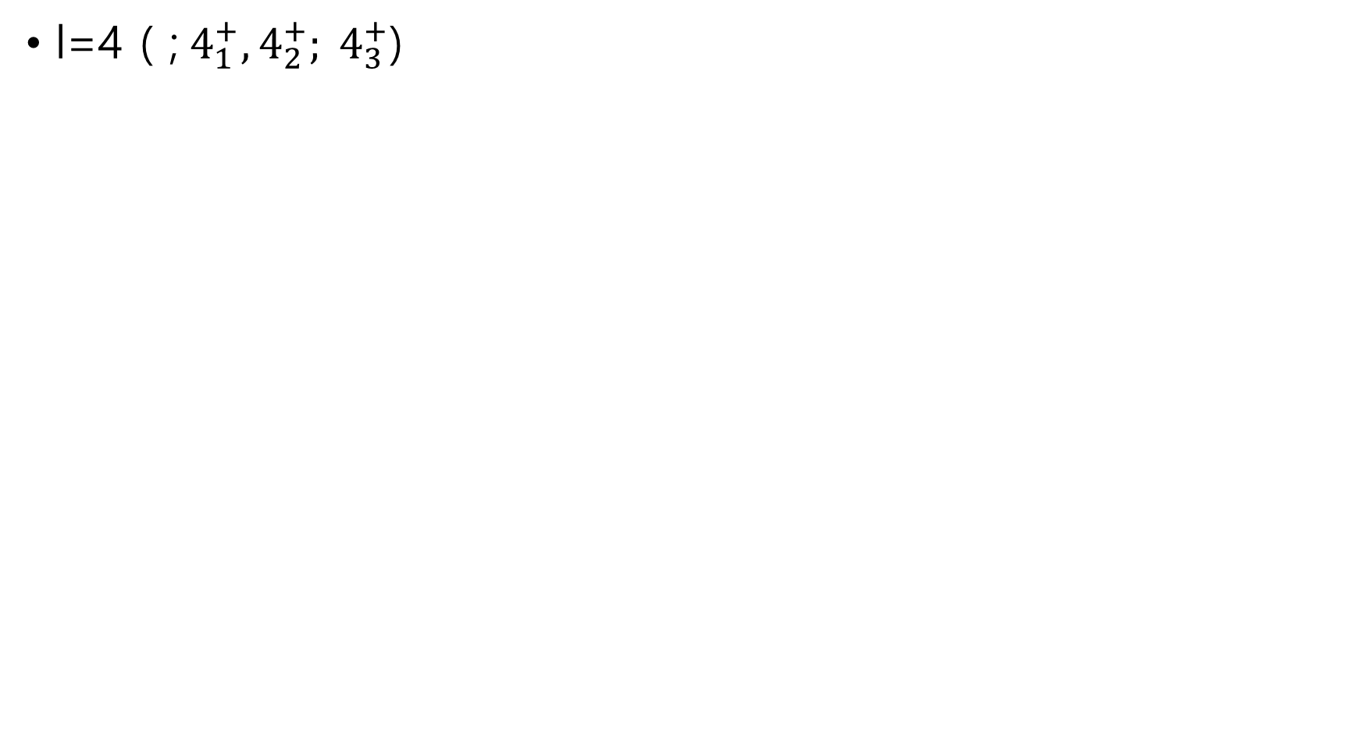
l=4 ( ;${ 4}_{1}^{+}, 4_{2}^{+}; 4_{3}^{+}$)

Slide 26
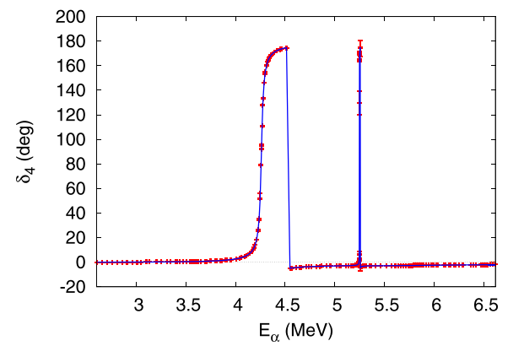

Slide 27

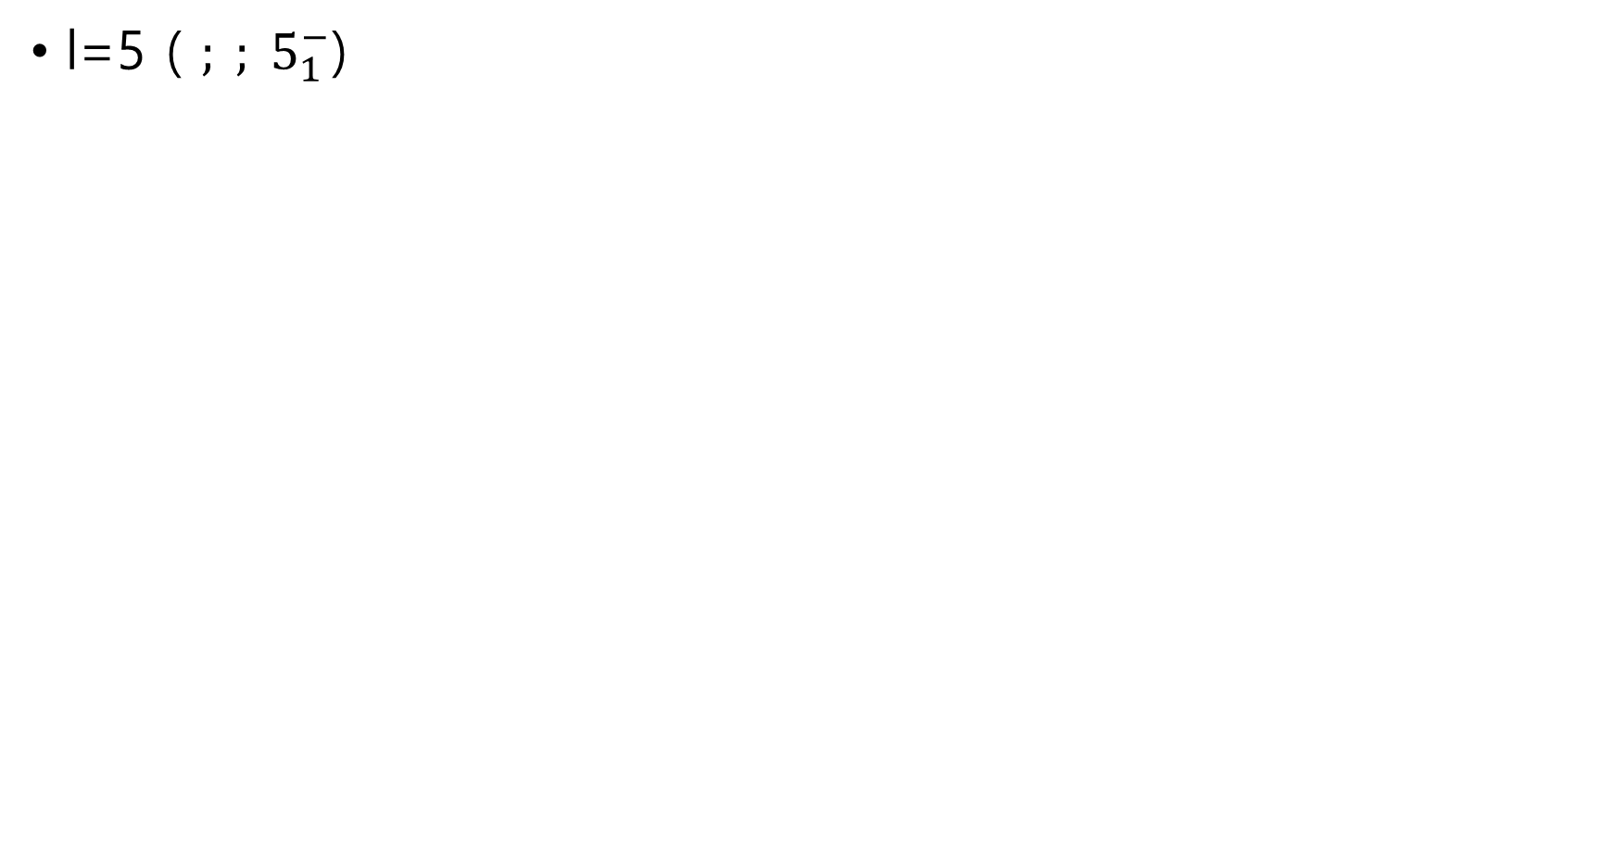
l=5 ( $; ; 5_{1}^{−}$)

Slide 28
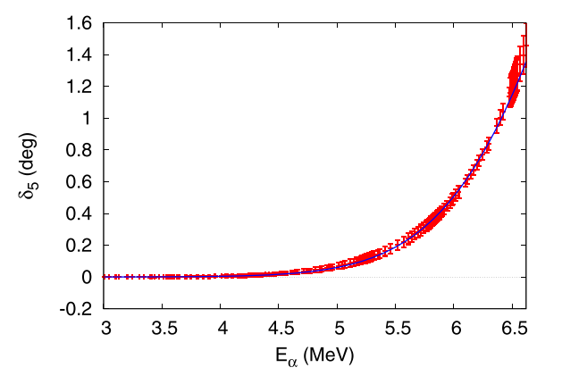

Slide 29
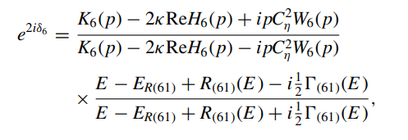
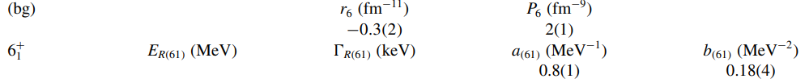
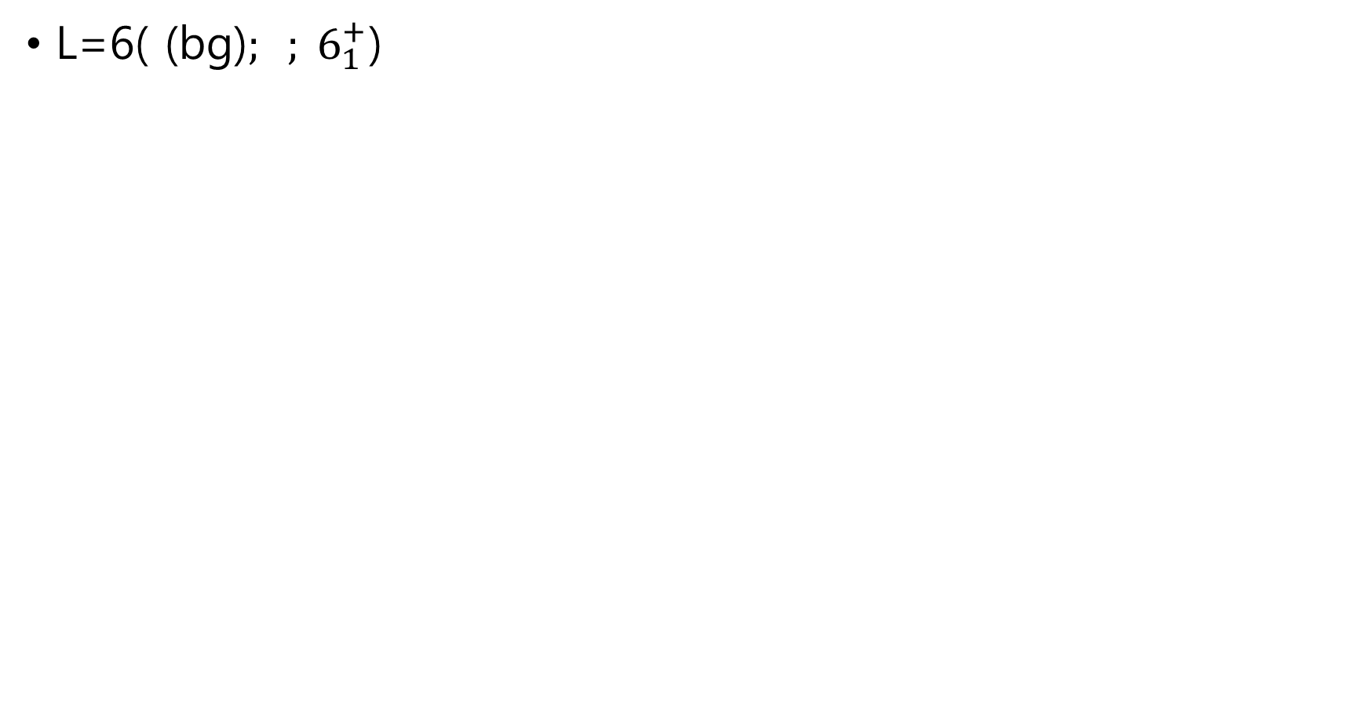
L=6( (bg)$; ; 6_{1}^{+}$)

Slide 30
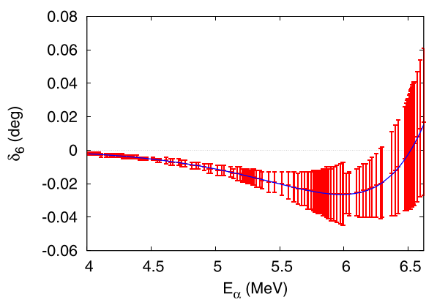

Slide 31
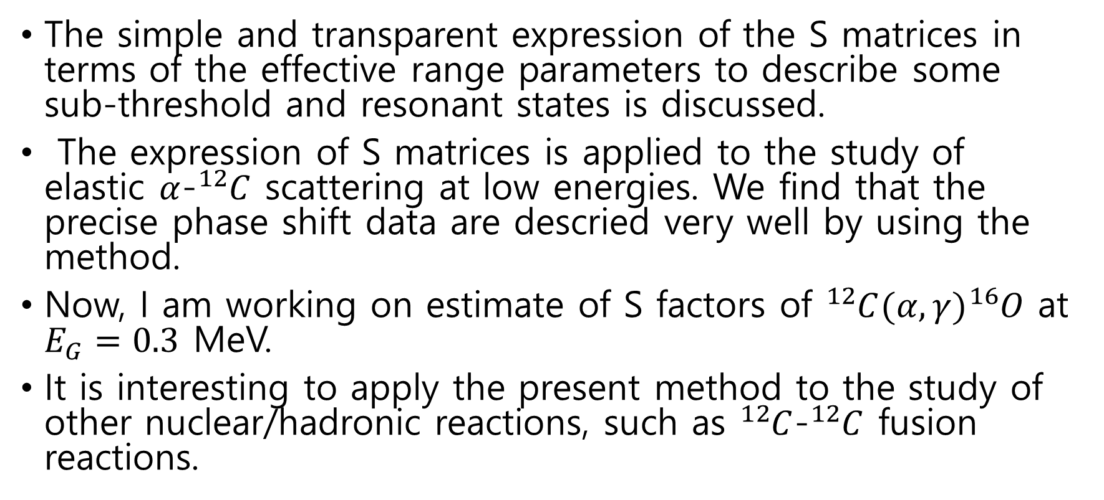
Results and discussion
The simple and transparent expression of the S matrices in terms of the effective range parameters to describe some sub-threshold and resonant states is discussed.
The expression of S matrices is applied to the study of elastic $α$-${}_{ }^{12}C$ scattering at low energies. We find that the precise phase shift data are descried very well by using the method.
Now, I am working on estimate of S factors of ${}_{ }^{12}C(α,γ){}_{ }^{16}O$ at $E_{G}=0.3$ MeV.
It is interesting to apply the present method to the study of other nuclear/hadronic reactions, such as ${}_{ }^{12}C$-${}_{ }^{12}C$ fusion reactions.

Slide 33
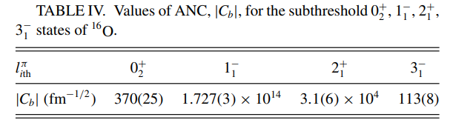
Asymptotic normalization coefficients

