Slide 1
title has been changed.
Tetraquark mixing model for light mesons and its evidence from experimental partial decay widths
Hungchong Kim (Korea University)
K.S. Kim (Korea Aerospace University)
Based on EPJC (2022) 82, 1113
14th APCTP-BLTP JINR Joint Workshop
7/9-7/14, APCTP, Pohang

Slide 2
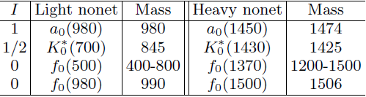

Overview
There are two sets of resonances in $J^{P}=0^{+}$, which we call ‘light’ and ‘heavy’ nonets .
$∆M≳500$ MeV
In this talk, we motivate tetraquark mixing model for them and present successful signatures that support this model.
We focus on a strong signature from the experimental partial decay widths of the two nonets.

Slide 3
Introduction

Slide 4






Introduction cont.
Multiquarks, hadrons composed of four or higher number of constituent quarks, have been anticipated for long time.
$$q\overline{q}$$
$$qqq$$
and similar states in heavy quark (Q) sector.
Normal hadrons
meson
baryon
Multiquarks
$$qq\overline{q}\overline{q}$$
$$qqqq\overline{q}$$
$$qqqqqq$$
$$∙∙∙∙$$
tetraquark
pentaquark
hexaquark
and similar states in heavy quark (Q) sector also.

Slide 5
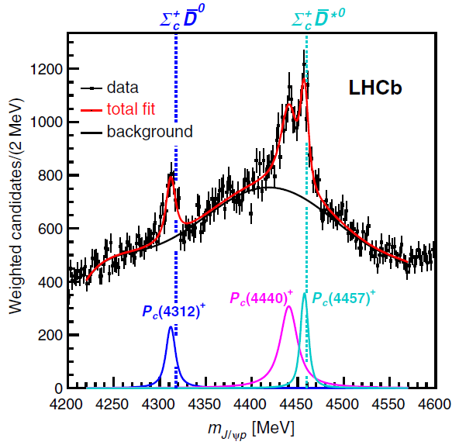
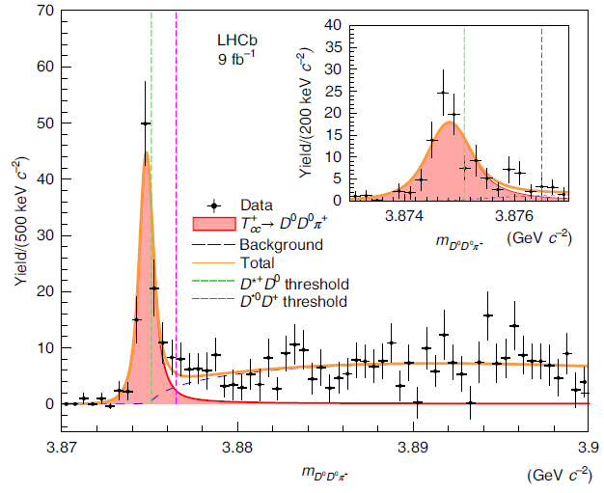


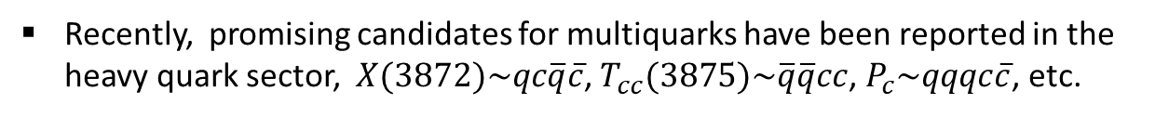



Introduction cont.
Recently, promising candidates for multiquarks have been reported in the heavy quark sector, $X(3872)\sim qc\overline{q}\overline{c}$, $T_{cc}(3875)\sim \overline{q}\overline{q}cc$, $P_{c}\sim qqqc\overline{c}$, etc.
$T_{cc}^{+}\left(3875\right)⟹D^{0}D^{0}π^{+}$
$P_{c}\left(4312\right)$, $P_{c}\left(4440\right)$, $P_{c}\left(4457\right)$
[LHCb, NP 18, 751 (2022)]
LHCb, PRL 122, 222001 (2019)
※$P_{c}\left(4450\right)$ in 2015 is splitted into two states, $P_{c}\left(4440\right),P_{c}\left(4457\right)$, in 2019
They can be interpreted as hadronic molecules ?
$X\left(3872\right)\sim D^{0}{\overline{D}}^{0}$, $T_{cc}≈DD^{∗}$
$P_{c}\left(4312\right)\sim Σ_{c}\overline{D}$, $P_{c}\left(4440\right)$, $P_{c}\left(4457\right)\sim Σ_{c}{\overline{D}}^{∗}$

Slide 6
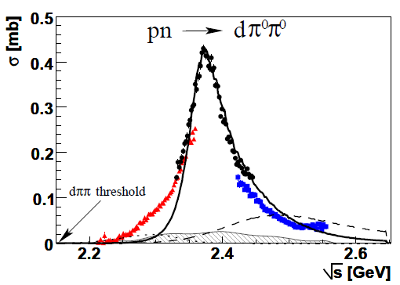




Introduction cont.
Hexaquark candidate : $d^{∗}\left(2380\right)$
$$qqqqqq∈1_{c}$$
Solid line from the s-channel contribution.
WASA-at-COSY, PRL 106, 242302, (2011)
It could be a hadronic molecule like $Δ∆$
$$(qqq∈1_{c}\text{)}(qqq∈1_{c}\text{)}$$

Slide 7
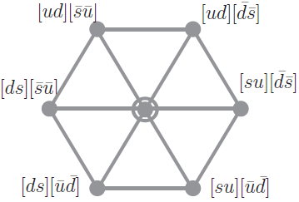





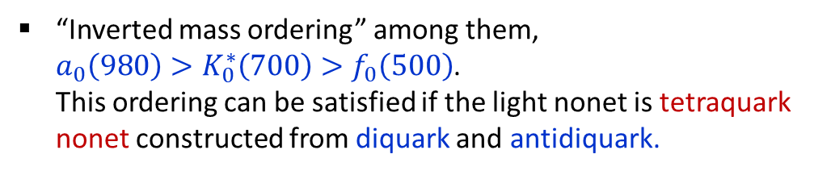



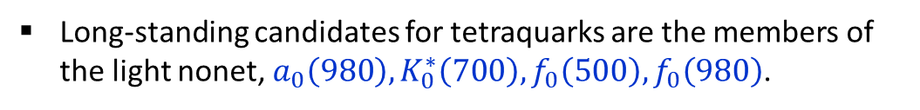









Introduction cont.
Tetraquark candidates in the light quark system
Long-standing candidates for tetraquarks are the members of the light nonet,${ a}_{0}\left(980\right),K_{0}^{∗}\left(700\right),f_{0}\left(500\right), f_{0}\left(980\right)$.
[Jaffe (1977)]
“Inverted mass ordering” among them,
$a_{0}\left(980\right)>K_{0}^{∗}\left(700\right)>f_{0}\left(500\right)$.
This ordering can be satisfied if the light nonet is tetraquark nonet constructed from diquark and antidiquark.
$$qq$$
$$\overline{q}\overline{q}$$
($q=u,d,s)$
$${\overline{3}}_{f}⨂3_{f}=8_{f}⨁1_{f}$$
$$K_{0}^{∗0}\left(800\right)$$
$$K_{0}^{∗+}\left(700\right)$$
$8_{f}$
$$a_{0}^{−}\left(980\right)$$
$$a_{0}^{0}\left(980\right)$$
$$a_{0}^{+}\left(980\right)$$
$$f_{0}\left(500\right)$$
$${\overline{K}}_{0}^{∗−}\left(800\right)$$
$${\overline{K}}_{0}^{∗0}\left(800\right)$$
$$1_{f}$$
$$f_{0}\left(980\right)$$
This ordering cannot be satisfied if the light quark is treated as $q\overline{q}$ ($ℓ=1$).

Slide 8
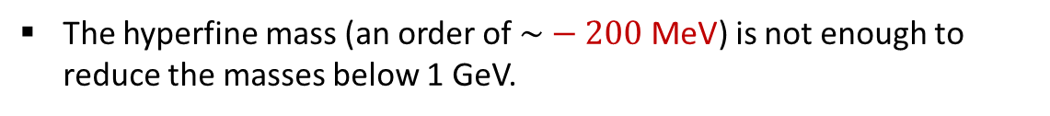
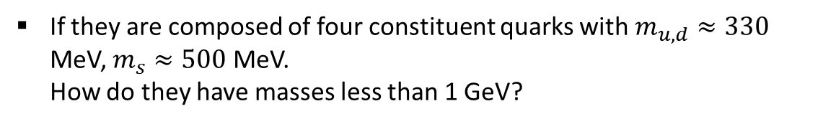
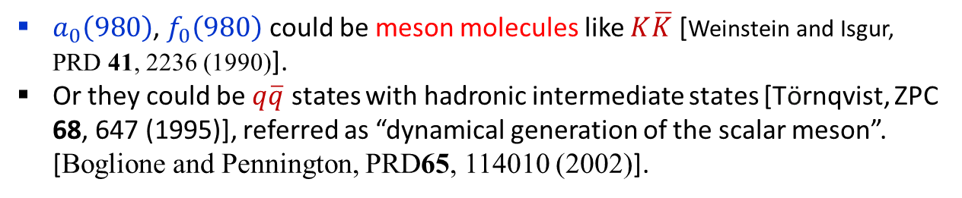
Introduction cont.
One problem with this picture is that the light nonet is too light !
If they are composed of four constituent quarks with $m_{u,d}≈330$ MeV, $m_{s}≈500$ MeV.
How do they have masses less than 1 GeV?
The hyperfine mass (an order of $\sim −200$ MeV) is not enough to reduce the masses below 1 GeV.
Models other than tetraquarks !
$a_{0}\left(980\right)$, $f_{0}\left(980\right)$ could be meson molecules like $K\overline{K}$ [Weinstein and Isgur, PRD 41, 2236 (1990)].
Or they could be $q\overline{q}$ states with hadronic intermediate states [Törnqvist, ZPC 68, 647 (1995)], referred as “dynamical generation of the scalar meson”. [Boglione and Pennington, PRD65, 114010 (2002)].
These models explain only a few members and probably not all the members of the nonet.
As Boglione and Pennington put this, “it is not possible to reach one common conclusion for all the members of the scalar meson family”.

Slide 9




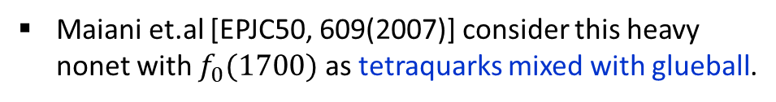







Introduction cont.
Another tetraquark candidates in the light quark system
The heavy nonet composed of
${ a}_{0}\left(1450\right),K_{0}^{∗}\left(1430\right), f_{0}\left(1370\right),f_{0}\left(1500\right)$
The heavy nonet has the same isospin composition as the light nonet.
The heavy nonet has the inverted mass ordering also,
${a_{0}\left(1450\right)≳K}_{0}^{∗}(1430)≳f_{0}\left(1370\right)$ (marginal)
$$K_{0}^{∗0}\left(1430\right)$$
$$K_{0}^{∗+}\left(1430\right)$$
☞ This heavy nonet could be tetraquarks also forming $9_{f}$.
$$a_{0}^{+}\left(1450\right)$$
$$a_{0}^{−}\left(1450\right)$$
$$a_{0}^{0}\left(1450\right)$$
$$f_{0}\left(1370\right)$$
Maiani et.al [EPJC50, 609(2007)] consider this heavy nonet with $f_{0}(1700)$ as tetraquarks mixed with glueball.
$${\overline{K}}_{0}^{∗−}\left(1430\right)$$
$${\overline{K}}_{0}^{∗0}\left(1430\right)$$
$$f_{0}\left(1500\right)$$

Slide 10
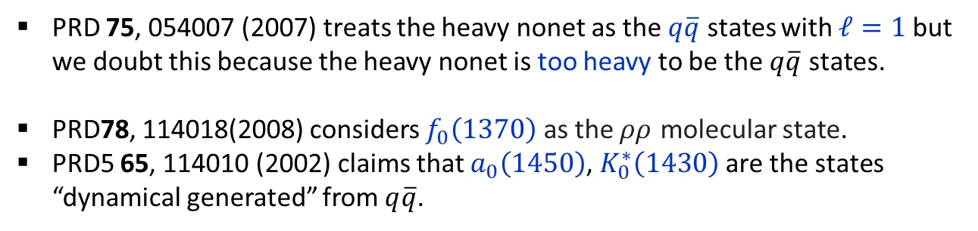
Introduction cont.
Models other than tetraquarks
PRD 75, 054007 (2007) treats the heavy nonet as the $q\overline{q}$ states with $ℓ=1$ but we doubt this because the heavy nonet is too heavy to be the $q\overline{q}$ states.
PRD78, 114018(2008) considers $f_{0}\left(1370\right)$ as the $ρρ$ molecular state.
PRD5 65, 114010 (2002) claims that $a_{0}\left(1450\right)$, $K_{0}^{∗}\left(1430\right)$ are the states “dynamical generated” from $q\overline{q}$.
Again, these models seem to explain only a few members and probably not all the members of the nonet.

Slide 11
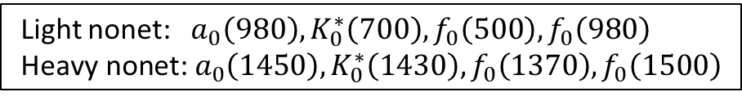
Introduction cont.
Multiquarks have not been confirmed because they can be described as other models with different structures. Therefore, a certain framework is required to identify multiquarks exclusively.
Recently, we proposed a tetraquark mixing model that combine the two nonets into one framework.
Light nonet: ${ a}_{0}\left(980\right),K_{0}^{∗}\left(700\right),f_{0}\left(500\right), f_{0}\left(980\right)$
$$\text{Heavy} \text{nonet}\text{:}{ a}_{0}\left(1450\right),K_{0}^{∗}\left(1430\right), f_{0}\left(1370\right),f_{0}\left(1500\right)$$
In this model, the two nonets are generated from the mixing of two types of tetraquarks.
We believe that this mixing model has successful features that cannot be reproduced in models other than tetraquarks.

Slide 12
Tetraquark mixing model

Slide 13




















Tetraquark mixing model cont.
We want to construct a tetraquark model ($9_{f}$) to explain the two nonets in $J^{P}=0^{+}$.
Light nonet
$${ a}_{0}\left(980\right),K_{0}^{∗}\left(800\right),f_{0}\left(500\right), f_{0}\left(980\right)$$
Heavy nonet
$${ a}_{0}\left(1450\right),K_{0}^{∗}\left(1430\right), f_{0}\left(1370\right),f_{0}\left(1500\right)$$
$$K_{0}^{∗0}\left(800\right)$$
$$K_{0}^{∗+}\left(700\right)$$
$$K_{0}^{∗0}\left(1430\right)$$
$$K_{0}^{∗+}\left(1430\right)$$
$$a_{0}^{−}\left(980\right)$$
$$a_{0}^{0}\left(980\right)$$
$$a_{0}^{+}\left(980\right)$$
$$a_{0}^{−}\left(1450\right)$$
$$a_{0}^{0}\left(1450\right)$$
$$a_{0}^{+}\left(1450\right)$$
$$f_{0}\left(500\right)$$
$$f_{0}\left(980\right)$$
$$f_{0}\left(1370\right)$$
$$f_{0}\left(1500\right)$$
$${\overline{K}}_{0}^{∗−}\left(800\right)$$
$${\overline{K}}_{0}^{∗0}\left(800\right)$$
$${\overline{K}}_{0}^{∗−}\left(1430\right)$$
$${\overline{K}}_{0}^{∗0}\left(1430\right)$$
To do this, two types of tetraquarks are needed.

Slide 14
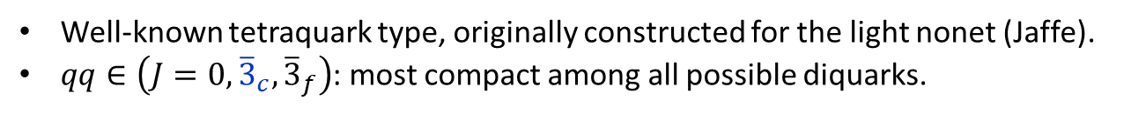
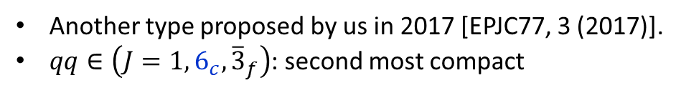


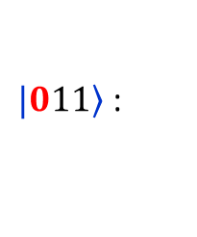


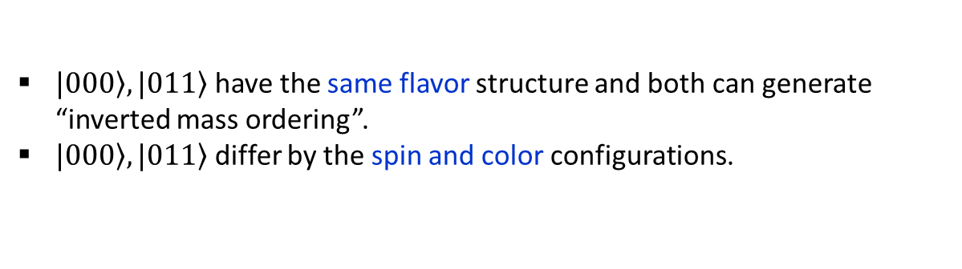

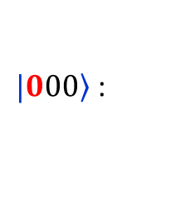
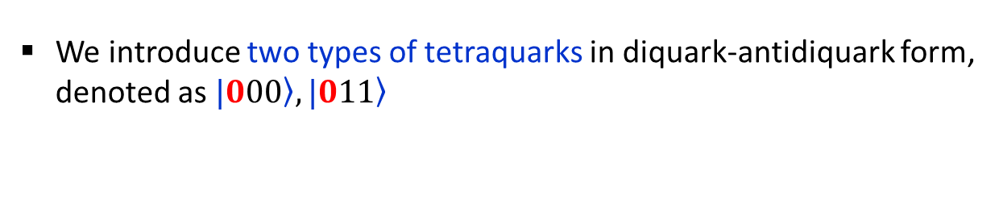
Tetraquark mixing model cont.
We introduce two types of tetraquarks in diquark-antidiquark form, denoted as $\left.|000\right\rangle ,\left.|011\right\rangle$
$$qq$$
$$\overline{q}\overline{q}$$
($q=u,d,s)$
$\left.|000\right\rangle$ :
$$\left[qq∈\left({J=0,{\overline{3}}_{c},\overline{3}}_{f}\right)\right]⨂\left[\overline{q}\overline{q}∈(J=0,3_{c},3_{f})\right]$$
$⟹$ $qq\overline{q}\overline{q}∈\left({J=0,1}_{c}, 9_{f}\right)$
Well-known tetraquark type, originally constructed for the light nonet (Jaffe).
$qq∈\left({J=0,{\overline{3}}_{c},\overline{3}}_{f}\right)$: most compact among all possible diquarks.
$\left.|011\right\rangle$ :
$$\left[qq∈\left({J=1,6_{c},\overline{3}}_{f}\right)\right]⨂\left[\overline{q}\overline{q}∈(J=1,{\overline{6}}_{c},3_{f})\right]$$
$⟹$ $qq\overline{q}\overline{q}∈\left({J=0,1}_{c}, 9_{f}\right)$
Another type proposed by us in 2017 [EPJC77, 3 (2017)].
$qq∈\left({J=1,6_{c},\overline{3}}_{f}\right)$: second most compact
Comments
$\left.|000\right\rangle ,\left.|011\right\rangle$ have the same flavor structure and both can generate “inverted mass ordering”.
$\left.|000\right\rangle ,\left.|011\right\rangle$ differ by the spin and color configurations.

Slide 15


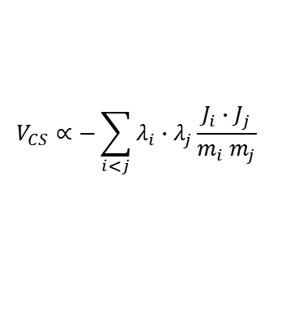

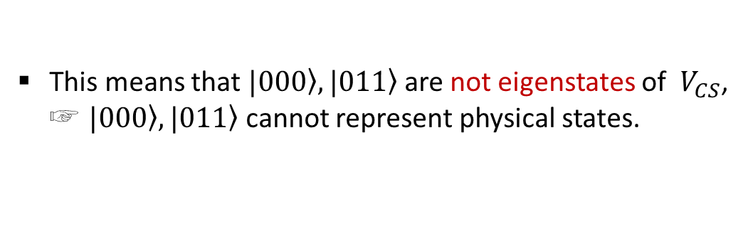
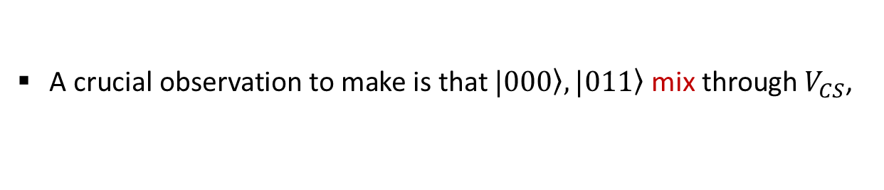


Tetraquark mixing model cont.
A crucial observation to make is that $\left.|000\right\rangle ,\left.|011\right\rangle$ mix through $V_{CS}$,
$\left\langle 011 | V_{CS} | 000\right\rangle ≠0$
$$V_{CS}∝−\sum_{i<j}{λ_{i}∙λ_{j}\frac{J_{i}∙J_{j}}{m_{i} m_{j}}}$$
⇒ $V_{CS}$ forms a 2x2 matrix for each flavor member
Color-spin interaction
ex) For the $I=1$ channel,
$$\left\langle V_{CS}\right\rangle$$
strong mixing
This means that $\left.|000\right\rangle ,\left.|011\right\rangle$ are not eigenstates of $V_{CS}$, ☞ $\left.|000\right\rangle ,\left.|011\right\rangle$ cannot represent physical states.

Slide 16
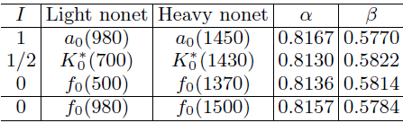
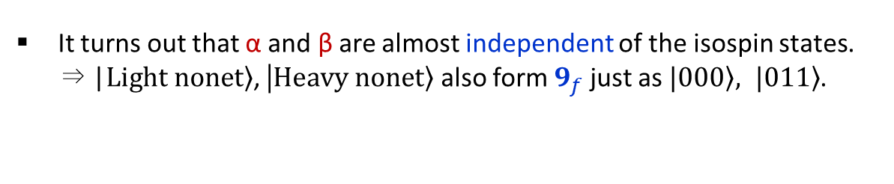
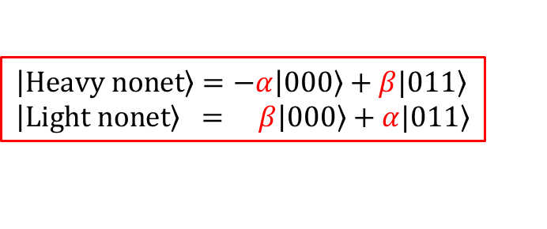


Tetraquark mixing model cont.
Physical states can be constructed by diagonalizing the 2x2 matrix of $V_{CS}$.
The diagonalization process produces two sets of “physical” states,
$$\left|\left.Heavy nonet\right\rangle =−α\right|\left.000\right\rangle +β\left.|011\right\rangle \\ \left|\left.Light nonet\right\rangle = β\right|\left.000\right\rangle +α\left.|011\right\rangle$$
⇒${ a}_{0}\left(1450\right),K_{0}^{∗}\left(1430\right), f_{0}\left(1370\right),f_{0}\left(1500\right)$
⇒${ a}_{0}\left(980\right),K_{0}^{∗}\left(800\right),f_{0}\left(500\right), f_{0}\left(980\right)$
and the mixing parameters, $α,β,$ for each flavor member,
It turns out that α and β are almost independent of the isospin states.
⇒ |$\left.Light nonet\right\rangle$, |$\left.Heavy nonet\right\rangle$ also form $9_{f}$ just as $\left.|000\right\rangle , \left.|011\right\rangle$.
This is tetraquark mixing model for the two nonets !
EPJC77, 3 (2017); EPJC77, 435 (2017); PRD97, 094005 (2018); PRD 99, 014005 (2019)
PRD100, 034021(2019); EPJC82, 1113 (2022)

Slide 17
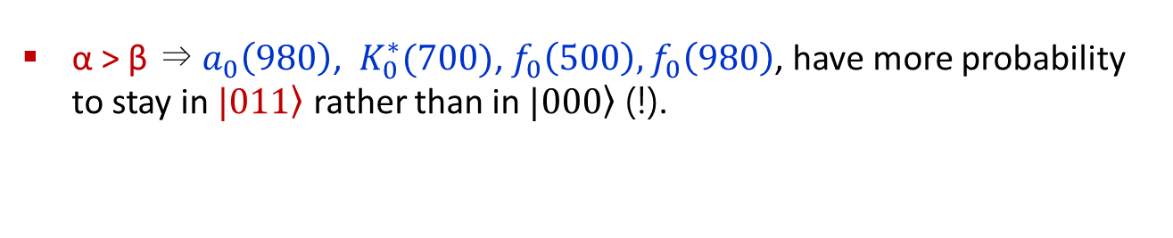
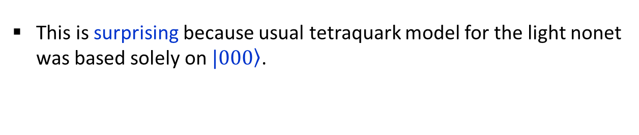
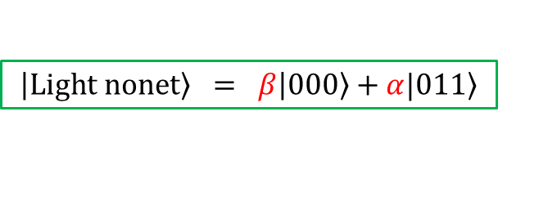
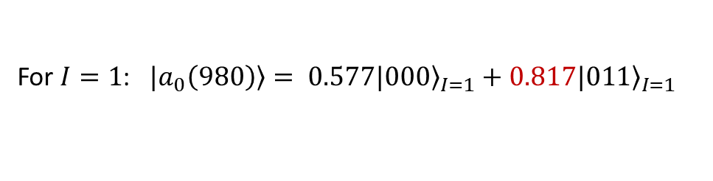
Skip
One remarkable feature of tetraquark mixing model
α > β ⇒ $a_{0}\left(980\right)$, $K_{0}^{∗}(700)$, $f_{0}\left(500\right),f_{0}\left(980\right)$, have more probability to stay in $\left.|011\right\rangle$ rather than in $\left.|000\right\rangle$ (!).
$$\left|\left.Light nonet\right\rangle = β\right|\left.000\right\rangle +α\left.|011\right\rangle$$
For $I=1$: $\left.|a_{0}\left(980\right)\right\rangle = 0.577|{\left.000\right\rangle }_{I=1}+0.817|{\left.011\right\rangle }_{I=1}$
This is surprising because usual tetraquark model for the light nonet was based solely on $\left.|000\right\rangle$.
☞ QCD sum rules for $a_{0}\left(980\right)$ support this result (Lee et.al. PRD2019).

Slide 18
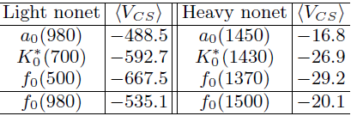
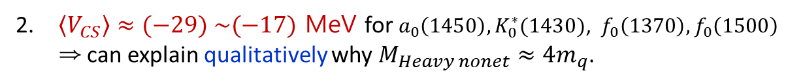
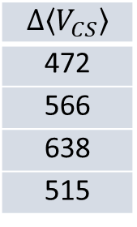

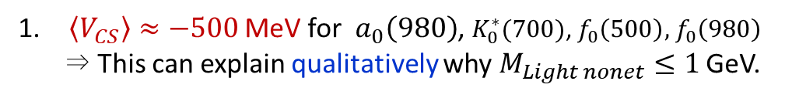

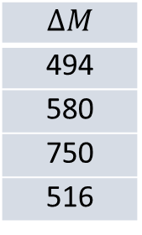
Tetraquark mixing model cont.
Successful features of the model from the hyperfine mass, $\left\langle V_{CS}\right\rangle$
$\left\langle V_{CS}\right\rangle ≈−500$ MeV for $a_{0}\left(980\right)$, $K_{0}^{∗}(700)$, $f_{0}\left(500\right),$ $f_{0}\left(980\right)$ ⇒ This can explain qualitatively why $M_{Light nonet}≤1$ GeV.
$\left\langle V_{CS}\right\rangle ≈(−29) \sim (−17)$ MeV for $a_{0}\left(1450\right),K_{0}^{∗}(1430)$, $f_{0}\left(1370\right),f_{0}\left(1500\right)$
⇒ can explain qualitatively why $M_{Heavy nonet}≈4m_{q}$.
$ΔM≈Δ\left\langle V_{CS}\right\rangle$ !
The same formula type works for the mass difference between vector meson –pseudoscalar meson, baryon octet- baryon decuplet. It works also here.
$$ΔM$$
494
580
750
516
$$Δ\left\langle V_{CS}\right\rangle$$
472
566
638
515
$\left\langle V_{CS}\right\rangle$ in the physical basis
Note, these successful features originate from the fact that two types of tetraquarks mix each other.

Slide 19
Prediction on coupling strengths
from tetraquark mixing model

Slide 20

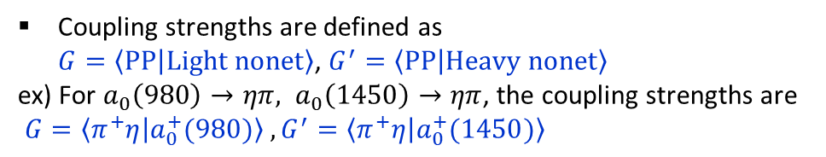


coupling strength cont.
The most striking prediction of tetraquark mixing model
is that the coupling strengths into PP (two pseudoscalar mesons) satisfy
$\left|G\right|$(light nonet) $≫$ ${|G}^{′}|$ (heavy nonet)
Coupling strengths are defined as
$G=\left\langle PP | Light nonet\right\rangle$, $G^{′}=\left\langle PP | Heavy nonet\right\rangle$
ex) For $a_{0}\left(980\right)→ηπ, a_{0}\left(1450\right)→ηπ$, the coupling strengths are
$G=\left\langle π^{+}η | a_{0}^{+}(980)\right\rangle , G^{′}=\left\langle π^{+}η | a_{0}^{+}(1450)\right\rangle$
Light nonet ⇒ PP
Heavy nonet ⇒ PP
Pseudoscalar
Pseudoscalar
Light nonet
$$G$$
Heavy nonet
$$G^{′}$$
Pseudoscalar
Pseudoscalar

Slide 21




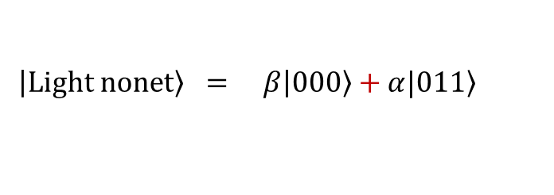

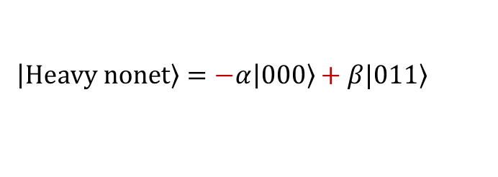
coupling strength cont.
Why $\left|G\right|$ $≫$ ${|G}^{′}|$ in tetraquark mixing model ?
Tetraquarks decay into two mesons mainly through the fall-apart mechanism.
(24)
$$q_{1}q_{2}{\overline{q}}_{3}{\overline{q}}_{4}$$
$$[$$
$$]_{1_{c}}$$
$⟹[{\left(q_{1}{\overline{q}}_{3}\right)}_{1_{c}}⊗{\left(q_{2}{\overline{q}}_{4}\right)}_{1_{c}}]_{1_{c}}⊕[{\left(q_{1}{\overline{q}}_{3}\right)}_{8_{c}}⊗{\left(q_{2}{\overline{q}}_{4}\right)}_{8_{c}}]_{1_{c}}$
(13)
2-meson modes
$$\left|\left.Heavy nonet\right\rangle =−α\right|\left.000\right\rangle +β\left.|011\right\rangle$$
$$\left|\left.Light nonet\right\rangle = β\right|\left.000\right\rangle +α\left.|011\right\rangle$$
$qq\overline{q}\overline{q}$ fall-apart decay
Due to the difference in relative signs,
☞ the coupling strengths for the PP modes are enhanced in the light nonet but suppressed in the heavy nonet.

Slide 22
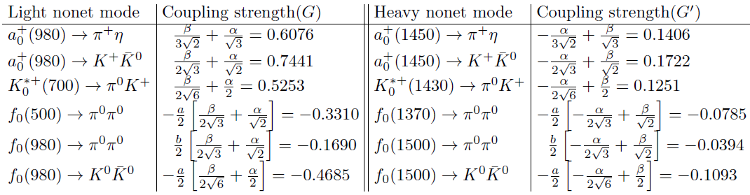




coupling strength cont.
Coupling strengths to PP mesons
$a,b$ are flavor mixing parameters for the isoscalar resonances.
So, the tetraquark mixing model predicts that
$\left|G\right|$(light nonet) $≫$ ${|G}^{′}|$ (heavy nonet)
⇒ $\frac{G}{G^{′}}≈4 !$
Interesting prediction that may not be made from other models !
Tetraquark mixing model may be unique in making this prediction as it is from the fact that two types of tetraquarks mix each other.
This prediction can be experimentally verified by examining partial decay widths.
$$Γ_{partial}=G^{2}Γ_{kin}$$
Notes:
There are inequalities between the coupling strengths. They are enhanced in the light nonet but suppressed in the heavy nonet.
Experimentally, this inequalities can be tested from the corresponding partial decay widths because the
width is proportional to the coupling strength square times the other part depending only kinematics.

Slide 23
Comparison
of our prediction and experimental partial decay widths

Slide 24
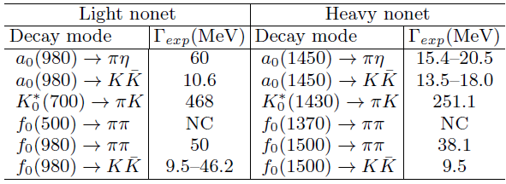
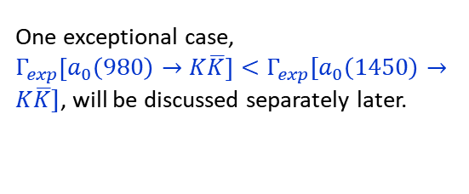
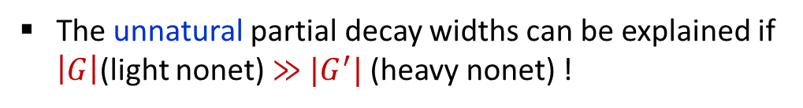
comparison cont.
Experimental partial decay widths estimated from PDG (2022)
NC: Not conclusive
One exceptional case,
$Γ_{exp}\left[a_{0}\left(980\right)→K\overline{K}\right]<Γ_{exp}\left[a_{0}\left(1450\right)→K\overline{K}\right]$, will be discussed separately later.
$$Γ_{exp}\left[f_{0}\left(980\right)→K\overline{K}\right]≳Γ_{exp}\left[f_{0}\left(1500\right)→K\overline{K}\right]$$
For $f_{0}(500)⟶ππ$, $f_{0}(1370)⟶ππ$, expt. data are not conclusive but $f_{0}(500)$ is very famous for its broad width.
General trend is, $Γ_{exp}$(light nonet) $≳Γ_{exp}$(heavy nonet).
This is not natural because, kinematically, resonances with greater mass are expected to have larger partial widths. (Not easy to understand intuitively!)
The unnatural partial decay widths can be explained if
$\left|G\right|$(light nonet) $≫$ ${|G}^{′}|$ (heavy nonet) !
Notes:
1. Some partial widths are not known until recently.
ex) $K_{0}^{∗}(700)⟹πK$, $f_{0}(980)⟹ππ$ were not listed in 2016 PDG.
2. Some partial widths still have large uncertainty.
ex) $f_{0}(980)⟹K\overline{K}$ .
Purely from the kinematical point of view, this inequality is quite unnatural.

Slide 25

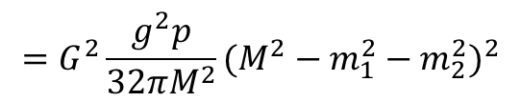
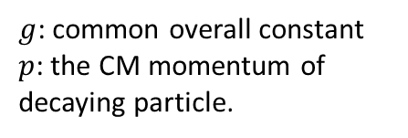
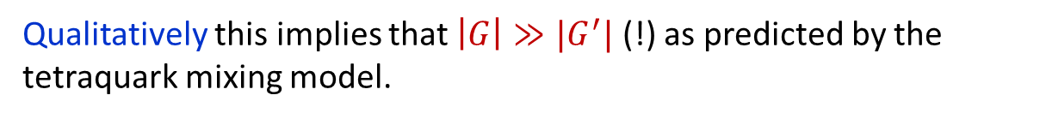
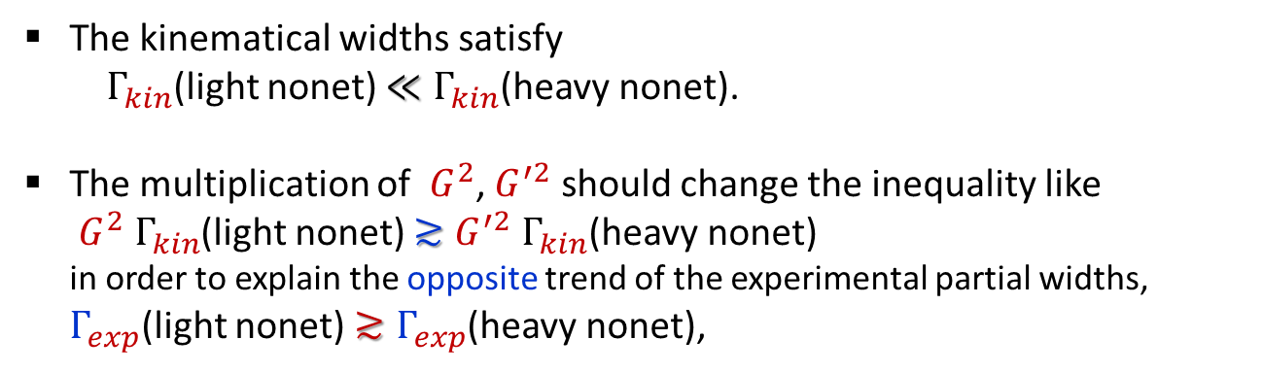

comparison cont.
Partial decay width can be calculated by
$$Γ\left[M⟶m_{1},m_{2}\right]≡G^{2}{ Γ}_{kin}$$
$g$: common overall constant
$p$: the CM momentum of decaying particle.
$$=G^{2}\frac{g^{2}p}{32πM^{2}}(M^{2}−m_{1}^{2}−m_{2}^{2})^{2}$$
using Lagrangian, $Gg∂_{μ}ψ_{m_{1}}∂^{μ}ψ_{m_{2}}ψ_{M}$, [PRD 61,074001 Black et.al.]
The kinematical widths satisfy
$Γ_{kin}$(light nonet) $≪Γ_{kin}$(heavy nonet).
The multiplication of $G^{2}$, $G^{′2}$ should change the inequality like
$G^{2} Γ_{kin}$(light nonet) $≳{G^{′2} Γ}_{kin}$(heavy nonet)
in order to explain the opposite trend of the experimental partial widths,
$Γ_{exp}$(light nonet) $≳Γ_{exp}$(heavy nonet),
ex) $\frac{Γ_{kin}[a_{0}(1450)⟶πη]}{Γ_{kin}[a_{0}(980)⟶πη]}≈1.68$
Qualitatively this implies that $\left|G\right|≫{|G}^{′}|$ (!) as predicted by the tetraquark mixing model.
Notes:
To get the experimental ratio, we need to have different couplings for the two nonets. And the light nonet couplings must be a lot larger than the heavy nonet couplings.

Slide 26


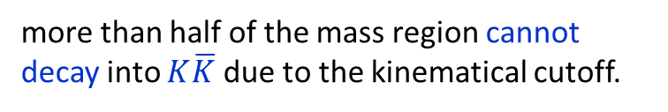


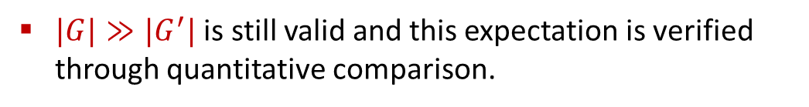





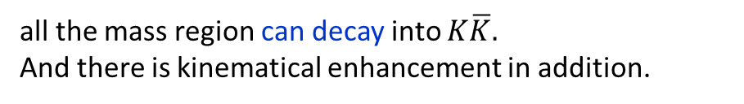
comparison cont.
The exceptional case is the isovectors decaying into $K\overline{K}$
$Γ_{exp}\left[a_{0}\left(980\right)→K\overline{K}\right]<Γ_{exp}\left[a_{0}\left(1450\right)→K\overline{K}\right]$ does not ruin our prediction $|G|≫{|G}^{′}|$,
because $Γ_{exp}\left[a_{0}\left(980\right)→K\overline{K}\right]$ is smaller by the kinematical cutoff.
A resonance mass is usually broadened by the total width, $Γ_{tot}$.
$$Γ_{tot}$$
$$M_{c}$$
For $a_{0}\left(980\right)→K\overline{K}$ (the light nonet)
$K\overline{K}\sim 987$MeV
more than half of the mass region cannot decay into $K\overline{K}$ due to the kinematical cutoff.
$$Γ_{tot}$$
For $a_{0}\left(1450\right)→K\overline{K}$ (the heavy nonet)
$${M[a}_{0}(980)]$$
all the mass region can decay into $K\overline{K}$.
And there is kinematical enhancement in addition.
$$K\overline{K}$$
$|G|≫{|G}^{′}|$ is still valid and this expectation is verified through quantitative comparison.
$${M[a}_{0}(1450)]$$
Notes:
For isovector case, we have the opposite inequality in the experimental partial widths, light nonet width is smaller than the heavy nonet one. Even in this case, we expect
the same enhancement in the couplings.
For $a_{0}\left(980\right)→K\overline{K}$, most region cannot decay to $K\overline{K}$ due to the kinematical cutoff. Only the mass region above the $K\overline{K}$ threshold can decay.
But for $a_{0}\left(1450\right)→K\overline{K}$, all the mass region can decay to $K\overline{K}$.

Slide 27

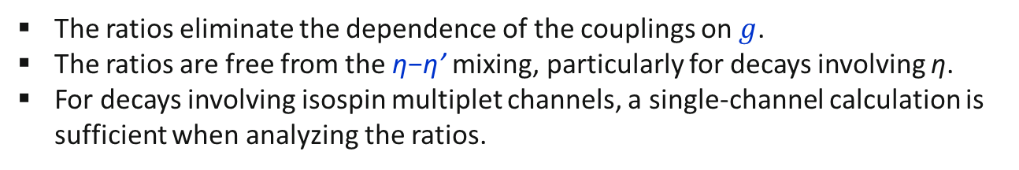




Quantitative comparison
comparison cont.
To make quantitative verification, we calculate theoretical partial decay width, $Γ_{theory}$, including the mass distribution caused by the total width,
$$Γ_{theory}(M_{c}, Γ_{tot})=\frac{\int_{m_{1}+m_{2}}^{∞}{Γ\left(M⟶m_{1}, m_{2}\right)f\left(M\right)dM}}{\int_{m_{1}+m_{2}}^{∞}{f\left(M\right)dM}}$$
$$Γ_{tot}$$
with $G, G^{′}$ fixed by the tetraquark mixing model.
$$M_{c}$$
Next calculate the ratios of partial widths,
$$\frac{Γ_{theory}(Lignt nonet)}{Γ_{theory}(Heavy nonet)}$$
and compare them to the experimental ratios,
$$\frac{Γ_{expt}(Lignt nonet)}{Γ_{expt}(Heavy nonet)}$$
Why ratios ?
The ratios eliminate the dependence of the couplings on $g$.
The ratios are free from the η−η’ mixing, particularly for decays involving η.
For decays involving isospin multiplet channels, a single-channel calculation is sufficient when analyzing the ratios.

Slide 28




Ratio of partial widths
comments
comparison cont.
acceptable(?)
not good
Expt. data is very uncertain.
This comparison is insufficient for quantitative validation. Some improvements may be needed in future, theoretically and experimentally.
But(!) none of the ratios undermine the qualitative conclusion that,
$\left|G\right|$(light nonet) $≫$ ${|G}^{′}|$ (heavy nonet)
This inequality remains valid.
Note, theoretical ratios are sensitive to expt. inputs from PDG data.
For $K_{0}^{∗}\left(700\right)$,
$M_{c}≈845$ MeV, $Γ_{tot}≈468$MeV in PDG[2022] ⇒ 2.58
$M_{c}≈682$ MeV, $Γ_{tot}≈547$MeV in PDG[2016] ⇒ 1.76

Slide 29



conclusions
Conclusions from analysis on the coupling strengths
$\left|G\right|$(light nonet) $≫$ ${|G}^{′}|$ (heavy nonet),
is clearly supported by $Γ_{exp}$(light nonet) $≳Γ_{exp}$(heavy nonet),
which is, otherwise, not easy to understand theoretically.
The tetraquark mixing model is likely the only one that can explain this unnatural experimental partial decay widths.
This result may help us to understand why the $K_{0}^{∗}(700)$ is so broad [and the $f_{0}\left(500\right)$ width as well].
It is quite likely that this conclusion cannot be made from models other than tetraquarks.
It may not be reproduced from the meson-molecular picture or from the $q\overline{q}$ states with hadronic intermediate states.

Slide 30


Summary
In this talk, we demonstrate that the tetraquark mixing model can describe the two nonets: [$a_{0}\left(980\right),K_{0}^{∗}\left(800\right),f_{0}\left(500\right), f_{0}\left(980\right)$], [$a_{0}\left(1450\right),K_{0}^{∗}\left(1430\right), f_{0}\left(1370\right),f_{0}\left(1500\right)$].
The tetraquark mixing model suggests that the two nonets are generated by the mixing of two types of tetraquarks, $\left.|000\right\rangle ,\left.|011\right\rangle$,
This mixing model can explain qualitatively the masses of the two nonets and the mass differences between the two nonets.
One striking prediction of this model is that the coupling strengths of the two nonets decaying into two pseudoscalar mesons satisfy
$\left|G\right|$(light nonet) $≫$ ${|G}^{′}|$ (heavy nonet).
This prediction is supported by the experimental partial decay widths satisfying $Γ_{exp}$(light nonet) $≳Γ_{exp}$(heavy nonet).
This could be strong evidence to support the tetraquark mixing model.
$$\left|\left.Heavy nonet\right\rangle =−α\right|\left.000\right\rangle +β\left.|011\right\rangle \\ \left|\left.Light nonet\right\rangle = β\right|\left.000\right\rangle +α\left.|011\right\rangle$$

Slide 31

Summary cont.
All the successful features come from the fact that two types of tetraquark mix each other.
None of these can be reproduced if only one type of tetraquark is used.
☞ This means that the two nonets should not be treated separately.
The results from the tetraquark mixing model work for all members of the two nonets. This aspect is different from models that are not based on tetraquarks, like meson-meson molecules or $q\overline{q}$ states with hadronic intermediate states.
In this sense, this tetraquark mixing model can provide a unique framework that distinguish tetraquarks from models other than tetraquarks.
We hope that this study can establish tetraquarks in the light quark system.

