Slide 1

Gamow-Teller transitions by Charge Exchange Reactions in Raon Accelerator
Eun Ja Ha
Department of physics, Hanyang University, Seoul, Korea
in collaboration with
Myung-Ki Cheoun¹ and Hiroyuki Sagawa²
1) Origin of Matter and Evolution of Galaxy (OMEG) Institute & Soongsil University, Seoul, Korea
2) RIKEN and University of Aizu, Japan
14th APCTP-BLTP JINA Joint Workshop, Jul. 10-14, 2023, APCTP, Pohang
Notes:
Gamow-Teller transition is the main reaction in nucleosysthesis.
This talk aims to provide guidelines on Gamow-Teller(GT) transition which is a charge exchange reaction to be performed in future Raon accelerator.

Slide 2
Contents
The aim of this talk is to provide guidelines for GT transition experiments.
Introduction
Gamow-Teller(GT) transition
Formalism
Results
N=Z nuclei : ²⁴Mg, ²⁸Si, and ³²S
N=Z+2 nuclei : ¹⁸O, ²⁶Mg, and ⁴²Ca
Doubly magic nuclei : ⁴⁸Ca, ⁷⁸Ni, and ²⁰⁸Pb
Open shell nuclei : ^{62,64}Ni, ⁷⁶Ge, and ⁸²Se
4. Summary
Ha et al. EPJA 53(2017)
Ha et al. PTEP 043D01(2022)
Ha et al. PRC 94(2016)
Ha et al. submitted to PLB
Ha et al. JPG 46(2019)
Ha et al. NPA 934(2015)
Notes:
For your comfort,

Slide 3
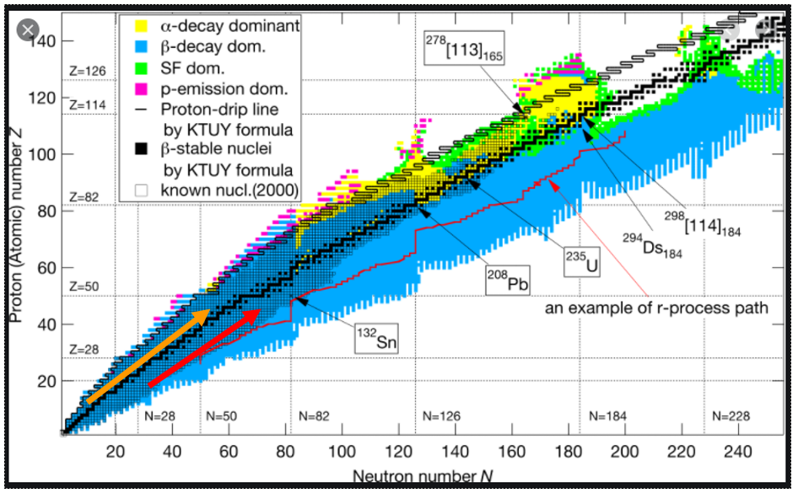
Introduction
Area of interest : N=Z or N > Z nuclei
For N=Z nuclei, np pairing is more dominant than the like-pairing(nn- & pp-pairing).
Unstable nuclides(6000-8000) can be deformed.
Notes:
Stable nuclides : 270
In this situation, deformation is more important.

Slide 4
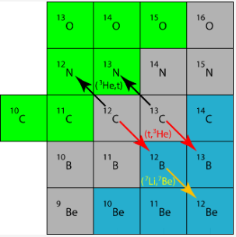
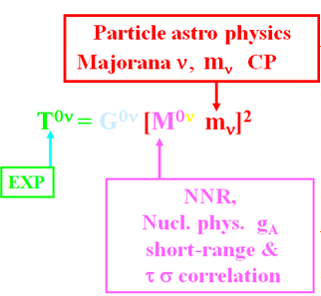
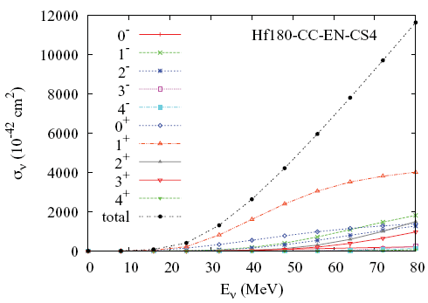
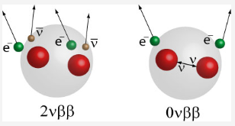
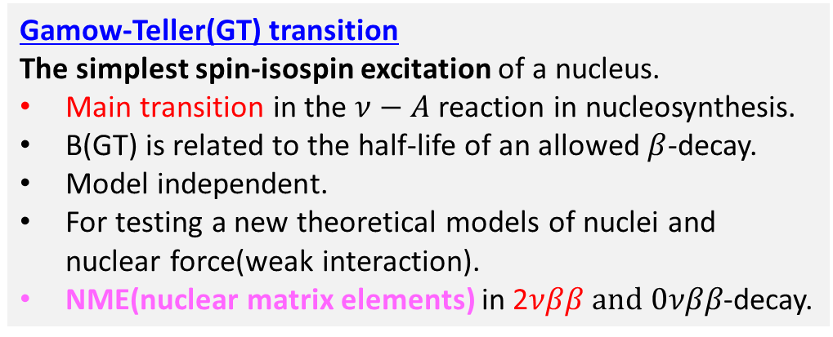
Why Gamow-Teller transition?
CE(charge-exchange) reaction is very useful to study the spin-isospin excitations of nuclei.
Gamow-Teller(GT) transition
The simplest spin-isospin excitation of a nucleus.
Main transition in the $ν−A$ reaction in nucleosynthesis.
B(GT) is related to the half-life of an allowed $β$-decay.
Model independent.
For testing a new theoretical models of nuclei and nuclear force(weak interaction).
NME(nuclear matrix elements) in 2𝜈𝛽𝛽$and 0νββ$-decay.
But we do not have enough data for GT transition to confirm the theoretical estimation.
CHEOUN,HA,..PRC 82(2010)
Notes:
Hf : hafnium
Zero neutrino DBD : Majorana particle(마요라나)
In 0vbb-decay, v is majorana particle, determine v mass Exp. 150Nd
G is the kinematic phase factor. M is NME for Fermi and GT

Slide 5
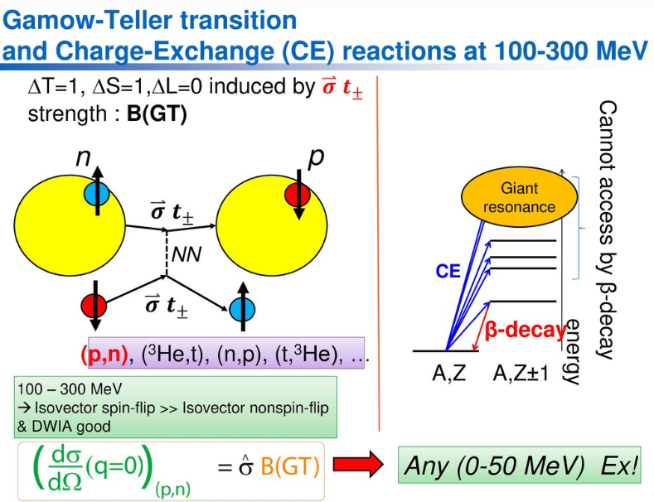
(p,n) reaction is an inverse kinematics.
From M. Sasano’s talk
Notes:
(p,n) reaction in inverse kinematics. Tritium=3H we can measure up to 50MeV. We can measure below blue line.
Q=0이어야 하는 이유?
Delta_l=0 이므로 parity is conserved
Beta-decay는 q=0 due to decay
Cross section 에서 delta_l=0 데이터가 forward 쪽에 있다.

Slide 6
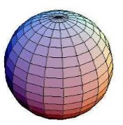

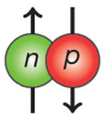
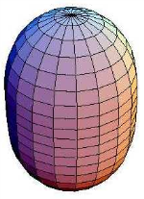
Formalism
SPS(single particle state).
WS(Woods-Saxon),SHF(Skyrme-Hartree-Fock)
BCS(Bardeen Cooper Schrieffer)
QRPA(Quasiparticle Random Phase Approximation)
SPS(WS)
BCS
(nn+pp)
pn-QRPA
SPS(WS)
BCS
(nn+pp+np)
QRPA
more elaborated
DSPS(DWS)
DBCS
(nn+pp)
pn-DQRPA
HFB
DSPS(DWS)
(SHF)
DBCS
(nn+pp+pn+np)
DQRPA
replacing WS with SHF
G-matrix for residual interactions
(Bonn potential)
parameter free !!!
Notes:
The lower part is more elaborated.

Slide 7
Results
N=Z nuclei
²⁴Mg, ²⁸Si, and ³²S
np pairing is more dominant than the nn- & pp-pairing.

Slide 8
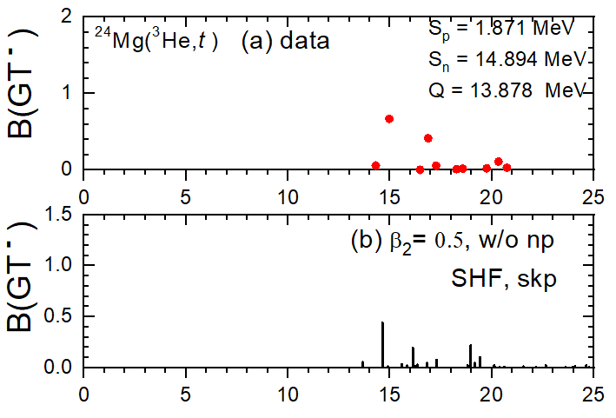
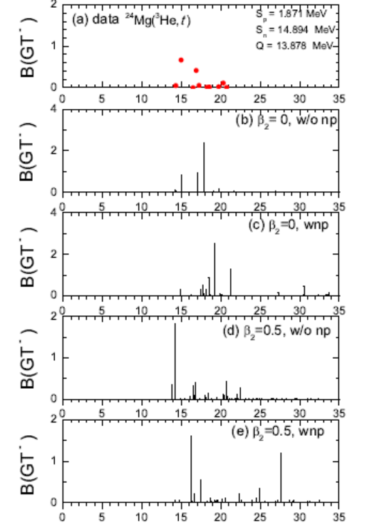



GT strength,B(GT), for ²⁴Mg
Ha et al. EPJA 53(2017)
Exp. data PRC 78, 014314(2008)
$B(GT)$ : GT strength
$β_{2}=0.605$ from B(E2)
preliminary
GT peaks are fragmented due to the deformation compared to the spherical case.
It comes from the modified smearing
of the Fermi surface due to deformation
effect.
The np pairing shifts low-lying GT excitation to a bit higher energy region and predicts some high-lying GT states around 27MeV.
The deformation effect is much more important than the np-pairing correlations.
Notes:
But there is no experimental data of this high-lying excited state yet.
Our calculation shows that ISR is not satisfied. We need more research.

Slide 9
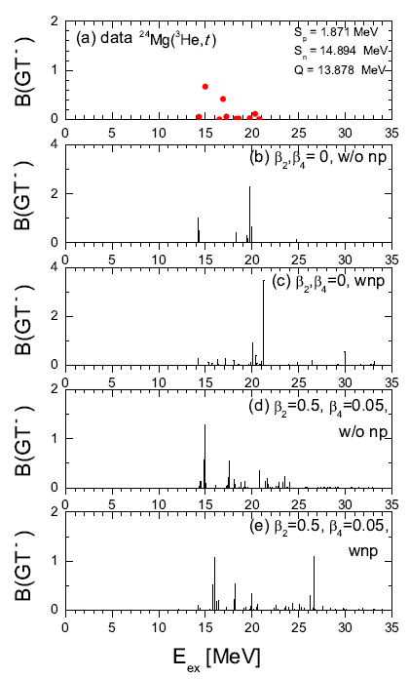
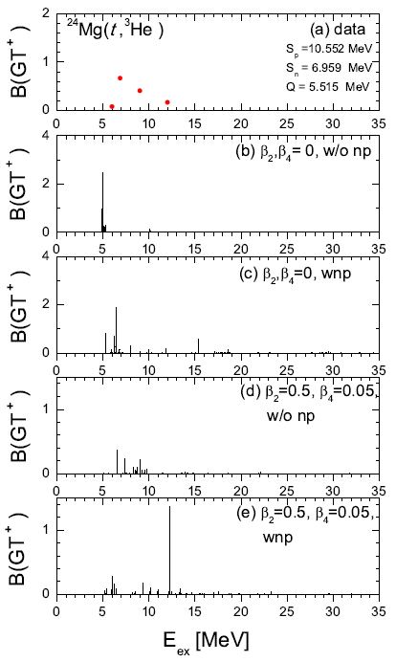

GT strength for ²⁴Mg
$β_{4}$ effect is almost negligible.
Exp. data PRC 78, 014314(2008)
Exp. data PRC 78, 047302(2008)

Slide 10
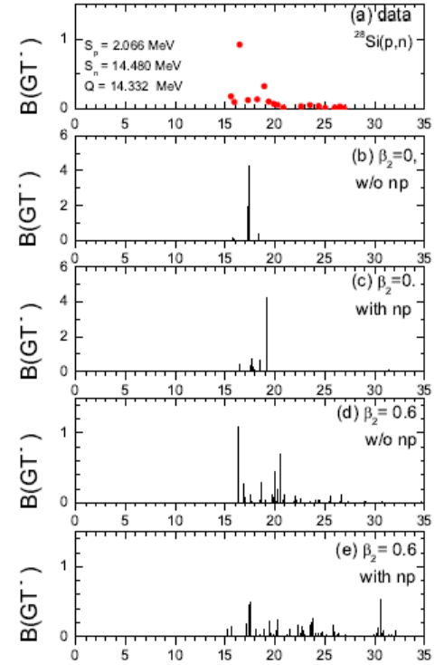

GT strength for ²⁸Si
Exp. data PRC 43, 50(1991)
$β_{2}=0.407$ from B(E2)
The open shell structure leads to a mixture of attractive particle-particle interaction and repulsive particle−hole interaction.
GT peaks are fragmented due to the deformation compared to the spherical case.
If we consider np-pairing there appears the high excited GT peak around 31MeV.
Notes:
This tendency shows in open shell nuclei.
The tendency is similar to the previous one.

Slide 11
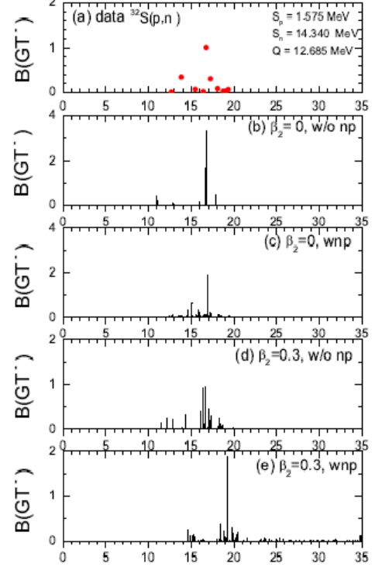

GT strength for ³² S
Exp. data PRC 43, 50(1991)
$β_{2}=0.312$ from B(E2)
Deformation effects scatter reasonably a peak strength to lower and higher excitations.
np- pairing shifts low-lying GT excitation to a bit higher energy region and predicts some high-lying GT states. But the high-lying GT excitations are very weak compared to those for ²⁴Mg and ²⁸Si.

Slide 12
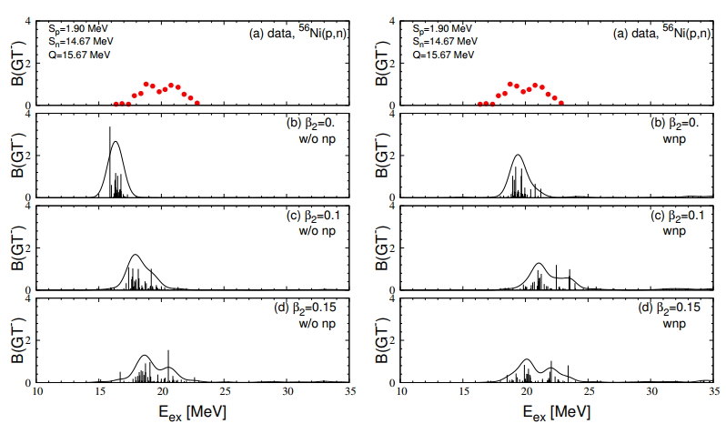
Gamow-Teller strength for ⁵⁶Ni
Ha et al. JPG 46(2019)
In particular, ⁵⁶Ni is thought to be almost spherical because of its double magic numbers.
If we take α-cluster model for ⁵⁶Ni, the ground state may be slightly deformed. PRC 84, 024302(2011)
The np pairing effects can properly explain the GT strength although the deformation is also another important property.
Notes:
So we consider a slight deformation for 56Ni.

Slide 13
N=Z+2 nuclei
¹⁸O, ²⁶Mg, and ⁴²Ca
particle-particle(p-p) interaction is important for N=Z+2 nuclei.

Slide 14
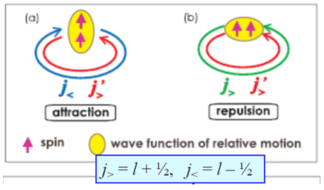


















Role of Tensor force(TF) in GT(-)
p-p representation
$$f_{5/2},f_{5/2}:repulsive$$
$$f_{5/2},f_{7/2}:attractive$$
$$×$$
$$f_{5/2}$$
$$p_{3/2}$$
$$28$$
$$f_{7/2}$$
$${7/2}^{−}$$
$${5/2}^{−}$$
$$×$$
$$×$$
$$×$$
$${3/2}^{−}$$
$$20$$
$${ 1/2}^{−}$$
$$π$$
$$ν$$
$${{}_{20}^{42}{Ca}}_{22}→{{}_{21}^{42}{Sc}}_{21}$$
particle-particle interaction is important for N=Z+2 nuclei.
Notes:
One neutron moves to here.

Slide 15
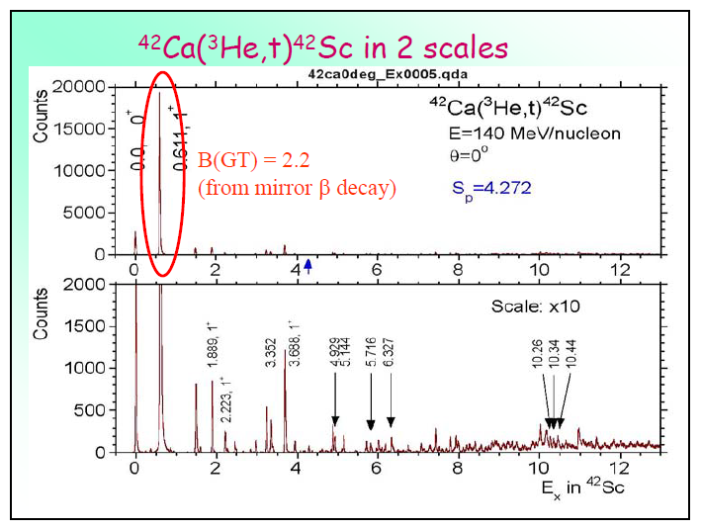
LeSGT in N=Z+2 nuclei
LeSGT(low energy super GT)
GTGR(Gamow-Teller Giant Resonance)
LeSGT : 80% of the total B(GT) strength is concentrated
in the excitation of the 0.611MeV state.
GTGR
From Y. Fujita’s talk
Notes:
Normal nuclei have a bump structure. In contrast

Slide 16
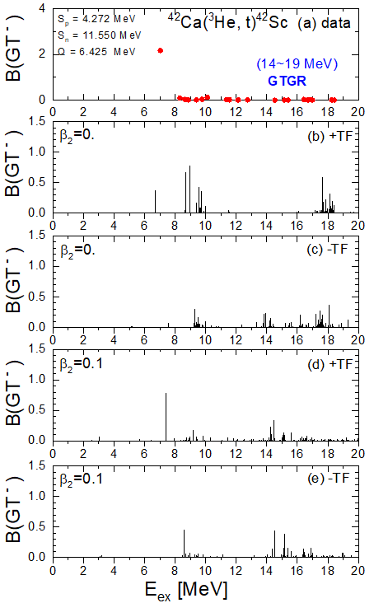

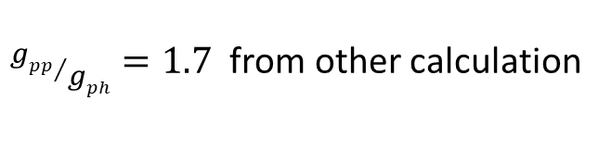
Role of TF in GT states for ⁴²Ca
Ha et al. PTEP 043D01(2022)
LeSGT
N=Z+2 nucleus is important for p-p interaction.
${gpp}/{gph}=1.7$ from other calculation
$gpp$($gph$):strength of particle-particle(particle-hole)
TF has non-central property.
TF can be also associated with nuclear deformation.
$β_{2}=0.245$ from B(E2)
The attractive TF plays a crucial role in shifting the main GT peak to the LeSGT.
The effect of TF decreases with the nuclear deformation.
Notes:
We choose this value. This is the ratio between A and B.
The length of the arrow is the effect of the tensor force

Slide 17
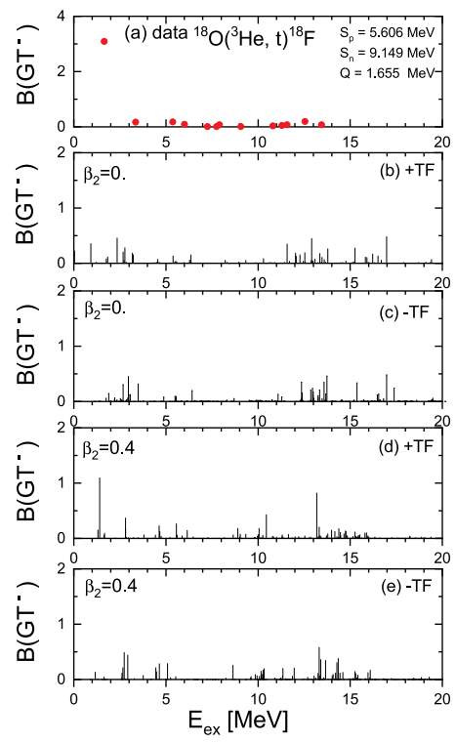

Role of TF in GT states for ¹⁸O
$β_{2}=0.355$ from B(E2)
The attractive TF plays a crucial role in shifting the main GT peak to the low excitation-energy region leading to the LeSGT.

Slide 18
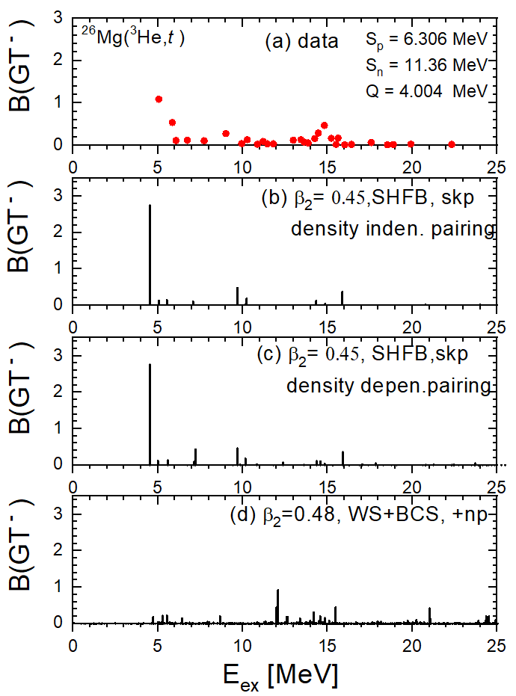
B(GT) for ²⁶Mg
I've been replacing WS with SHF lately.
HFB(Hartree-Fock-Bogolyubov)
preliminary
consider only like-pairing in SHF yet.
We can not reproduce the first peak in WS.
Ha et al. PRC 94(2016)

Slide 19
Doubly magic nuclei
⁴⁸Ca, ⁷⁸Ni, and ²⁰⁸Pb
particle-hole(p-h) interaction is important for doubly magic nuclei.

Slide 20
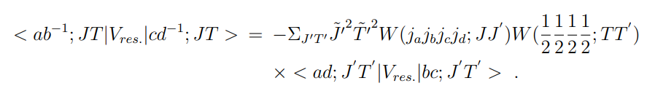
























Role of Tensor force(TF) in GT(-)
p-p representation p-h representation
$$f_{5/2},f_{5/2}:repulsive$$
$$f_{5/2},f_{5/2}:attractive$$
$$f_{5/2},f_{7/2}:attractive$$
$$f_{5/2},f_{7/2}:repulsive$$
Pandya transformation
$$×$$
$$f_{5/2}$$
$$p_{3/2}$$
$$28$$
$$f_{7/2}$$
$$×$$
$$×$$
$${7/2}^{−}$$
These states are degenerated in f_{7/2}
$$×$$
$$×$$
$${5/2}^{−}$$
$$×$$
$$×$$
$$×$$
$${3/2}^{−}$$
$$20$$
$$×$$
$$×$$
$${ 1/2}^{−}$$
$$π$$
$$ν$$
$${{}_{20}^{48}{Ca}}_{28}→{{}_{21}^{48}{Sc}}_{27}$$
p-h interaction is important for doubly magic nuclei
Notes:
One neutron moves to here. The situation is reversed.

Slide 21
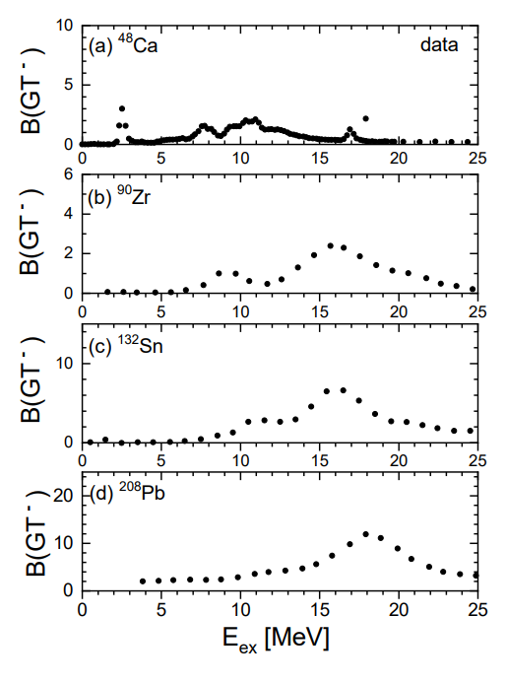
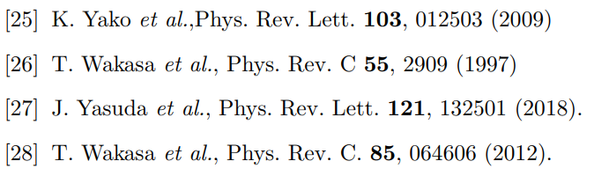
Experimental data
The low energy GT peaks moved to high-lying GT states with the increase of the nuclear mass.
By the competition of the TF effect to the SO force, the low-lying peak appears as a single peak, a left shoulder of the main GT peak and absorbed in the heavy nucleus.

Slide 22
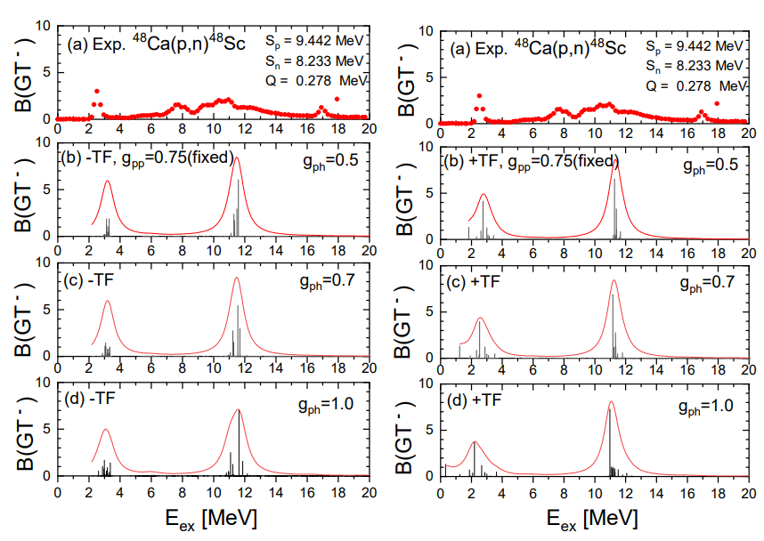
Role of TF in GT states for ⁴⁸Ca
Ha et al. submitted to PLB
As the g_{ph} increases, the low-lying excited GT states are shifted to the lower energy region.

Slide 23
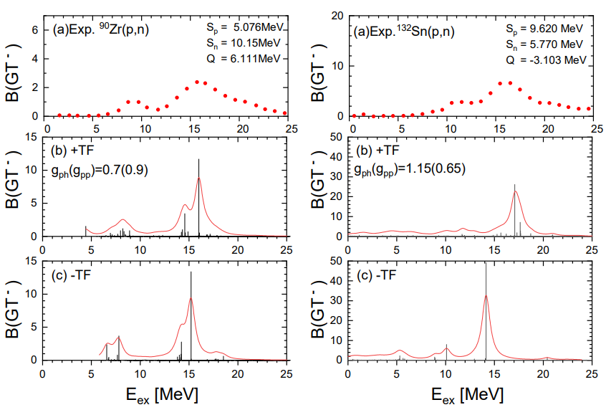
Role of TF in GT states for ⁹⁰Zr and ¹³²Sn
The attractive p−h TF contributes to the low-lying GT excitation, but the repulsive p−h TF contributes to the high-lying GT excitation.
Notes:
Low-lying GT peak moves to the lower side.
High-lying GT peak moves to the higher side.

Slide 24
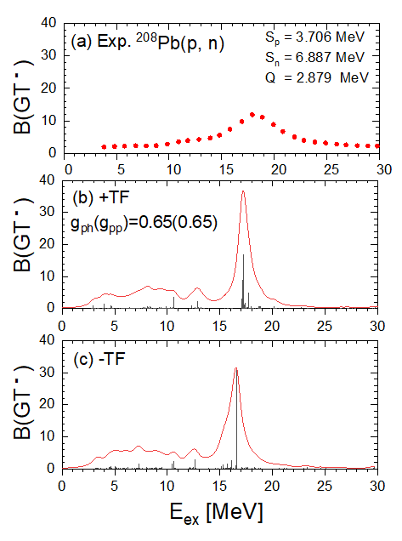
Role of TF in GT states for ²⁰⁸Pb
The left shoulder of the main GT peak is absorbed in ²⁰⁸Pb.
The TF is smaller than the SO force.

Slide 25
Open shell nuclei
^{62,64}Ni, ⁷⁶Ge, and ⁸²Se
Notes:
# of proton for Ge : 32
# of proton for Se : 34
# of proton for Zr : 40

Slide 26
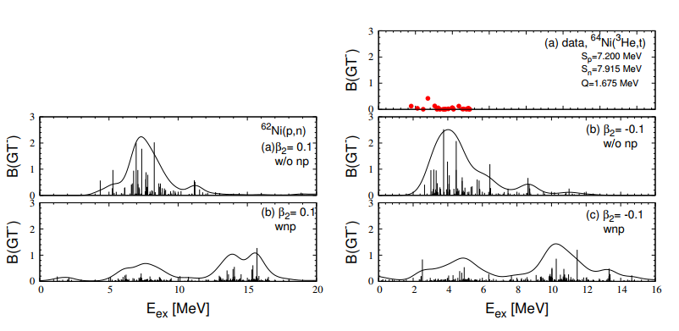
GT strength for ^{62,64}Ni
B(GT) in high-lying region get bigger due to np-pairing effect.

Slide 27
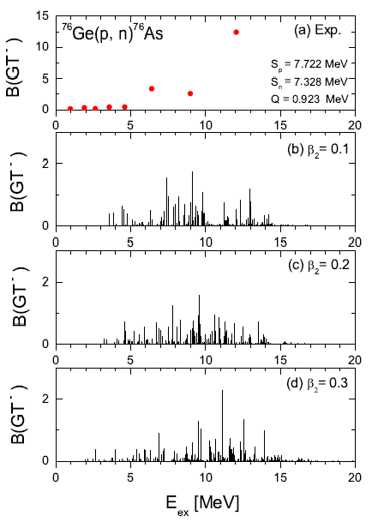
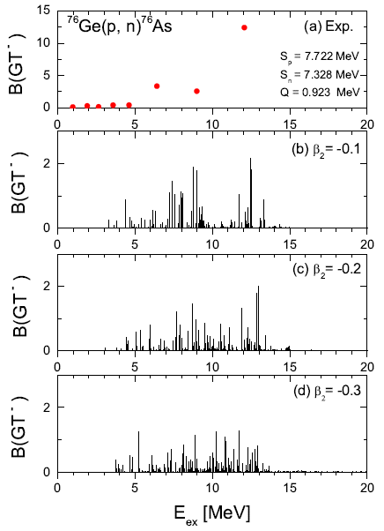

GT(-) strength for ⁷⁶Ge
Ha et al. NPA 934(2015)
consider only deformation.
$β_{2}=0.262$ from B(E2)
⁷⁶Ge is prolate deformed.

Slide 28
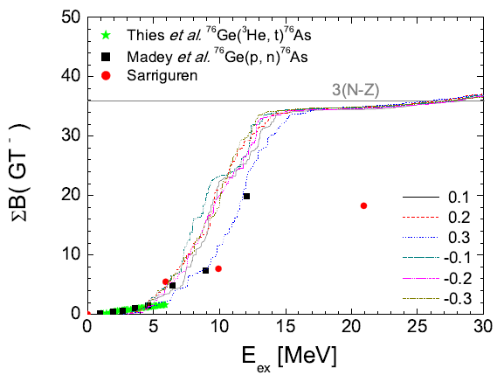
Running sum of GT(-) strength for ⁷⁶Ge
(cal.)
Results by DQRPA reproduce well experimental data without quenching factor.
ISR_{exp} = 55% (up to 12MeV)
There may be a possibility of the high-lying GT state above 12.0 MeV.
ISR_{DQRPA} ≈ 98 %
Notes:
Red one is by other theory group.

Slide 29
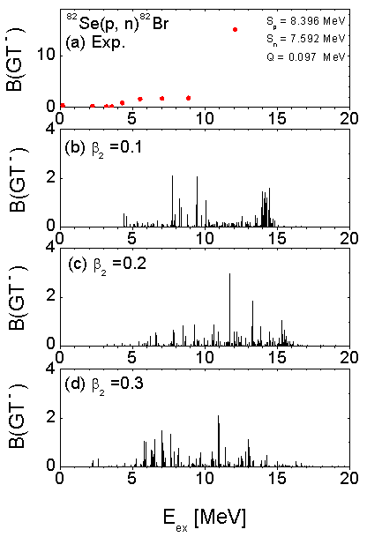
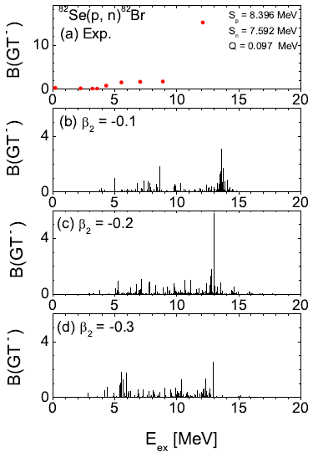

GT(-) strength for ⁸²Se
$β_{2}=0.193$ from B(E2)
⁸²Se is prolate deformed.

Slide 30
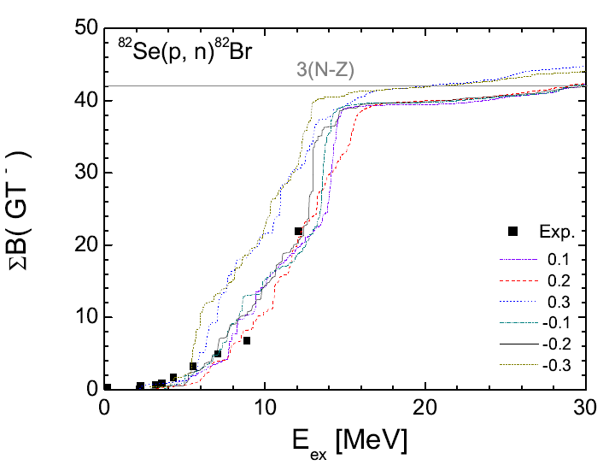
Running sum of GT(-) strength for ⁸²Se
Results by DQRPA reproduce well experimental data without quenching factor.

Slide 31
Summary
Even though ²⁴Mg, ²⁸Si, and ³²S are N=Z nuclei, the deformation effect is more important than the np-pairing correlations.
For N~Z nuclei, the TF properties in the residual interaction can be changed in the case of p-p and p-h by Pandya transformation.
By the attractive TF, there appear Low Energy Super GT (LeSGT) excitations.
But, the LeSGT peaks moved to high-lying GT states with the increase of
the nuclear mass for doubly magic nuclei because of the competition of
TF and Spin-Orbit force.
5. However, we do not have enough data for GT transition to confirm the
theoretical estimation, like pairing interactions as well as tensor force,
and deformation effect inside nuclei. We expect roles of RAON accelerator.
6. We are now calculating GT transitions by using SHF energy density
functionals, which enables us to confirm the effects inside nuclei.
Thank you.

Slide 32
2-2.연구개요
Back Up

Slide 33
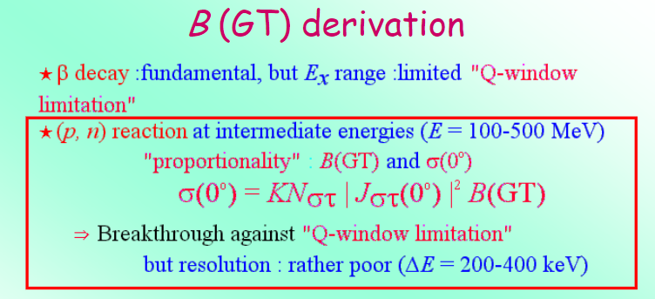
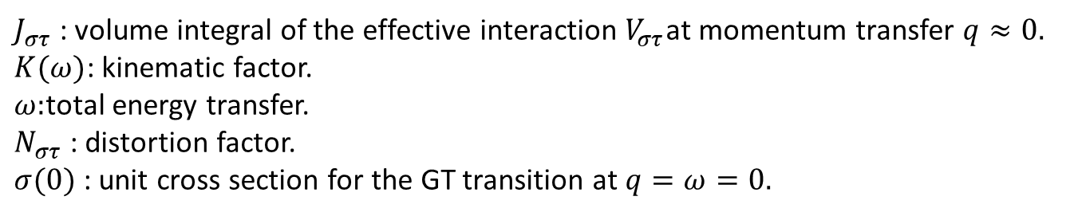
$J_{στ}$ : volume integral of the effective interaction $V_{στ}$at momentum transfer $q≈0.$
$K(ω)$: kinematic factor.
$ω:$total energy transfer.
$N_{στ}$ : distortion factor.
$σ(0)$ : unit cross section for the GT transition at $q=ω=0.$

Slide 34
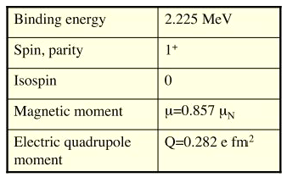
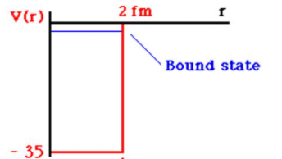
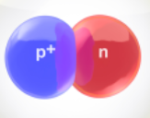
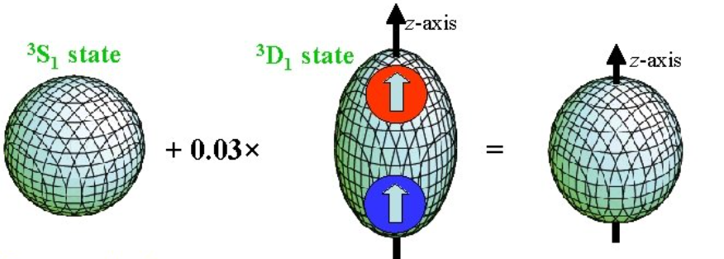

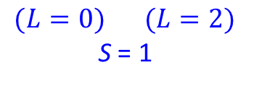
Tensor force(TF) : first evidence from the deuteron
Not spherical
^{2S+1} L _{J}
$$(L=0) (L=2)$$
S = 1
Tensor force(TF) mixes two states.
Deuteron is unbound without TF.
Notes:
There is a TF in the ground state of deuteron.

Slide 35
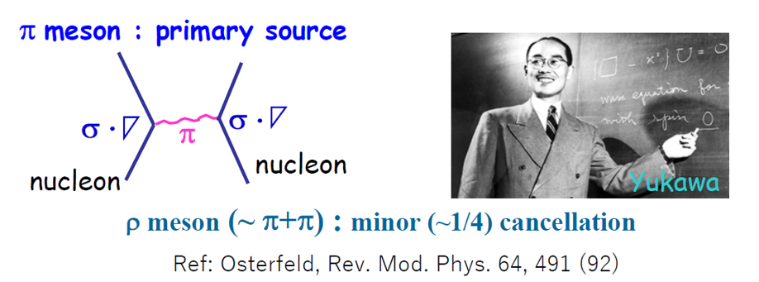
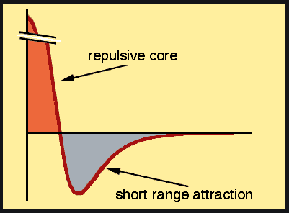

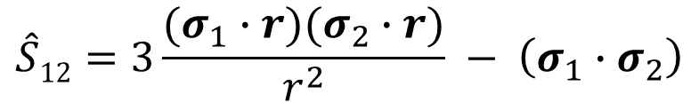

Tensor force (TF)
In OBEP
$$\hat{V}={\hat{V}}_{c}+\hat{V}T$$
Tensor part
$$\hat{V}T=V_{T}\left(r\right)\hat{S}12$$
non-central
$$\hat{S}12=3\frac{(σ_{1}∙r)(σ_{2}∙r)}{r^{2}} − \left(σ_{1}∙σ_{2}\right)$$
Tensor force operator
Origin of TF :
Tensor attraction 80% of entire attraction.
From Otsuka’s talk

Slide 36
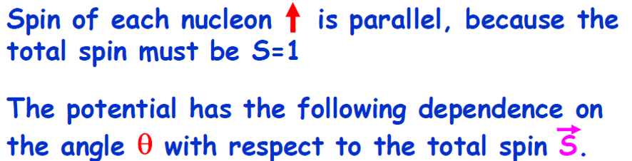
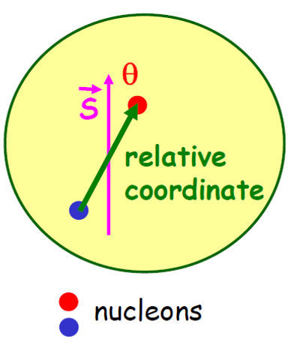

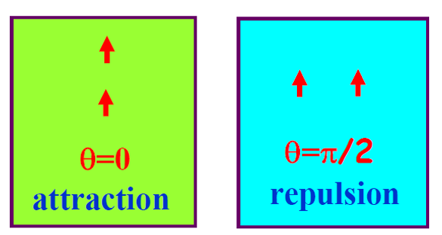

How does the TF work ?
$$\hat{S}12=3\frac{(σ_{1}∙r)(σ_{2}∙r)}{r^{2}} − \left(σ_{1}∙σ_{2}\right)=−2S^{2}\left(1−3cos2θ\right) \sim Y_{2,0}$$
$\hat{S}12=0$ for $S=0,$
Only S=1 contribute to TF.
Tensor force
From Otsuka’s talk
Notes:
Only S=1 contribute to TF.
If two nucleons are located in this way, If two particles are perpendicular(horizontal)

Slide 37
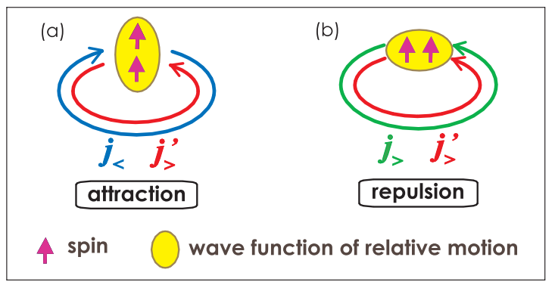





TF acting two nucleons in shell models
$∆p is large→∆r$is small by the principle of uncertainty
$$−l+\frac{1}{2}$$
$$l+\frac{1}{2}$$
$$l+\frac{1}{2}$$
$$l+\frac{1}{2}$$
TO et al., PRL 95, 232502(2005)
Notes:
If two arrows are small magnets,

Slide 38




TF in shell model
D. Steppenbeck et al. Nature 502,207(2013)
New magic number from ⁵⁴Ca (N=34)!
From Otsuka’s talk
As two-proton(hole) are removed(created) the attractive(repulsive) TF becomes weaker(stronger).
$$in p−p representation$$
$$in p−h representation$$
attractive
repulsive
28
ㅊㅍ
ㅊㅍ
The attractive TF in p-p representation corresponds to the repulsive TF in p-h representation.
$$N=34 isotones$$
Notes:
The attractive force becomes weaker than Fe. As you go to the right nucleus, the attractive force becomes more and more weak.
F5/2 orbit pushes outward.

Slide 39


Effect of TF in G-matrix
How do the properties of TF work in the excited state?
E. Ha et al. PRC 104(2021)
(d_{5/2}, d_{5/2})
(d_{3/2}, d_{3/2})
(d_{5/2}, d_{3/2})
The properties of TF are maintained not only in the ground state but also in the excited state.

Slide 40


Slide 41

Low-energy super GT state(LeSGT)
Isoscalar(IS) pairing has spin-triplet(S=1).
TF has also spin-triplet.

Slide 42




Role of TF in GT states
$$√$$
$$attractive TF$$
The nucleons on the fermi surface contribute to make the LeSGT peak.
Notes:
There are many configurations giving the attractive TF.

Slide 43

B(GT) for ²⁰⁸Pb
E. Litvinova, PLB 730(2014) 307-313
* RTBA : relativistic time blocking approximation

Slide 44
G-matrix
Realistic two body interaction inside nuclei was taken by Brueckner
g-matrix, which is a solution of the Bethe-Salpeter Eq., derived from
the Bonn-CD potential for nucleon-nucleon interaction in free space.
a,b,c,d : single particle states from the Woods-Saxon potential.
V_{ab,cd} : phenomenological nucleon-nucleon potential in free space.
Notes:
Residual interaction contains two parts.
A particle-hole force are defined with positive sign, which is repulsive, and particle-particle force is negative sign which is attractive.

Slide 45

Charge exchange(CE) reaction is very useful to study the spin-isospin excitations of nuclei. In particular, Gamow-Teller(GT) transition is the simplest spin-isospin excitation of a nucleus and is a main transition in neutrino-nucleus reaction in nucleosynthesis. The GT strength, B(GT), is related to the half-life of an allowed $beta$-decay.
We investigated the effect of deformation and tensor force on GT transitions in nuclei. However, we do not have enough data for GT transition to confirm the theoretical estimation, like pairing interactions as well as tensor force, and deformation effect inside nuclei. We expect roles of RAON accelerator.

