Slide 1
Hadron transverse momentum distributions in the Tsallis statistics with escort probabilities
Parvan Alexandru
BLTP JINR Dubna Russia
DFT IFIN-HH Bucharest Romania
14th APCTP-BLTP JINR Joint Workshop – Memorial Workshop in Honor of Prof. Yongseok Oh
July 9-14, 2023, POSCO International Center, APCTP, Pohang, Korea

Slide 2
Motivation
Experiment:
RHIC, LHC
FAIR, NICA
Theory:
Approximate Tsallis -distributions:
Exact -distributions of the Tsallis statistics:
Tsallis-like distribution
Phenomenological Tsallis distribution
Tsallis-1 statistics
Tsallis-2 statistics
Tsallis-3 statistics
q-dual statistics
Rules of theory selection:
Experiment
Thermodynamical self-consistency of -distributions
Consistent derivation of -distributions from the first principles of statistical mechanics
Approximate results Exact results

Slide 3
Tsallis statistics with escort probabilities (Tsallis-3 statistics)
Grand Canonical Ensemble
Tsallis entropy:
- Boltzmann-Gibbs
entropy
Norm equation:
C. Tsallis, J. Stat. Phys. 52 (1988) 479;
C. Tsallis et al., Physica A 261 (1998) 534
Mean value of the
quantum operator :
Thermodynamic
potential:
- Legendre transform
A.S.P., arXiv:2306.01003 [hep-ph]
Mean energy and mean
number of particles:

Slide 4
Tsallis statistics with escort probabilities (Tsallis-3 statistics)
Grand Canonical Ensemble
The probability is determined from the principle of
thermodynamic equilibrium:
Probability:
A.S.P., arXiv:2306.01003 [hep-ph]
- two norm functions
Two norm equations:
Mean value of the
quantum operator:

Slide 5
Different variants of nonextensive statistics in grand canonical ensemble
Tsallis entropy
q-dual entropy
Tsallis-1 statistics
Tsallis-2 statistics
q-dual statistics
C. Tsallis, J. Stat. Phys. 52 (1988) 479; C. Tsallis et al., Physica A 261 (1998) 534;
A.S.P., Eur. Phys. J. A 51 (2015) 108; A.S.P., Eur. Phys. J. A 53 (2017) 53
A.S.P., Eur. Phys. J. A 56 (2020) 4, 106
The Tsallis-2 statistics is inconsistent since the mean value of unity is not equal to unity .
The Tsallis-1 statistics and q-dual statistics are correctly defined and consistent.

Slide 6
Tsallis-3 statistics in the grand canonical ensemble: General formalism
Statistical averages of the operators:
A.S.P., arXiv:2306.01003 [hep-ph]
Series expansion:
Boltzmann-Gibbs
quantities:
Norm functions Λ, θ :

Slide 7
- distribution in Tsallis-3 statistics: Relativistic ideal gas
Relativistic transverse momentum distribution in grand canonical ensemble ( -B-E statistics, -F-D statistics, - M-B statistics)
Norm functions Λ, θ :
A.S.P., arXiv:2306.01003 [hep-ph]

Slide 8
- distribution in Tsallis-3 statistics: Maxwell-Boltzmann statistics of particles
Relativistic transverse momentum distribution in grand canonical ensemble for Maxwell-Boltzmann statistics of particles:
A.S.P., arXiv:2306.01003 [hep-ph]
Norm functions Λ, θ :

Slide 9
Ultrarelativistic - distribution in Tsallis-3 statistics: Maxwell-Boltzmann statistics
Ultrarelativistic -distribution in grand canonical ensemble for Maxwell-Boltzmann statistics of particles:
Norm functions Λ, θ :
A.S.P., arXiv:2306.01003 [hep-ph]

Slide 10
- distribution in Tsallis-3 statistics: Zeroth term approximation
Relativistic -distribution in zeroth term approximation ( -B-E statistics, -F-D statistics, - M-B statistics)
-quantum
A.S.P., arXiv:2306.01003 [hep-ph]
Entropy in the zeroth term approximation is zero for
all values of temperature and chemical potential
Relativistic -distribution in zeroth term approximation for Maxwell-Boltzmann statistics of particles:
Tsallis-2
Tsallis-3
q-dual statistics
-classical
-distribution of the Tsallis-3 statistics in the zeroth term approximation for Maxwell-Boltzmann statistics of particles exactly coincides with the approximate phenomenological Tsallis distribution defined in [J. Cleymans, D. Worku, Eur. Phys. J. A 48 (2012) 160].
In the Tsallis-3 statistics, the approximate phenomenological Tsallis distribution for the Maxwell-Boltzmann statistics of particles is inconsistent as it corresponds to the unphysical condition of zero entropy of system.
In the Tsallis-2 statistics, the approximate phenomenological Tsallis distribution for the Maxwell-Boltzmann statistics of particles is inconsistent as the Tsallis-2 statistics is incorrectly defined: .
The approximate phenomenological Tsallis distribution for the Maxwell-Boltzmann statistics of particles is consistent in q-dual statistics as the q-dual statistics is correctly defined: .
Zeroth term approximation for Tsallis statistics was introduced in:
A.S.P., Eur. Phys. J. A 53 (2017) 53; A.S.P., Eur. Phys. J. A 52 (2016) 355

Slide 11
Tsallis-3 statistics: Quantum spectra in factorization approximation of the zeroth term approximation
Let us consider the factorization approximation, which implies the following mathematically unsanctioned replacement:
H. Hasegawa, Phys. Rev. E 80, 011126 (2009)
Relativistic -distribution in the factorization approximation of the zeroth term approximation ( -B-E statistics, -F-D statistics) for Tsallis-3 statistics
A.S.P., arXiv:2306.01003 [hep-ph]
Tsallis-2
Tsallis-3
q-dual statistics
The form of this quantum distribution is similar to the quantum Tsallis-like distributions used in the high-energy physics.
Thus, the quantum Tsallis-like distributions of this form are mathematically inconsistent because of equation of factorization given above.

Slide 12
Numerical results
Comparison with experimental data

Slide 13
Cut-off of infinite sum of -distribution in the Tsallis-3 statistics
In the series expansion, a few terms are only convergent. The integrals are not convergent due to the divergence of the integrants as .
The single upper cut-off limit of summation:
ν - a fixed parameter
The Maxwell-Boltzmann transverse momentum distribution of the Tsallis-3 statistics for
Norm functions Λ, θ :
A.S.P., arXiv:2306.01003 [hep-ph]

Slide 14
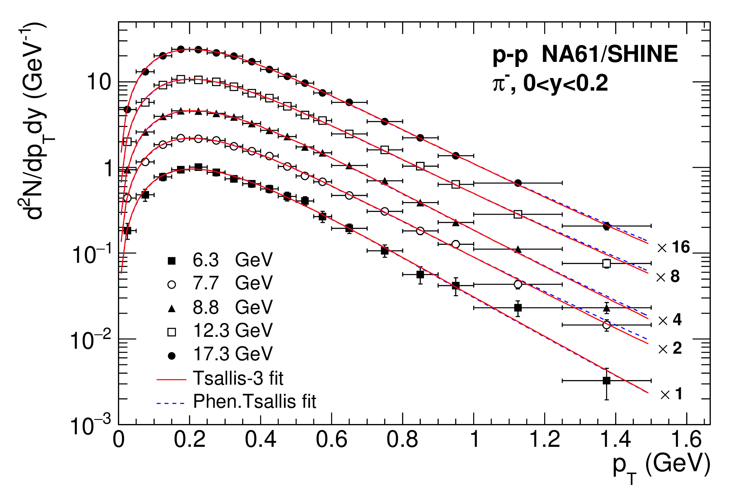
Comparison of exact
-distribution of the Tsallis-3 statistics with experimental data of NA61/SHINE Collaboration
Experimental Data: NA61/SHINE, EPJC 74 (2014) 2794

Slide 15
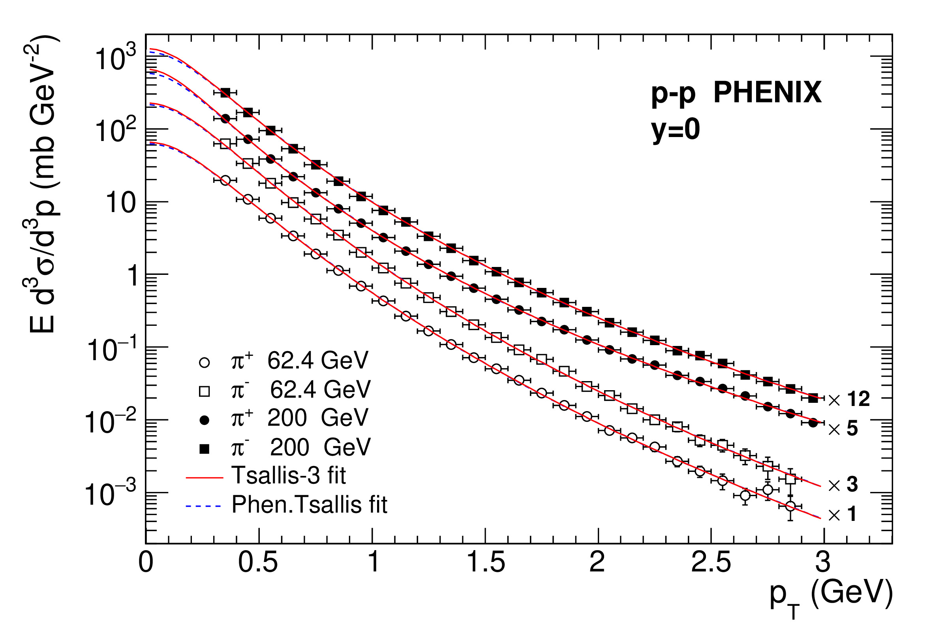
Comparison of exact
-distribution of the Tsallis-3 statistics with experimental data of PHENIX Collaboration
Experimental Data: PHENIX, PRC 83 (2011) 064903

Slide 16
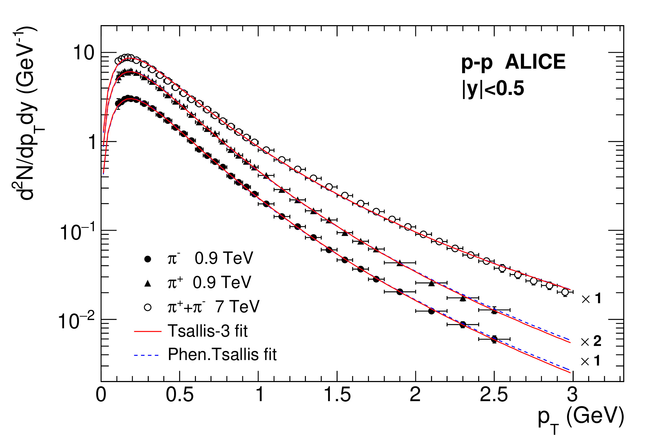
Comparison of exact
-distribution of the Tsallis-3 statistics with experimental data of ALICE Collaboration
Experimental Data: ALICE, EPJC 71 (2011) 1655; ALICE, EPJC 75 (2015) 226

Slide 17
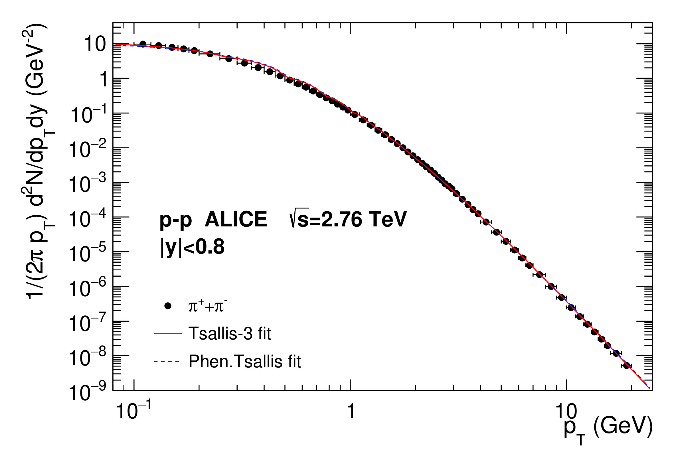
Comparison of exact
-distribution of the Tsallis-3 statistics with experimental data of ALICE Collaboration
Experimental Data: ALICE, PLB 736 (2014) 196

Slide 18
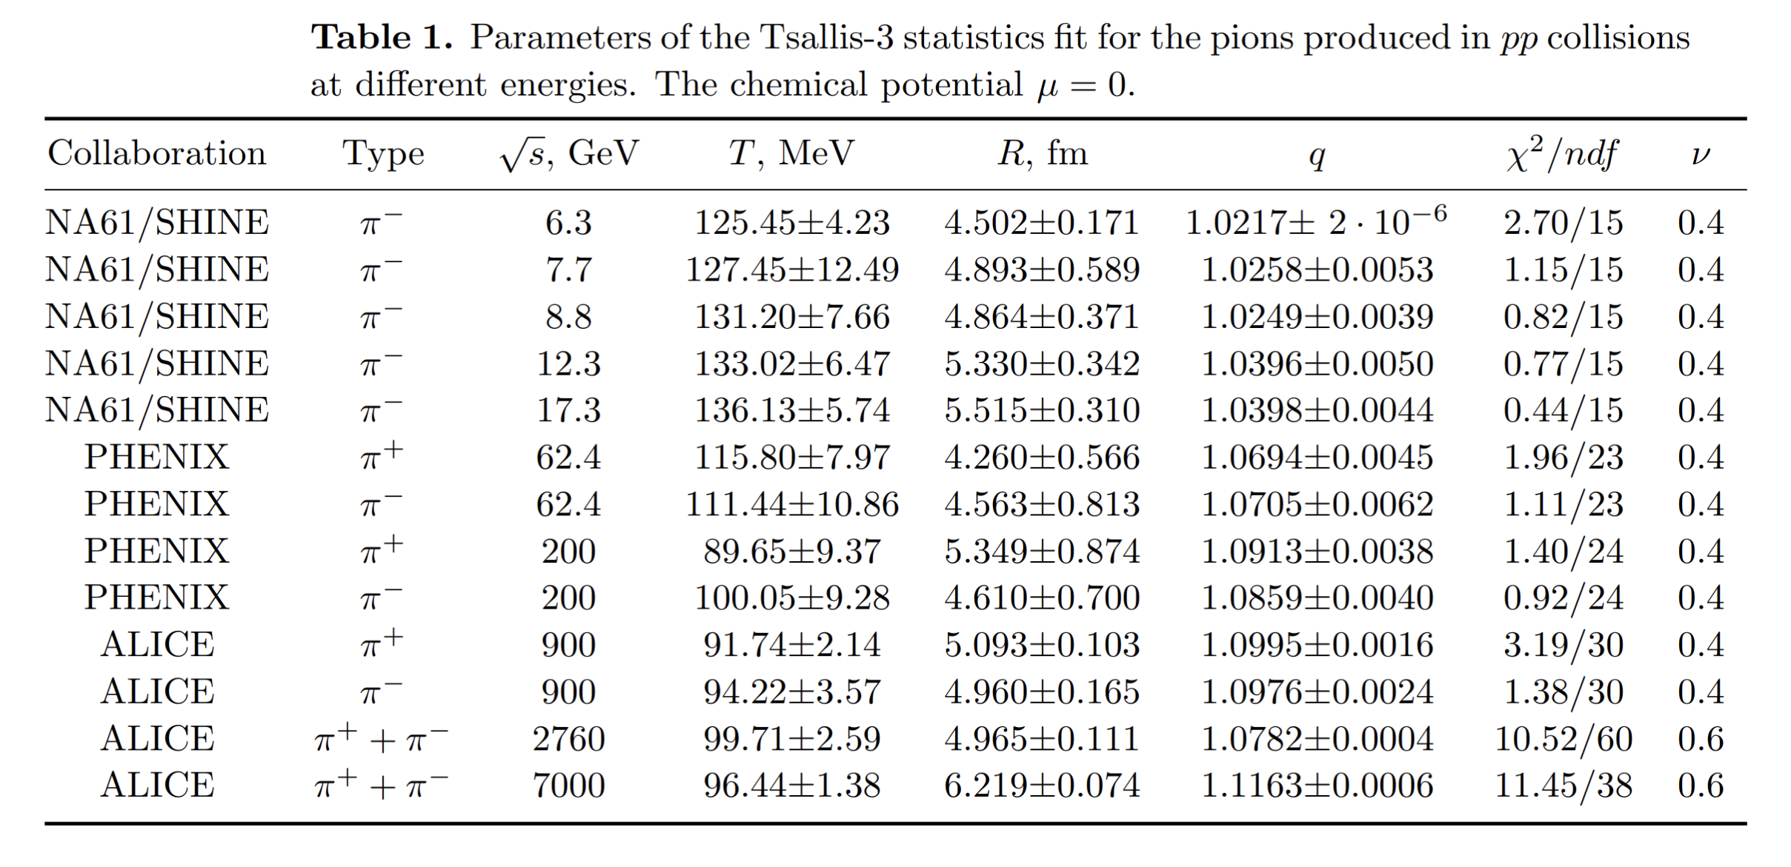
The exact -distribution of the Tsallis-3 statistics

Slide 19
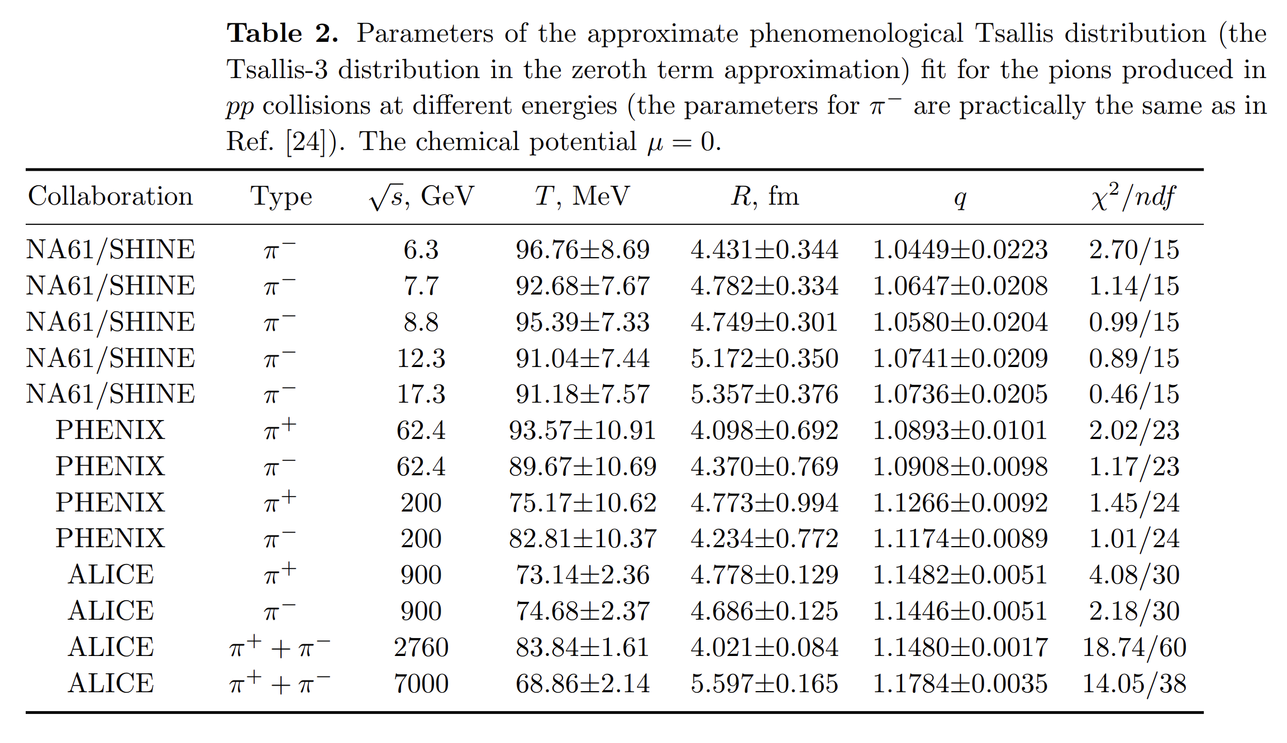
The approximate phenomenological Tsallis distribution

Slide 20
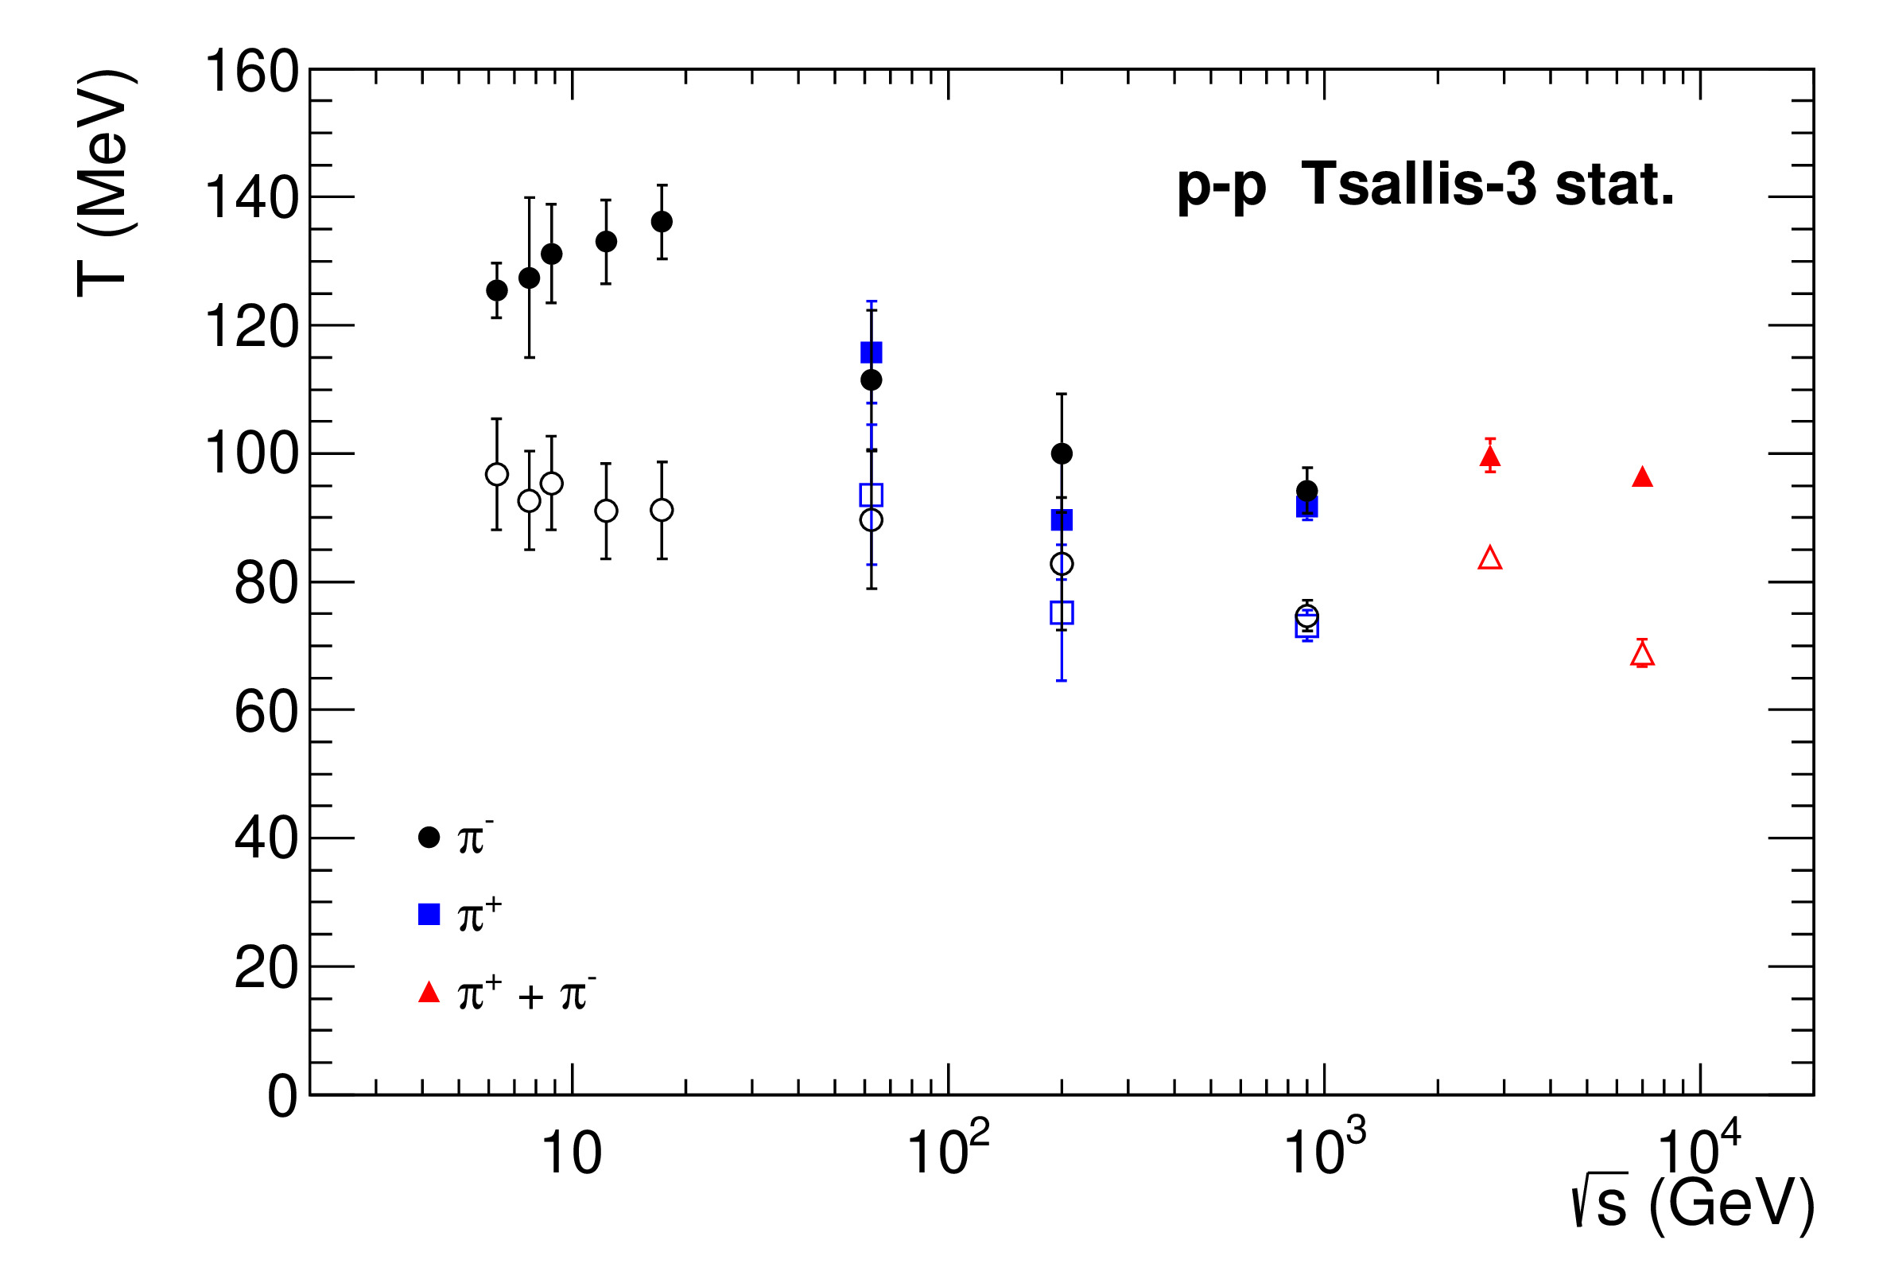
Temperature T of the Tsallis-3 statistics and the approximate phenomenological Tsallis distribution
Solid symbols – the exact Tsallis-3 statistics distribution
Open symbols – the approximate phenomenological Tsallis distribution

Slide 21
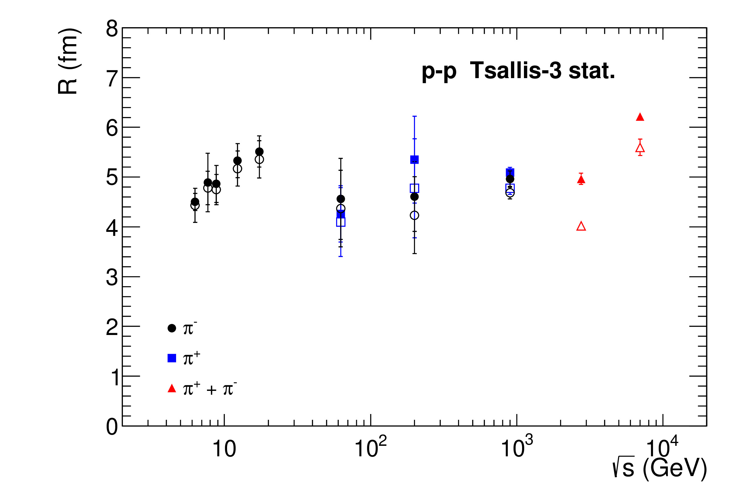
Radius R of system for the Tsallis-3 statistics and the approximate phenomenological Tsallis distribution
Solid symbols – the exact Tsallis-3 statistics distribution
Open symbols – the approximate phenomenological Tsallis distribution

Slide 22
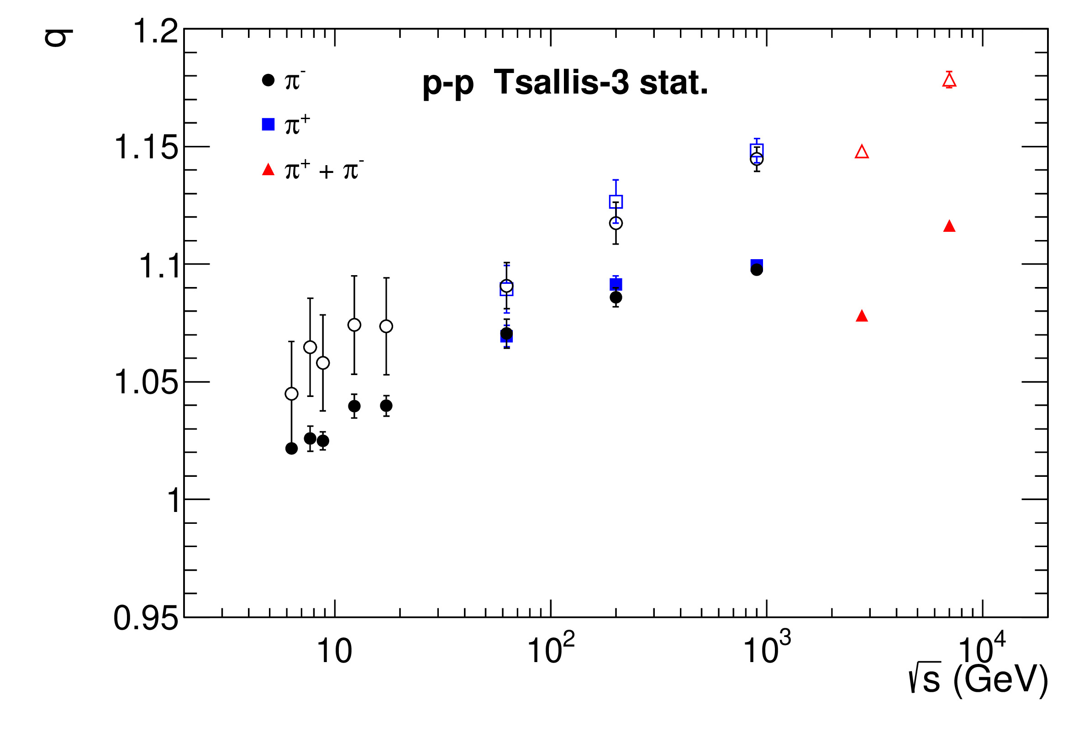
Parameter q for the Tsallis-3 statistics and the approximate phenomenological Tsallis distribution
Solid symbols – the exact Tsallis-3 statistics distribution
Open symbols – the approximate phenomenological Tsallis distribution

Slide 23
Conclusions
The exact transverse momentum distributions for the Tsallis-3 statistics in the grand canonical ensemble for the Fermi-Dirac, Bose-Einstein and Maxwell-Boltzmann statistics of particles have been found.
The exact Tsallis-3 classical -distribution and the classical approximate phenomenological Tsallis distribution have been applied to describe the experimental spectra of the charged pions produced in the collisions at LHC and RHIC energies.
We have revealed that the well-known classical approximate phenomenological Tsallis distribution in the framework of the Tsallis-3 statistics corresponds to the zeroth term approximation and to the unphysical condition of zero entropy of the system in the whole range of state variables. Moreover, we have found that it approximates the exact Tsallis-3 classical distribution unsatisfactory in the whole energy range of collision.
We have found that the quantum approximate phenomenological Tsallis distribution and the quantum Tsallis-like distribution used in high-energy physics are similar to the quantum transverse momentum distribution obtained in the Tsallis-3 statistics by introducing a mathematically inconsistent factorization approximation in the zeroth term approximation.
We have revealed that the transverse momentum distributions in the zeroth term approximation and in the factorization approximation of the zeroth term approximation are the same in the Tsallis-3, Tsallis-2 and q-dual statistics.

Slide 24
Thank you for your attention!

